Slide 1


ANATOMY OF COCKROACH
DIGESTION IN COCKROACH,CIRCULATION IN COCKROACH
SUBJECT : BIOLOGY
CHAPTER NUMBER: 07
CHAPTER NAME : STRUCTURAL ORGANISATION IN ANIMALS

Slide 2
DIGESTION IN COCKROACH
The alimentary canal present in the body cavity is divided into three regions:
1. Foregut
2. Midgut
3.Hind-gut.

Slide 3
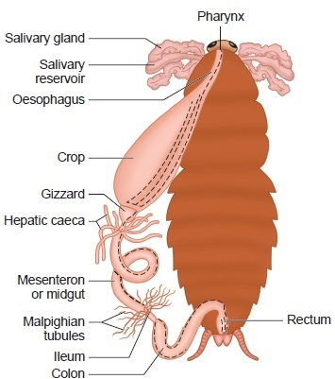
DIGESTION IN COCKROACH

Slide 4
DIGESTION IN COCKROACH
The mouth opens into a short tubular pharynx, leading to a narrow tubular passage called oesophagus.
This in turn opens into a sac like structure called crop used for storing of food.
The crop is followed by gizzard or proventriculus.
It has an outer layer of thick circular muscles and thick inner cuticle forming six highly chitinous plate called teeth. Gizzard helps in grinding the food particles.

Slide 5
DIGESTIVE SYSTEM IN COCKROACH

Slide 6
DIGESTION IN COCKROACH
The entire foregut is lined by cuticle.
A ring of 6-8 blind tubules called hepatic or gastric caeca is present at the junction of foregut and midgut, which secrete digestive juice.
At the junction of midgut and hindgut is present another ring of 100-150 yellow coloured thin filamentous Malpighian tubules.
They help in removal of excretory products from haemolymph.
The hindgut is broader than midgut and is differentiated into ileum, colon and rectum.
The rectum opens out through anus.

Slide 7
CIRCULATION IN COCKROACH
Blood vascular system of cockroach is of open type.
Blood vessels are poorly developed and open into space (haemocoel).
Visceral organs located in the haemocoel are bathed in blood (haemolymph).
The haemolymph is composed of colourless plasma and haemocytes.
Heart of cockroach consists of elongated muscular tube lying along mid dorsal line of thorax and abdomen.
It is differentiated into funnel shaped chambers with ostia on either side.
Blood from sinuses enter heart through ostia and is pumped anteriorly to sinuses again.

Slide 8
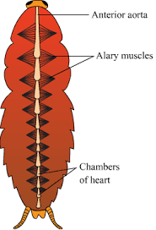
CIRCULATORY SYSTEM IN COCKROACH

Slide 9
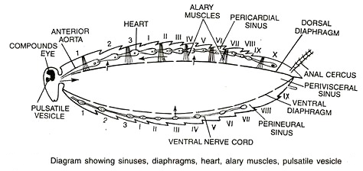
CIRCULATION IN COCKROACH

Slide 10
THANKING YOU
ODM EDUCATIONAL GROUP

