Slide 1


MORPHOLOGY OF FLOWERING PLANTS
FRUIT AND SEED
SUBJECT :BIOLOGY
CHAPTER NUMBER:05
CHAPTER NAME :MORPHOLOGY OF FLOWERING PLANTS

Slide 2
THE FRUIT
STRUCTURE OF A FRUIT
The fruit is a characteristic feature of the flowering plants. It is a mature or ripened ovary, developed after fertilisation.
If a fruit is formed without fertilisation of the ovary, it is called a parthenocarpic fruit. Generally, the fruit consists of a wall or pericarp and seeds. The pericarp may be dry or fleshy.
When pericarp is thick and fleshy, it is differentiated into the outer epicarp, the middle mesocarp and the inner Endocarp.In Mango and Coconut, the fruit is known as a drupe .
They develop from monocarpellary superior ovaries and are one seeded. In Mango the pericarp is well differentiated into an outer thin epicarp, a middle fleshy edible mesocarp and an inner stony hard endocarp. In Coconut which is also a drupe, the mesocarp is fibrous.

Slide 3
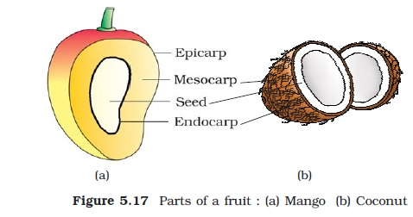
STRUCTURE OF A FRUIT

Slide 4
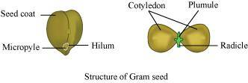
STRUCTURE OF SEED
The outermost covering of a seed is the seed coat.
The seed coat has two layers, the outer testa and the inner tegmen.
The hilum is a scar on the seed coat through which the developing seeds were attached to the fruit.
Above the hilum is a small pore called the micropyle.
Within the seed coat is the embryo, consisting of an embryonal axis
and two cotyledons.
The cotyledons are often fleshy and full of reserve food materials.

Slide 5
At the two ends of the embryonal axis are present the radicle and the plumule.
In some seeds such as castor the endosperm formed as a result of double fertilisation, is a food storing tissue and called endospermic seeds.
In plants such as bean, gram and pea, the endosperm is not present in mature seeds and such seeds are called non endospermIc.

Slide 6
STRUCTURE OF A DICOT SEED
The ovules after fertilisation, develop into seeds.
A seed is made up of a seed coat and an embryo.
The embryo is made up of a radicle, an embryonal axis and one (as in wheat, maize) or two cotyledons (as in gram and pea).

Slide 7
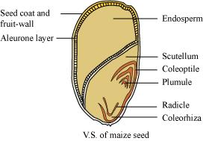
STRUCTURE OF A MONOCOT SEED
Generally, monocotyledonous seeds are endospermic but some as in orchids are non-endospermic.
In the seeds of cereals such as maize the seed coat is membranous and generally fused with the fruit wall. The endosperm is bulky and stores food.
The outer covering of endosperm separates the embryo by a proteinous layer called aleurone layer. The embryo is small and situated in a groove at one end of the endosperm.
It consists of one large and shield shaped cotyledon known as scutellum and a short axis with a plumule and a radicle.
The plumule and radicle are enclosed in sheaths which are called coleoptile and coleorhiza respectively.

Slide 8
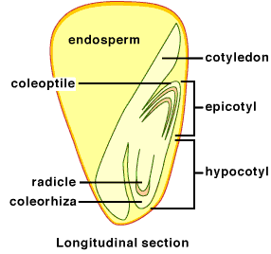
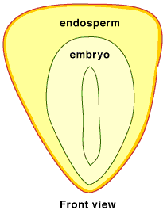
STRUCTURE OF SEED

Slide 9
THANKING YOU
ODM EDUCATIONAL GROUP

