Slide 1


ANIMAL KINGDOM
HEMICHORDATA & CHORDATA INTRODUCTION
SUBJECT : BIOLOGY
CHAPTER NUMBER: 4
CHAPTER NAME : ANIMAL KINGDOM

Slide 2
General Characters of Hemichordata:
Greek hemi, meaning “half,” and chorde, meaning “string,”
1. Solitary and colonial, mostly tubicolous , exclusively marine.
2. Body soft, fragile, vermiform and divisible into proboscis, collar and trunk.
3. Body wall with a single-layered epidermis.
4. Coelom present.
5. Buccal diverticulum, earlier considered as notochord, present in the proboscis.
6. Digestive tract complete; in the form of straight or U-shaped tube.
7. Gill-slits, when present, are paired and one to numerous.
8. Circulatory system simple and well developed; closed type; usually with a contractile heart vesicle and two longitudinal vessels, one dorsal and one ventral, interconnected by lateral vessels and sinuses.
9. Excretion by a single glomerulus situated in the proboscis.
10. Nervous system primitive comprising mainly of an intra-epidermal nerve plexus.
11. Reproduction mostly sexual. Sexes separate or united . Gonads one to several pairs.
12. Fertilisation external. Development mostly indirect through a free swimming tornaria larva. Direct development is also found in some forms.

Slide 3
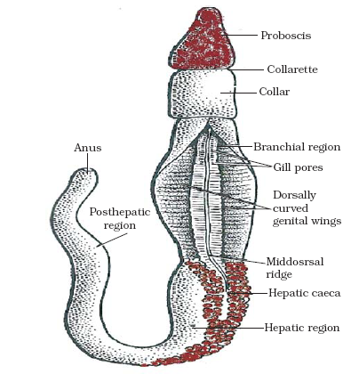
Hemichordata
It is worm like animal.
The body is divisible into three regions:
(i) Proboscis:
It appears as a tongue-like projec­tion, hence the name “tongue worm”,
(ii) Collar:
It is the muscular region which bears mouth ventrally below the proboscis stalk,
(iii) Trunk:
It is divisible into three regions:
(a) The anerior branchiogenital region which has gill pores and gonads. The lateral regions containing the gonads are thin and flat and form genital wings.
(b) The middle hepatic region is marked externally with irregular elevations due to sacculations formed by pro­jecting hepatic caeca of the intestine;
(c) The posterior abdominal region gradually tapers posteriorly and bears a terminal anus.

Slide 4
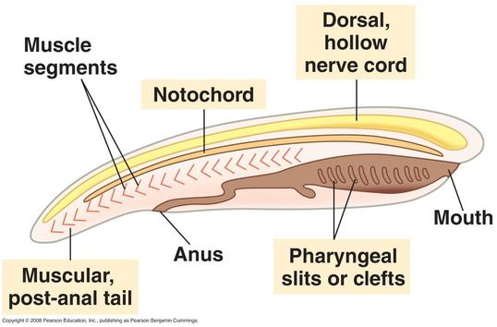
Phylum Chordata
Phylum Chordata belongs to the Kingdom Animalia and includes all the vertebrates, i.e., animals with a backbone, and several invertebrates, i.e., organisms without a backbone. They possess a bilaterally symmetrical body and are divided into three different sub-phyla.

Slide 5
Characteristics Of Phylum Chordata
Phylum Chordata possesses the following characteristic features:
Notochord
It is a longitudinal, cartilaginous rod running between the nerve cord and the digestive tract. It acts as a support for the nerve cord and is replaced by the vertebral column after the embryonic stage in all vertebrates.
Dorsal Nerve Cord
It is a bundle of nerves running along the “back” and splits into the brain and the spinal cord. It is hollow and lies dorsal to the notochord.
Pharyngeal Slits
They are the openings which allow the entry of water through the mouth without entering the digestive system viz. they connect mouth and throat. All Chordates have these openings on the lateral sides of the pharynx at some stage of their life.
Postanal Tail
It is an extension of the body to the anus. In chordates, the tail is composed of skeletal muscles which help in locomotion in fish-like species. It is absent in most of the adult Chordates.
Other characteristics of chordates include:
Bilaterally symmetrical, triploblastic, coelomic and segmented body.
The body design is complex and well-differentiated.
The body has an organ system level of organization.

Slide 6
Classification Of Phylum Chordata
Phylum Chordata is classified into three subphyla, namely
Urochordata (tunicates),
Cephalochordata (lancelets)
Vertebrata (vertebrates).
The subphylum Urochordata and Cephalochordata are collectively known as protochordates, which are marine animals. They are invertebrates but they share attributes of chordates.
Characteristics of Protochordata
They are generally found in marine water.
Their body is bilaterally symmetrical, triploblastic, and coelomated.
At a certain stage of their lives, their body develops a long, rod-like structure for support called the notochord.
They exhibit organ system level of organization.
Eg., Herdmania, Amphioxus.

Slide 7
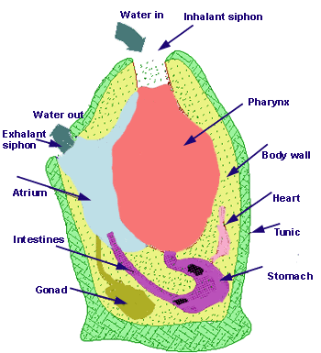
Urochordata or Tunicata
They are found in the marine environment.
They are sessile and filter-feeders.
They are also known as tunicates because their body is surrounded by a leathery sheath composed of tunicin (cellulose).
The notochord appears in the larval stage in the tail of the larva and disappears in the adult. This is known as retrogressive metamorphosis.
The neural tube in the larva is replaced by a dorsal ganglion in the adults.
Respiration occurs through gills.
They have an open circulatory system.
The excretory organs are absent.
They reproduce asexually by budding.
Eg., Herdmania

Slide 8
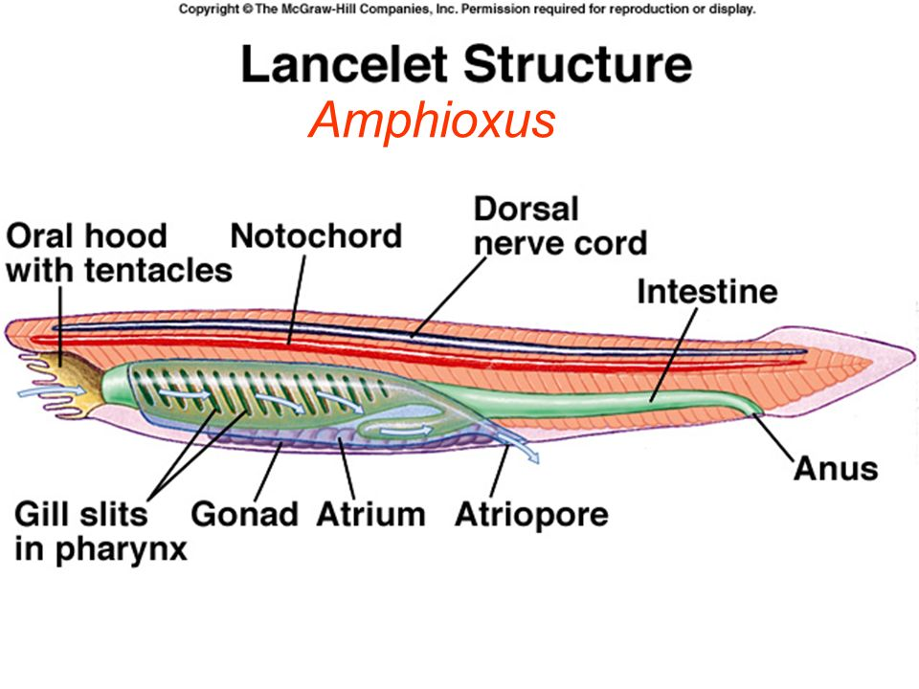
Cephalochordata
They are marine and filter-feeders.
The notochords remain throughout life and extend up to the head region.
The nerve cord and the tail also remain throughout life.
Solenocyts are the excretory organs.
They respire through gills which open in the
atrium.
The body wall comprises of myotomes.
Eg. Amphioxus

Slide 9
Vertebrata
The characteristic features of vertebrates include:
These are advanced chordates and have cranium around the brain.
The notochord is replaced by a vertebral column in adults. This is why it is said that ‘all vertebrates are chordates but all chordates are not vertebrates’.
A high degree of cephalization is observed.
The epidermis is multi-layered.
They consist of three types of muscles-striped, unstriped and cardiac.
They have a well-developed coelom.
The alimentary canal is complete.
The heart is three or four-chambered.
They have well-developed respiratory and excretory systems.
Endocrine glands are present in all.
They are unisexual and reproduce sexually, hagfish being an exception.
For eg., humans.

Slide 10
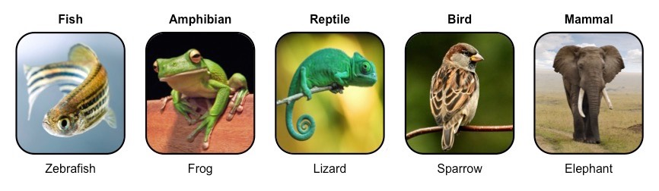
Subphylum Vertebrata is further classified into seven classes
They are:
Cyclostomata
Chondrichthyes
Osteichthyes
Amphibia
Reptilia
Aves
Mammalia

Slide 11
THANKING YOU
ODM EDUCATIONAL GROUP

