Slide 1


BIOLOGICAL CLASSIFICATION
KINGDOM PLANTAE & ANIMALIA
SUBJECT : BIOLOGY
CHAPTER NUMBER:2
CHAPTER NAME : BIOLOGICAL CLASSIFICATION

Slide 2
Classification of Plantae
In Linnaeus time a Two Kingdom system of classification with Plantae and Animalia kingdoms was developed that included all plants and animals respectively.
August Wilhelm Eichler (1883) a botanist, divided plant kingdom into two sub-kingdoms mainly on the basis of presence or absence of seeds.
Cryptogamae (Gr. Cryptos = hidden; gamos = marriage):
Lower plants in which sex organs are hidden and seeds and flowers absent.
It includes Thallophytes, Bryophytes, pteridophytes.
(2) Phanerogamae (Gr. Phaneros = visible; gamos = marriage):
Higher plants in which sex organs are evident; seeds present.
It includes Gymnosperms and Angiosperms.

Slide 3
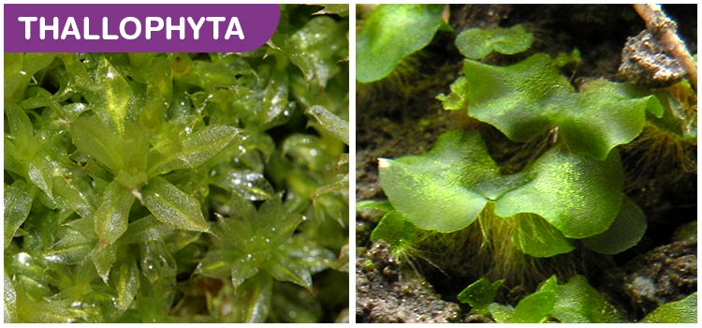
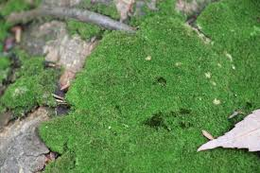
Thallophyta and Bryophytes
Thallophyta
Comprises the simplest plants which possess undifferentiated or thallus like forms.
Reproductive organs single celled no jacketed called gametangia.
Embryo stage, vascular and mechanical tissues are all absent.
Differentiation of true roots, stems and leaves is also absent.
Asexual reproduction by accessory spores is very common. Presently, it includes only Algae.
Bryophytes
These are nonvascular terrestrial plants of moist habitats in which a multicellular diploid sporophyte lives as a parasite on an independent multicellular haploid gametophyte that develops multicellular jacketed sex organs.
Thallophyta
Bryophytes

Slide 4
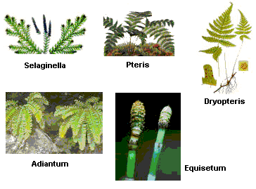
Vascular plants – Tracheophyta
They are those plants which posses conductiong or vascular tissues, xylem and phloem. Xylem transports water and minerals while phloem conducts organic food.
Vascular plants comprise more than 275,000 living species.
They are most visible green plants around us, so much so that the term ‘plants’ generally means vascular plants.
1.Pteridophytes- pteridophyta
Pteridophytes are seedless vascular plants that have sporophytic plant body, inconspicuous gametophytes contining small sessile antheridia and partially embedded archegonia with 4- rowed neck.
Pteridophytes

Slide 5
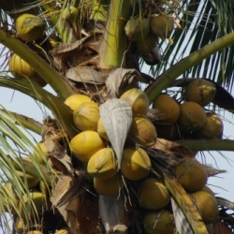
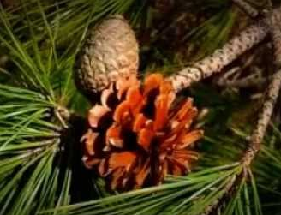
Vascular plants – Tracheophyta
2.Seed plants- spermatophyte
They comprise over 250,000 vascular plants.
After sexual reproduction , the plants produce seeds for dispersal and multiplication . The seeds are dormant and can easily pass through unfavourable conditions.
The plant body belongs to sporophytic generation.
The sporophytic plant body is differentiated into true stem, lves and roots.
Plants show heterospory or two types of meiospores, microspores and megaspores.
The two major types of seed plants are the gymnosperms (seeds in cones) and angiosperms (seeds in ovaries of flowers).
.

Slide 6
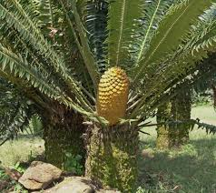

Gymnosperm and Angiosperm
Gymnosperms
Gymnosperms are those seed plants in which the seeds remain exposed over the surface of the megasporophylls because the latter are not folded to form pistils.
Angiosperms
Angiosperms are those seed plants in which seeds are formed inside fruits and the sporophylls are organized into flowers
CYCADS
HIBISCUS

Slide 7
Kingdom Animalia
Kingdom Animalia
This kingdom is characterised by heterotrophic eukaryotic organisms that are multicellular and their cells lack cell walls.
They directly or indirectly depend on plants for food. They digest their food in an internal cavity and store food reserves as glycogen or fat.
Their mode of nutrition is holozoic - by ingestion of food.
They follow a definite growth pattern and grow into adults that have a definite shape and size.
Higher forms show elaborate sensory and neuromotor mechanism.
The sexual reproduction is by copulation of male and female followed by embryological development.

Slide 8
Characteristics of Kingdom Animalia
Anaima: Animals without red blood e.g., sponges, cnidaria, mollusca, arthropoda, echinodermata, etc.
Enaima: Animals with red blood e.g., vertebrate
Vivipara: Animals which give birth to young ones are included in this subgroup e.g., man, dogs, cows, etc.
Ovipara: Animals which lay eggs are included in this subgroup e.g., frogs, toads, lizards, snakes, birds, etc.
Anamniotes: Vertebrates without embryonic membranes e.g., fishes, amphibians.
Amniotes: Vertebrates with embryonic membranes (chorion, amnion, allantois, yolk sac) e.g., reptiles, birds, mammals.

Slide 9
Characteristics of Kingdom Animalia
Acraniata or Protochordata: Chordates without cranium (brain box). It includes urochordata and cephalochordata.
Chordates: Animals with notochord dorsal tubular nerve cord, paired pharyngeal gill slits.
All urochordates, cephalochordates and vertebrates are called chordates.
Craniata or Vertebrate: Chordates with cranium.
It Includes cyclostomes, pisces, amphibians, reptiles, birds and mammals.
Nonchordates: Animals without notochord (a rod like elastic structure which supports the body). Phylum Porifera to phylum Hemichordata are called nonchordates.
Invertebrates: Animals without vertebral coloumn (backbone). All the nonchordates, urochordates and cephalochordates are collectively.

Slide 10
THANKING YOU
ODM EDUCATIONAL GROUP

