Slide 1


SUBJECT:BIOLOGY
CHAPTER:6
CHAPTER NAME: THE CIRCULATORY SYSTEM.
PERIOD-5

Slide 2
Tissue fluid
Fluid found in the spaces around cells. It comes from substances that leak out of blood capillaries (the smallest type of blood vessel). It helps bring oxygen and nutrients to cells and to remove waste products from them. As new tissue fluid is made, it replaces older fluid, which drains towards lymph vessels.

Slide 3
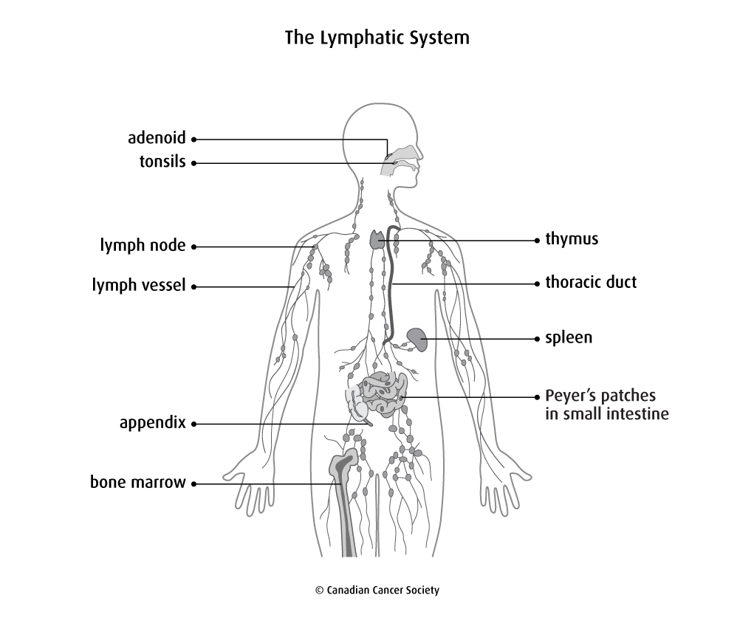
Lymph and lymphatic system

Slide 4
Composition of lymph
Lymph contains a variety of substances, including proteins, salts, glucose, fats, water, and white blood cells. Unlike your blood, lymph does not normally contain any red blood cells. The composition of lymph varies a great deal, depending on where in your body it originated.

Slide 5
Functions of lymph
Nutritive
Drainage
Absorption
defense

Slide 6
https://www.youtube.com/watch?v=5YPM74FZDQQ

Slide 7
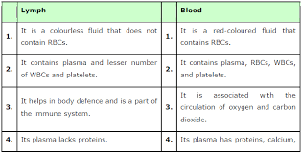
Differences between lymph and blood

Slide 8
THANKING YOU
ODM EDUCATIONAL GROUP.

