Slide 1


REPRODUCTION IN PLANTS .
SUBJECT:BIOLOGY
CHAPTER:2
POLLINATION AND FERTILISATION.
PERIOD-5

Slide 2
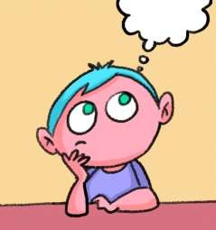
LEARNING OBJECTIVE
Student will be able to understand the meaning of life processes.
Student will be familiarized with the mechanism of nutrition, respiration, transportation, and excretion.
They will be able to analyze various types of nutrition .
Learners will be sensitized about the difference between prokaryotes and eukaryotes.

Slide 3
WARM UP QUESTIONS
Define living and nonliving.
Categorize the single celled and multi-celled organisms.
Identify the single celled, multi-celled organisms.
list the categories of living and non-living organisms.

Slide 4
POLLINATION
Transfer of pollen grains from the anther to the stigma is called pollination. Pollen grains are transferred mainly by wind, water and insects. They are called as pollinating agents. Pollination is the first and important event in the development of the fruit and seed. Pollination is followed by fertilization.

Slide 5
SELF POLLINATION
Self pollination is also known as autogamy. The transfer of pollen grains from the anther of a flower to the stigma of the same flower or another flower of the same plant is known as self pollination.

Slide 6
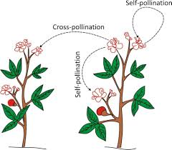
CROSS POLLINATION (ALLOGAMY)
The transfer of pollen grains of a flower to the stigma of another flower of a different plant of the same species is called cross pollination or allogamy.

Slide 7
ADVANTAGES OF SELF POLLINATION
Self pollination is certain in bisexual flowers.
Flowers need not depend on agents of pollination.
There is no wastage of pollen grains

Slide 8
https://www.youtube.com/watch?v=3cmB7bnymnk

Slide 9
AGENTS OF POLLINATION
Wind
Water
Insects
Animals

Slide 10
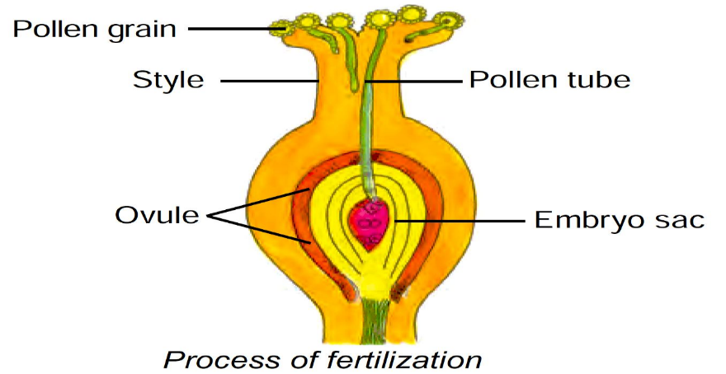
PROCESS OF FERTILIZATION
The pollen tube enters into the embryo sac through micropyle. At this time, the pollen tube bursts open, gametes released from the pollen tube and enter into the embryosac. One of the gametes fuses with the egg, and the other fuses with the secondary nucleus. The fusion of a male gamete with egg is known as fertilization. The fertilized egg is known as zygote which develops into embryo.

Slide 11
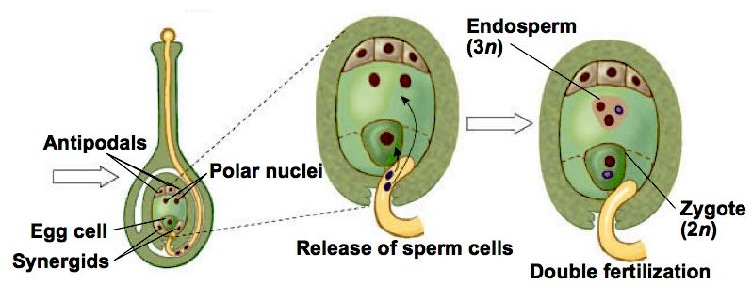
DOUBLE FERTILIZATION

Slide 12
Post fertilization events-
The ovule develops into seed.
The integuments of the ovule develop into seed coats.
The ovary enlarges and develops into fruit.

Slide 13
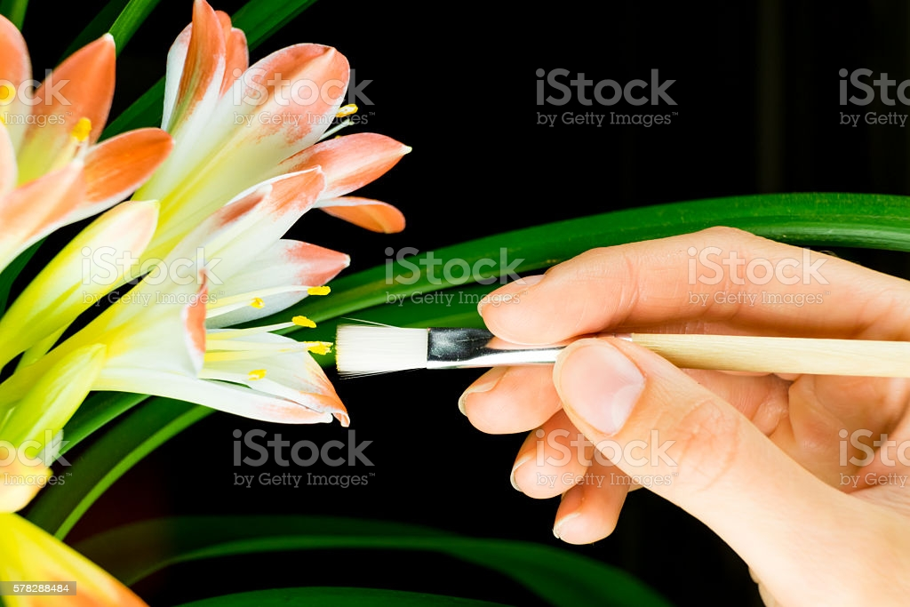
Artificial pollination

Slide 14
HOME ASSIGNMENTS
Exercise short Question No- 2, and Long Answer Question No-8,5

Slide 15

THANKING YOU
ODM EDUCATIONAL GROUP.

