Slide 1


CHEMICAL CONTROL AND INTEGRATION
TESTIS, OVARY, HORMONES OF HEART, KIDNEY ANDGASTROINTESTINAL TRACT
SUBJECT : BIOLOGY
CHAPTER NUMBER: 22
CHAPTER NAME : CHEMICAL CONTROL AND INTEGRATION

Slide 2
TESTES
A pair of testis is present in the scrotal sac (outside abdomen) of male individuals.
Testis performs dual functions as a primary sex organ as well as an endocrine gland.
Testis is composed of seminiferous tubules and stromal or interstitial tissue.
The Leydig cells or interstitial cells, which are present in the intertubular spaces produce a group of hormones called androgens mainly Testosterone.

Slide 3
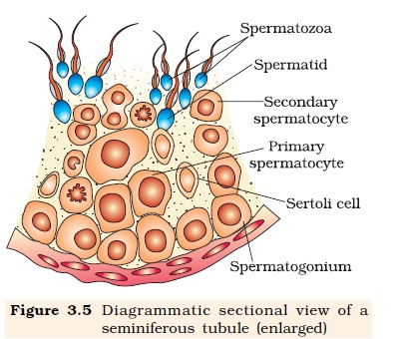

Slide 4
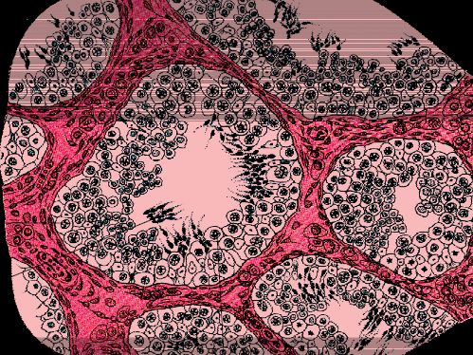
Interstitial cells
Sertoli cells
T.S of Testes

Slide 5
Androgens regulate the development, maturation and functions of the male accessory sex organs like epididymis, vas deferens, seminal vesicles, prostate gland, urethra etc.
These hormones stimulate muscular growth, growth of facial and axillary hair, aggressiveness, low pitch of voice etc.
Androgens play a major stimulatory role in the process of spermatogenesis (formation of spermatozoa).
Androgens act on the central neural system and influence the male sexual behaviour (libido).
These hormones produce anabolic (synthetic) effects on protein and carbohydrate metabolism.

Slide 6
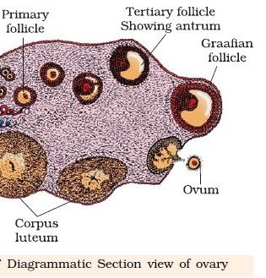

Slide 7
OVARY
Females have a pair of ovaries located in the abdomen. Ovary is the primary female sex organ which produces one ovum during each menstrual cycle.
In addition, ovary also produces two groups of steroid hormones called estrogen and progesterone.
Ovary is composed of ovarian follicles and stromal tissues.
The estrogen is synthesised and secreted mainly by the growing ovarian follicles.
After ovulation, the ruptured follicle is converted to a structure called corpus luteum, which secretes mainly progesterone.

Slide 8
Estrogens produce wide ranging actions such as stimulation of growth and activities of female secondary sex organs, development of growing ovarian follicles, appearance of female secondary sex characters (e.g., high pitch of voice, etc.), mammary gland development.
Estrogens also regulate female sexual behaviour. Progesterone supports pregnancy.
Progesterone also acts on the mammary glands and stimulates the formation of alveoli (sac-like structures which store milk) and milk secretion.

Slide 9
HORMONE OF THE HEART
Hormones are also secreted by some tissues which are not endocrine glands.
For example, the atrial wall of our heart secretes a very important peptide hormone called atrial natriuretic factor (ANF), which decreases blood pressure.
When blood pressure is increased, ANF is secreted which causes dilation of the blood vessels. This reduces the blood pressure.

Slide 10
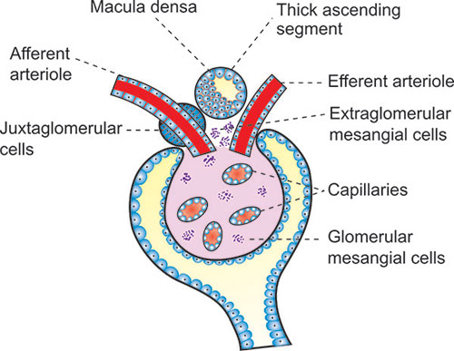
HORMONE OF THE KIDNEY
The juxtaglomerular cells of kidney produce a peptide hormone called erythropoietin which stimulates erythropoiesis (formation of RBC).

Slide 11
GASTROINTESTINAL TRACT
Endocrine cells present in different parts of the gastro-intestinal tract secrete four major peptide hormones, namely:
1. Gastrin
2. Secretin
3. Cholecystokinin (CCK)
4. Gastric inhibitory peptide (GIP).

Slide 12
GASTROINTESTINAL TRACT
Gastrin acts on the gastric glands and stimulates the secretion of hydrochloric acid and pepsinogen. Secretin acts on the exocrine pancreas and stimulates secretion of water and bicarbonate ions.
CCK acts on both pancreas and gall bladder and stimulates the secretion of pancreatic enzymes and bile juice, respectively.
GIP inhibits gastric secretion and motility.
Several other non-endocrine tissues secrete hormones called growth factors. These factors are essential for the normal growth of tissues and their repairing/regeneration.

Slide 13
THANKING YOU
ODM EDUCATIONAL GROUP

