Slide 1


MORPHOLOGY OF FLOWERING PLANTS
GYNOECIUM :THE FEMALE REPRODUCTIVE SYSTEM
SUBJECT : BIOLOGY
CHAPTER NUMBER:05
CHAPTER NAME :MORPHOLOGYOF FLOWERING PLANTS

Slide 2
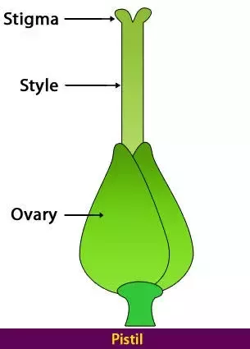
GYNOECIUM
THE PISTIL
Gynoecium is the female reproductive part of the flower and is made up of one or more carpels.
A carpel consists of three parts namely stigma, style and ovary.
Ovary is the enlarged basal part, on which lies the elongated tube, the style.
The style connects the ovary to the stigma.
The stigma is usually at the tip of the style and is the receptive surface for pollen grains.

Slide 3
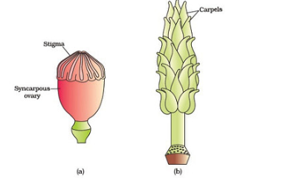
THE PISTIL
Each ovary bears one or more ovules attached to a flattened, cushion-like placenta.
When more than one carpel is present, they may be free (as in lotus and rose) and are called apocarpous.
They are termed syncarpous when carpels are fused, as in mustard and tomato. After fertilisation, the ovules develop into seeds and the ovary matures into a fruit.
Apocarpous
Syncarpous

Slide 4
PLACENTATION
The arrangement of ovules within the ovary is known as placentation. The placentation are of different types namely, marginal, axile, parietal, basal, central and free central.
In marginal placentation the placenta forms a ridge along the ventral suture of the ovary and the ovules are borne on this ridge forming two rows, as in Pea.
When the placenta is axial and the ovules are attached to it in a multilocular ovary, the placentation is said to be axile, as in China rose, Tomato and Lemon.

Slide 5
PLACENTATION
In parietal placentation, the ovules develop on the inner wall of the ovary or on peripheral part. Ovary is one-chambered but it becomes two chambered due to the formation of the false septum, e.g., Mustard and Argemone.
When the ovules are borne on central axis and septa are absent, as in Dianthus and Primrose the placentation is called free central.
In basal placentation, the placenta develops at the base of ovary and a single ovule is attached to it, as in Sunflower, Marigold.

Slide 6
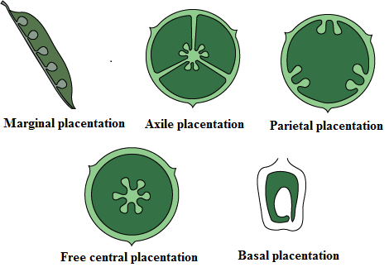
PLACENTATION

Slide 7
THANKING YOU
ODM EDUCATIONAL GROUP

