Slide 1


ANIMAL KINGDOM
ARTHROPODA,MOLLUSCA,ECHINODERMATA
SUBJECT : BIOLOGY
CHAPTER NUMBER: 4
CHAPTER NAME : ANIMAL KINGDOM

Slide 2
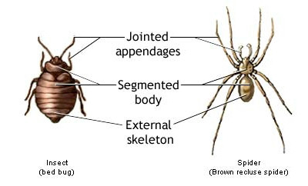
Arthropoda
Greek .arthron-"joint" and podos-"foot"
Arthropoda is the largest phylum with about nine lakh species. They may be aquatic, terrestrial or even parasitic. They have jointed appendages and a chitinous exoskeleton.
This phylum includes several large classes and contains the class Insecta which itself represents a major portion of the animal species in the world. They possess the ability to survive in every habitat.
Examples:
Economically important insects – Apis (Honey bee), Bombyx (Silkworm), Laccifer (Lac insect)
Vectors – Anopheles, Culex and Aedes (Mosquitoes)
Gregarious pest – Locusta (Locust)
Living fossil – Limulus (King crab).

Slide 3
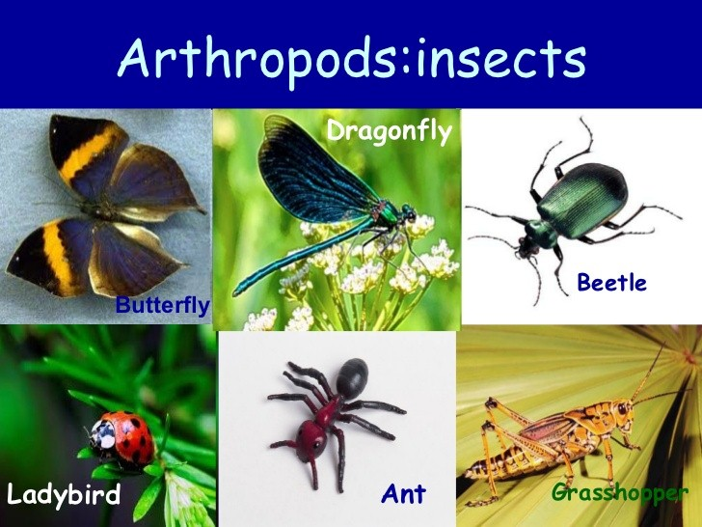
Arthropoda Characteristics
The arthropoda characteristics are mentioned below:
The body is triploblastic , segmented, and bilaterally symmetrical.
They exhibit organ system level of organization.
The body is divided into head, thorax, and abdomen.
Their body has jointed appendages which help in locomotion.
The coelomic cavity is filled with blood.
They have an open circulatory system.
The head bears a pair of compound eyes.
The exoskeleton is made of chitin.
The terrestrial Arthropods excrete through Malpighian tubules while the aquatic ones excrete through green glands or coaxal glands.
They are unisexual and have sexual reproduction. Most species go through larval stages after hatching. The larvae are very different from the adults. They change into the adult form in a process called metamorphosis. Other arthropod species, in contrast, hatch young that look like small adults. These species lack both larval stages and metamorphosis.
Fertilization is either external or internal.
They have a well-developed digestive system.
They respire through the general body surface or trachea.
They contain sensory organs like hairs, antennae, simple and compound eyes, auditory organs, and statocysts.

Slide 4
Mollusca
Means soft bodied
The term Mollusca was first given by Aristotle to cuttlefish. The term Molluscs was coined by Lamarck.
The animals belonging to the phylum Mollusca have soft-bodies, triploblastic and bilaterally symmetrical. The study of Mollusca is called Malacology. They are sluggish invertebrates, with a thin fleshy envelope known a the mantle. The animals belonging to phylum Mollusca are soft-bodied, triploblastic, non-metameric coelomates.
These organisms are found in the terrestrial as well as in deep seas. Their size ranges from microscopic organisms to organisms 20 metres long.
They play a very important role in the lives of humans. They are a source of jewellery as well as food. Natural pearls are formed within these molluscs.
The bivalve molluscs are used as bioindicators in the marine and freshwater environments. But few of them such as snails and slugs are pests.

Slide 5
Mollusca Characteristics
The organisms belonging to phylum Mollusca exhibit the following characteristics:
They are mostly found in marine and fresh water. Very few are terrestrial found in damp soil.
The body is divided into segment they exhibit organ system level of organization.
Their body has a cavity.The body is divided into head , dorsal visceral mass, and ventral muscular foot and mantle.
The head comprises of tentacles and compound eyes.
The body is covered by a shell made up of calcium carbonate.
The ventral muscular foot helps in locomotion.
The mouth contains a file-like rasping organ for feeding, called radula.
They have a well-developed digestive system and the structure is chitinous.
They respire through the general body surface, pulmonary sac,or gills.
The blood circulates through the open circulatory system.
They have a pair of metanephridia that helps in excretion.
The nervous system consists of paired ganglia, connectives, and nerves.The tentacles, eyes, osphradium, and statocysts act as the sensory organs.
The sexes are separate and the fertilization is external or internal.
Development may be direct or indirect.

Slide 6
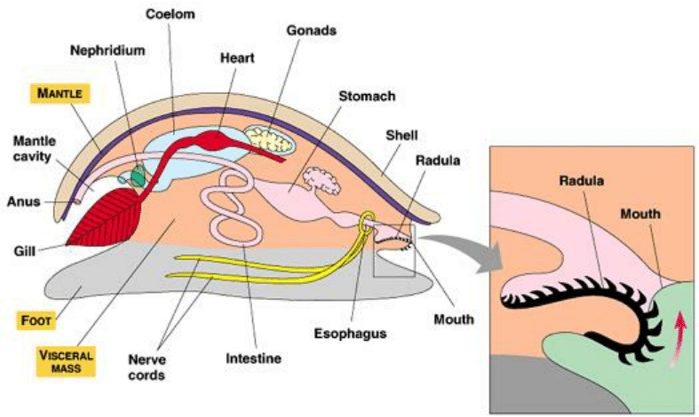
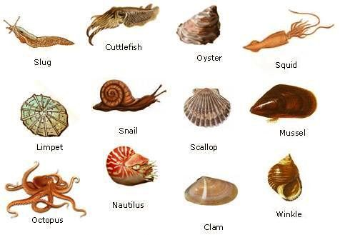
Mollusca

Slide 7
Unique Features
Unique Features
(i) Mantle covers the body.
(ii) Mantle may be surrounded by shell.
(iii) Nervous system consists of cerebral, visceral, pleural and pedal ganglia.
Advancement over Annelids:
(i) Shell is present in many individuals,
(ii) In some forms, a lungs is present for pulmonary respiration, and
(iii) Better developed sense organs such as eyes, statocysts and osphradia.
Examples : Pila (Apple snail), Pinctada (Pearl oyster), Sepia (Cuttlefish), Loligo (Squid), Octopus (Devil fish), Aplysia (Seahare), Dentalium (Tusk shell) and Chaetopleura (Chiton).

Slide 8
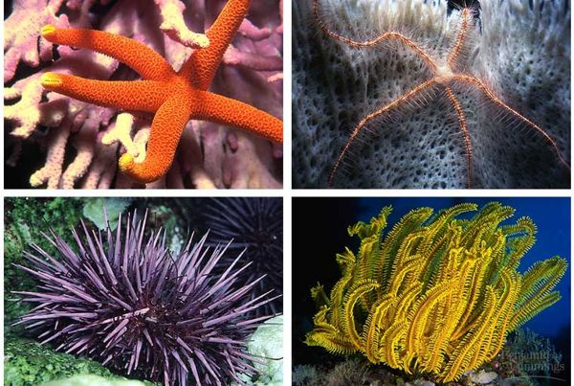
Echinodermata
The organisms belonging to the phylum Echinodermata are exclusively marine. Till date, there have been no traces of any terrestrial or freshwater Echinoderms.
These are multicellular organisms with well-developed organ systems. All the animals belonging to this phylum share the same characteristics features. They are colourful organisms with unique shapes. They are ecologically and geologically very important.
The Echinoderms are found in sea-depths as well as in the intertidal zones. An interesting feature of the phylum Echinodermata is that all the organisms belonging to this phylum are marine. None of the organisms is freshwater or marine.
The water vascular system present in echinoderms accounts for gaseous exchange, circulation of nutrients and waste elimination.

Slide 9
Characteristics of Echinodermata
They have a star-like appearance and are spherical or elongated.
They are exclusively marine animals.
The organisms are spiny-skinned.
They exhibit organ level of organization.
They are triploblastic and have a coelomic cavity.
The skeleton is made up of calcium carbonate.
They have an open circulatory system.
They respire through gills or cloacal respiratory tree.
They have a simple radial nervous system and the excretory system are absent.
The body is not segmented with no distinct head. The mouth is present on the ventral side while the anus is on the dorsal side.
The tube feet aids in locomotion.
They reproduce sexually through gametic fusion and asexually through regeneration. Fertilization is external.
The development is indirect.
They possess the power of regeneration.
They have poorly developed sense organs. These include chemoreceptors , tactile organs, terminal tentacles, etc.

Slide 10
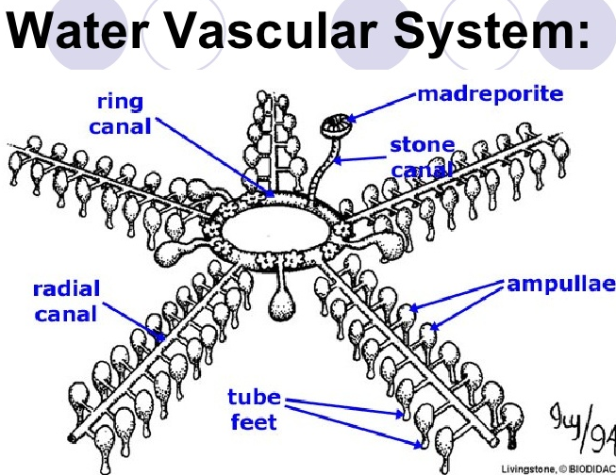
Water vascular system of echinoderms
The water vascular system of echinoderms is essentially a system of fluid-filled canals that extend along each of the body regions and have many external projections called tube feet. There are several functions of the system, one of which is to use water pressure to mediate movement and assist in feeding. It also carries out respiratory, excretory, and some circulatory functions within the animal.
The individual components of the water vascular system are the following:
Madreporite.
Stone canal.
Circular ring canal.
Radial canals.
Lateral canals.
Tube feet.

Slide 11
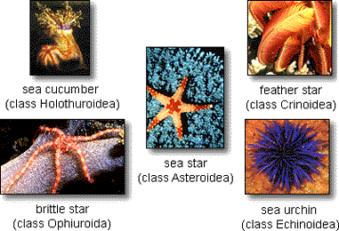
Unique Features
(i) Presence of spines and pedicellariae (Pedicellariae are modified spines that have a pincer-like structure at one end. They may be used for self-defense against predators).
(ii) Ambulacral system (water vascular system),
(iii) Haemal system (The haemal system is a series of channels throughout the body that transport and distribute food materials).
(iv) Mesodermal endoskeleton of calcareous plates.
(v) Bilateral symmetry in the larva and radial symmetry in the adult.

Slide 12
THANKING YOU
ODM EDUCATIONAL GROUP

