Slide 1


PLANT KINGDOM
PTERIDOPHYTES,GYMNOSPERMS
SUBJECT : BIOLOGY
CHAPTER NUMBER: 3
CHAPTER NAME : PLANT KINGDOM

Slide 2
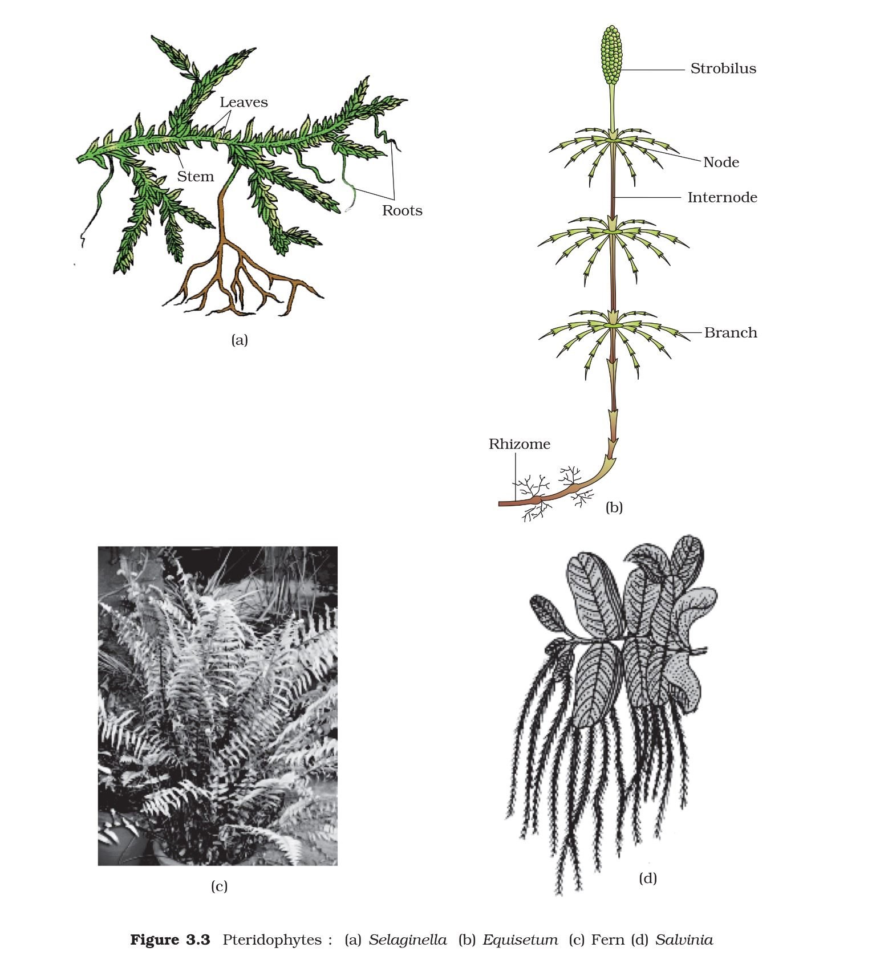
Pteridophytes
The pteridophytes (Gk. Pteron = feather and phyton = plants) means plants with feather like fronds or ferns.
They are flowerless, seedless, spore producing vascular plant which have successfully invaded the land.
Pteridophytes represent an intermediate position between bryophytes and spermatophytes (Gymnosperm and Angiosperm).
It was classified by Carolus Linnaeus (1754) under the class cryptogamia.
They are also called vascular cryptogams.
The group has a long fossil history. It is the most primitive group that flourished in Devonian and Carboniferous periods of Palaeozoic Era.

Slide 3
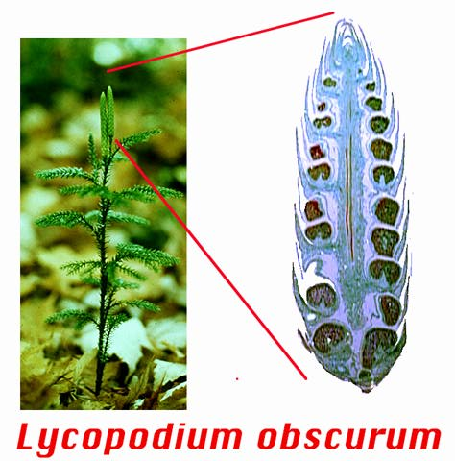
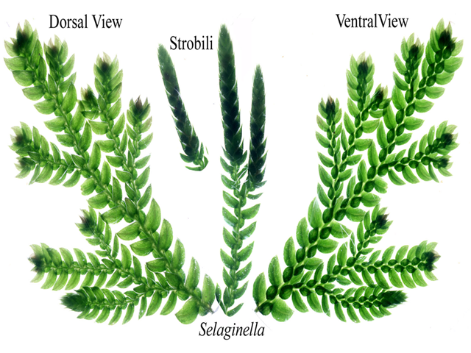
Characteristics of Pteridophytes
The Pteridophytes include horsetails and ferns.
Evolutionarily, they are the first terrestrial plants to possess vascular tissues - xylem and phloem.
The pteridophytes are found in cool, damp, shady places though some may flourish well in sandy ­soil conditions.
In pteridophytes, the main plant body is a sporophyte which is differentiated into true root, stem and leaves.
These organs possess well ­differentiated vascular tissues.
The leaves in pteridophyta are small (microphylls) as in Selaginelia or large (macrophylls) as in ferns.
The sporophytes bear sporangia that are subtended by leaf-like appendages called sporophylls.
In some cases sporophylls may form distinct compact structures called strobili or cones (Selaginella, Equisetum).

Slide 4
Continued....
The sporangia produce spores by meiosis in spore mother cells.
The spores germinate to give rise to inconspicuous, small but multicellular, free-living, mostly photosynthetic thalloid gametophytes called prothallus.
These gametophytes require cool, damp, shady places to grow. Because of this specific restricted requirement and the need for water for fertilisation, the spread of living pteridophytes is limited and restricted to narrow geographical regions.
The megaspores and micros pores germinate and give rise to female and male gametophytes, respectively.
The female gametophytes in these plants are retained on the parent sporophytes for variable periods.
The development of the zygotes into young embryos takes place within the female gametophytes.
This event is a precursor to the seed habit considered an important step in evolution.

Slide 5
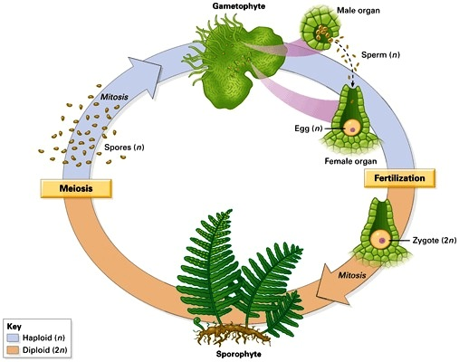
Reproduction
The gametophytes bear male and female sex organs called antheridia and archegonia, respectively.
Water is required for transfer of antherozoids the male gametes released from the antheridia, to the mouth of archegonium.
Fusion of male gamete with the egg present in the archegonium result in the formation of zygote.
The development of the zygotes into young embryos take place within the female gametophytes. This event is a precursor to the seed habit considered an important step in evolution.
In majority of the pteridophytes all the spores are of similar kinds; such plants are called homosporous.
Genera like Selaginella and Salvinia which produce two kinds of spores, macro (large) and micro (small) spores, are known as heterosporous.

Slide 6
Similarities with bryophytes
(a) Both have terrestrial mode of life.
(b) Water is indispensable for the process of fertilization.
(c) Male gametes are flagellated.
(d) The structure and ontogeny of sex organs i.e. antheridium and archegonium is based on similar pattern.
(e) Both the groups have definite alternation of sporophytic and gametophytic generations.
(f) Sexual reproduction is of oogamous type. Zygote is retained within the venter of archegonium to form embryo.
(g) Sex organs are surrounded by sterile jacket.
(h) The young sporophyte is partially or wholly dependent on the gametophyte for nourishment.

Slide 7
Similarities with spermatophytes
(a) In both the cases, sporophytic plant body is large, independently existing and dominant phase of life cycle.
(b) The plant body is differentiated into true stem, leaves and roots.
(c) Vascular tissue is present.
(d) Spores are produced inside the sporangia.
(e) Presence of distinct alternation of generations.
(f) Process of photosynthesis is mainly confined to leaves. Stomata are present on the leaves.

Slide 8
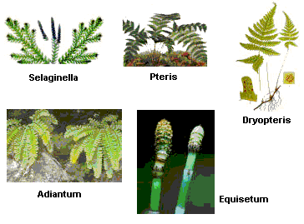
Classification
Eichler (1883) classified the plant kingdom into Cryptogamia and Phanerogamia.
The Cryptogamia was further divided into Thallophyta, Bryophytes and Pteridophyta.
Oswald and Tippo (1942) classified pteridophytes in to four sub-phyla.
(i) Psilopsida-Psilotum
(ii) Lycopsida-Sellaginella,Lycopodium
(iii) Sphenopsida- Equisetum
(iv) Pteropsida- Drtopteris, Pteris,Adiatum

Slide 9
Selaginella
Selaginella is commonly called the little club moss or spike moss. It is mainly found in damp shaded places.
The plant body is sporophytic (2n), which is an evergreen and delicate herb having adventitious roots.
The plants show great variation in their morphology.Some species are prostrate growing upon the surface and some are climbers.
Reproduction takes place by vegetative and sexual (by spores) method
SEXUAL REPRODUCTION: The reproductive structure in Selaginella is strobilus or spike. It is a sessile structure and develops at the terminal ends of the branches and its length varies from 1/4th of an inch to 2-3 inches in different species.
The sporangia are of two types:
Megasporangia: Borne on megasporophylls. Megasporangium is pale greenish and contains chalky white, yellow or orange megaspores.The megasporangium is four-lobed structure with a 2-layered jacket, one layer of tapetum and a large number of microspore mother cell. However, only one megaspore mother cell is functional. After meiosis it produces 4 megaspores out of which 1remains and 3 degenerate.
(ii) Microsporangia: Borne on microsporophylls having a large number of small spores. Thus Selaginella is heterosporous. Microsporangium is pale yellow, oval or spherical body, with 2-layered jacket, one layered tapetum and a number of microspore mother cells which undergo meiosis and form haploid microspores. The main body consists of a wall having two layers, inside which are present numerous small microspores (400-2000).

Slide 10
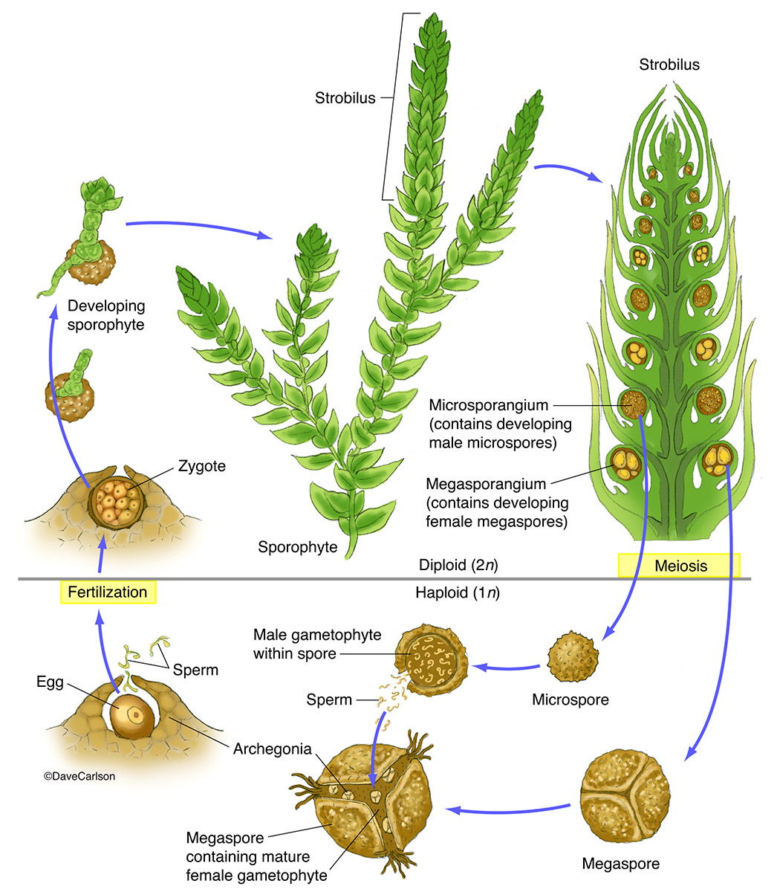

Slide 11
Economic importance
(i) Ornamental value: Many ferns are grown as ornamental plants in gardens for their large, Show and graceful foliage. e.g., species of Lycopodium, Nephrolepis, Selaginella, Lygodium, Anemia, Cyathea etc.
(ii) Medicines : An anthelmintic drug is obtained from the rhizomes and petioles of the fern Dryopteris. Lycopodium clavatum is used in skin diseases. Equisetum arvense has diuretic properties.
(iii) Food : The sporocarps of Marsilea are rich source of starch and used by tribals for their nutritive value.
(iv) Soil conservation : Plants like Selaginella are useful in soil conservation.

Slide 12
GYMNOSPERM
(Gk. Gymnos = naked ; sperma = seed) are the plants with exposed or naked seeds or ovules.
These plants represent the most ancient group of seed plants.
They have been generally placed in the division spermatophyta (seed bearing plants) along with angiosperms. They were not grouped separately as gymnosperms. But Robert Brown (1827) separated them from angiosperms and placed under a distinct group due to presence of unprotected ovules in them.
The gymnosperm originated much earlier than angiosperms. However, most of the members of this group have now become extinct and only few living forms are known today.
Gymnosperms include medium-sized trees or tall trees and shrubs.
One of the gymnosperms, the giant redwood tree Sequoia is one of the tallest tree species.

Slide 13
Characteristics of Gymnosperms
Characteristics of Gymnosperms
The roots are generally tap roots.
Roots in some genera have fungal association in the form of mycorrhiza (Pinus), while in some others (Cycas) small specialised roots called coralloid roots are associated with N2- fixing cyanobacteria.
The stems are unbranched (Cycas) or branched (Pinus, Cedrus).
The leaves may be simple or compound. In Cycas the pinnate leaves persist for a few years.
The leaves in gymnosperms are well­ adapted to withstand extremes of temperature, humidity and wind.
In conifers, the needle-like leaves reduce the surface area. Their thick cuticle and sunken stomata also help to reduce water loss.

Slide 14
Reproduction and life cycle of gymnosperms
REPRODUCTION
The gymnosperms are heterosporous; they produce haploid microspores and megaspores.
The two kinds of spores are produced within sporangia that are borne on sporophylls which are arranged spirally along an axis to form compact strobili or cones.
The strobili bearing microsporophylls and microsporangia are called microsporangiate or male strobili.
LIFECYCLE
The microspores develop into a male gametophytic generation which is highly reduced and is confined to only a limited number of cells. This reduced gametophyte is called a pollen grain.
The development of pollen grains takes place within the microsporangia.
The cones bearing megasporophylls with ovules or megasporangia are called macrosporangiate or female strobili.
The male or female cones or strobili may be borne on the same tree (Pinus) or on different trees (Cycas).
The megaspore mother cell is differentiated from one of the cells of the nucellus.
The nucellus is protected by envelopes and the composite structure is called an ovule. The ovules are borne on megaspo -rophylls which may be clustered to form the female cones.

Slide 15
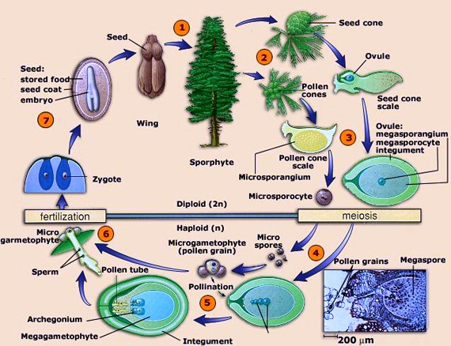
CONTD..
The MMC divides meiotically to form four megaspores.
One of the megaspores enclosed within the megasporangium (nucellus) develops into a multicellular female gametophyte that bears two or more archegonia or female sex organs.
The multicellular female gametophyte is also retained within megasporangium.
Unlike bryophytes and pteridophytes, in gymnosperms the male and the female gametophytes do not have an independent free-living existence.They remain within the sporangia retained on the sporophytes.
The pollen grain is released from the microsporangium and are carried in air currents and come in contact with the opening of the ovules borne on megasporophylls.
The pollen tube carrying the male gametes grow towards archegonia in the ovules and discharge their contents near the mouth of the archegonia.Following fertilisation, zygote develops into an embryo and the ovules into seeds.These seeds are not covered.

Slide 16
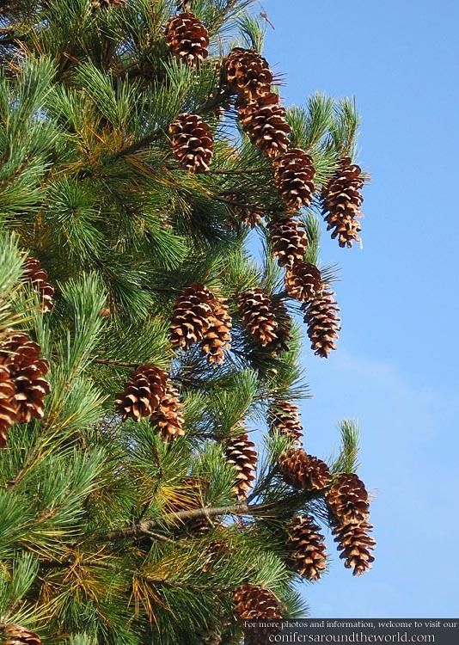
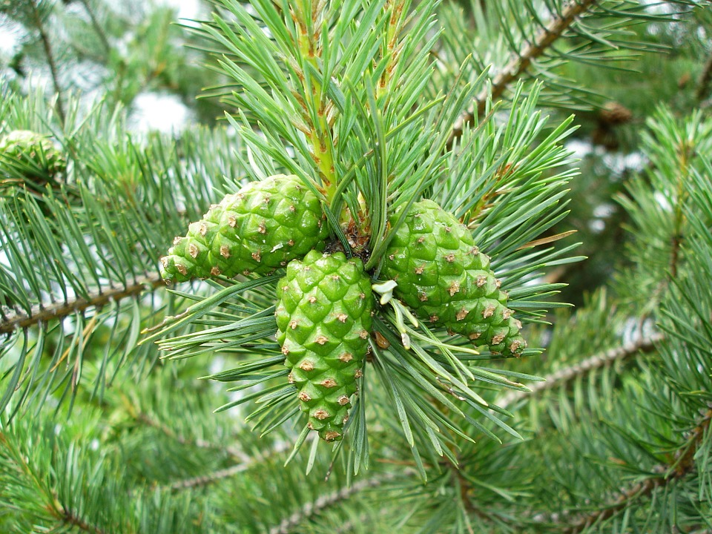
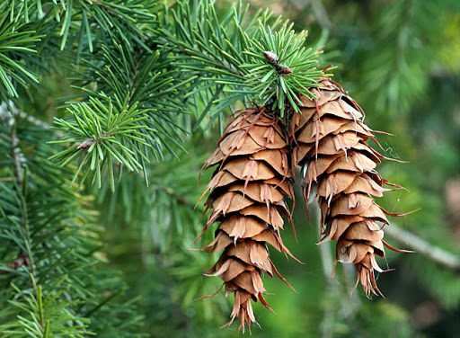
PINUS
Pinus is an evergreen, perennial plant of xerophytic nature.Mostly the species are tall and straight.The plant body is sporophyte , differentiated into roots, stem and leaves
the plants are monoecious.
Pinus reproduces only by means of spores. Micro and megasporophylls form compact male and female cone or strobilus respectively.
Pinus plant is sporophyte (2n), heterosporous (producing two type of spores - microspore and megaspore), monoecious (male and female cones are borne on same plant) .

Slide 17
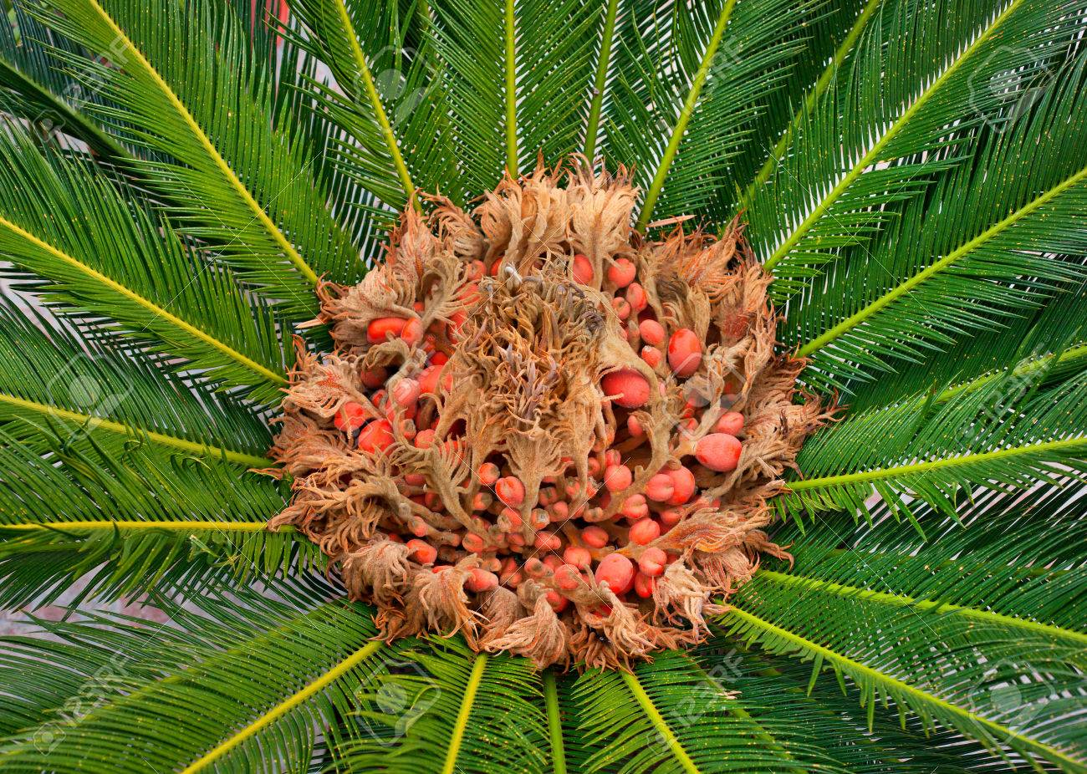
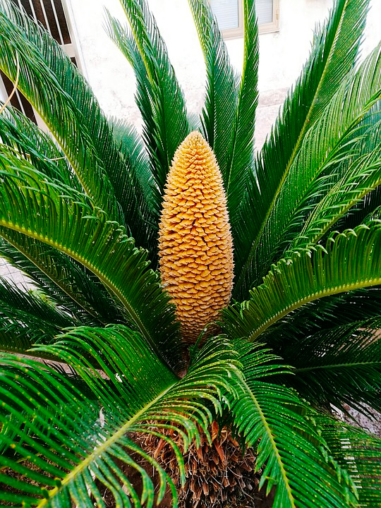
Cycas
Cycas
Cycas is an evergreen palm-like plant. Cycas plants are dioecious
Plant of Cycas is sporophyte (2n) and dioecious
The male and female gametes are formed by the germination of micro and megaspores which are born on microsporophylls and megasporophylls present in different plants.
The microsporophylls are grouped together to form a compact conical structure called male cone, whereas the megasporophylls are not aggregated to form a cone, they are produced at the apex of the stem in succession with the leaves.
FEMALE
MALE

Slide 18
THANKING YOU
ODM EDUCATIONAL GROUP

