Slide 1


BIOLOGICAL CLASSIFICATION
KINGDOM FUNGI
SUBJECT : BIOLOGY
CHAPTER NUMBER:2
CHAPTER NAME : BIOLOGICAL CLASSIFICATION

Slide 2

What is Fungi?
Fungi is a eukaryotic organism that includes microorganisms such as yeasts, moulds, and mushrooms. These organisms are classified under kingdom fungi.
The organisms found in Kingdom fungi contain a cell wall and are omnipresent. They are classified as heterotrophs among the living organisms.
To name a few – the appearance of black spots on bread left outside for some days, the mushrooms, the yeast cells, commonly used for the production of beer and bread are also fungi. They are also found in most of the skin infections and other fungal diseases.
If we observe carefully, all the examples that we cited involve moist conditions. Thus, we can say that fungi usually grow in places which are moist and warm enough to support them.
Let us have a detailed overview of the structure, classification and characteristics of fungi.

Slide 3
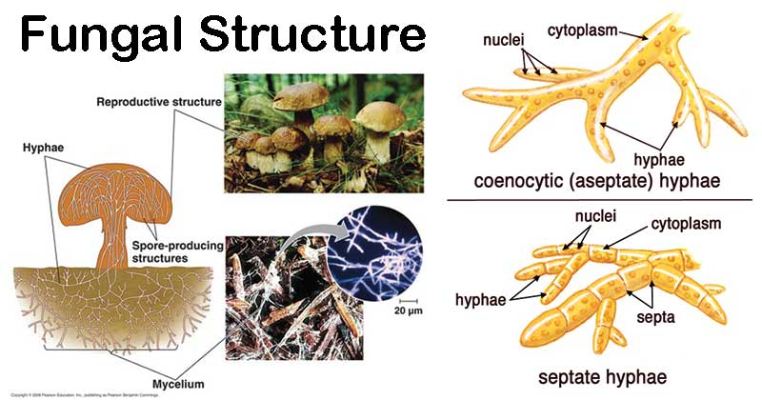
Structure of Fungi
The structure of fungi can be explained in the following points:
Almost all the fungi have a filamentous structure except yeast the cells.
They can be either single-celled or multicellular organism.
Fungi consist of long thread-like structures known as hyphae. These hyphae together form a mesh-like structure called mycelium.
Some hyphae are continuous tubes filled with multinucleated cytoplasm, these are called coenocytic hyphae and others have septae or cross walls in their hyphae.
Fungi possess a cell wall which is made up of chitin and polysaccharides.
The cell wall comprises of protoplast which is differentiated into other cell parts such as cell membrane, cytoplasm, cell organelles and nuclei.
The nucleus is dense, clear, with chromatin threads. The nucleus is surrounded by a nuclear membrane.

Slide 4
Characteristics of Fungi
Following are the important characteristics of fungi:
Fungi are eukaryotic, non-vascular, non-motile and heterotrophic organisms.
They may be unicellular or filamentous.
They reproduce by means of spores.
Fungi exhibit the phenomenon of alternation of generation.
Fungi lack chlorophyll and hence cannot perform photosynthesis.
Fungi store their food in the form of starch.
Biosynthesis of chitin occurs in fungi.
The nuclei of the fungi are very small.
During mitosis, the nuclear envelope is not dissolved.
The fungi have no embryonic stage. They develop from the spores.
The mode of reproduction is sexual or asexual.
Some fungi are parasitic and can infect the host.
Fungi produce a chemical called pheromone which leads to sexual reproduction in fungi.
For eg. mushrooms, moulds, yeast.

Slide 5
Nutrition
The fungi lack chlorophyll and hence they cannot prepare their food. They live as heterotrophs i.e., as parasites and saprophytes. Some forms live symbiotically with other green forms.
(i) Parasites: They obtain their food from a living host. A parasite may be obligate or facultative. The obligate parasites thrive on a living host throughout their life. The facultative parasites are in fact saprophytes which have secondarily become parasitic.
(ii) Saprophytes: They derive their food from dead and decaying organic matter. The saprophytes may be obligate or facultative. An obligate saprophyte remains saprophytic throughout its life. On the other hand, a facultative saprophyte is infact a parasite which has secondarily become saprophytic.
(iii) Symbionts: Some fungal forms grow in symbiotic association with the green or blue-green algae and constitute the lichen. Here the algal component is photosynthetic and the fungal is reproductive. A few fungal forms grow in association with the roots of higher plants. This association is called as mycorrhiza.

Slide 6
Reproduction
The fungi may reproduce vegetatively, asexually as well as sexually:
(i) Vegetative reproduction
(a) Fragmentation: Some forms belonging to Ascomycotina and Basidiomycotina multiply by breakage of the mycelium.
(b) Budding: Some unicelled forms multiply by budding. A bud arises on the parent cell and then after its matures it separates into a completely independent entity.
(c) Fission: A few unicelled forms like yeasts and slime molds multiply by this process.
(ii) Asexual reproduction
(a) Sporangiospores: These are thin-walled, non-motile spores formed in a sporangium. They may be uni-or multinucleate. On account of their structure, they are also called as aplanospores.
(b) Zoospores: They are thin-walled, motile spores formed in a zoosporangium. Example: In Pilobulus a sticky mass containing many spores is discharged as a single unit.
(c) Conidia: In some fungi the spores are not formed inside a sporangium. They are born freely on the tips of special branches called conidiophores. The spores thus formed are called as conidia. On the basis of development, two types of conidia are recognised namely thallospores and blastospores or true conidia.

Slide 7
Contd..
(iii) Sexual reproduction:
With the exception of Deuteromycotina (Fungi imperfecti), the sexual reproduction is found in all groups of fungi. During sexual reproduction the compatible nuclei show a specific behaviour which is responsible for the onset of three distinct mycelial phases. The three phases of nuclear behaviour are as under:
Fusion of protoplasms between two motile or non-motile gametes called plasmogamy.
Fusion of two nuclei called karyogamy.
Meiosis in zygote resulting in haploid spores.
The fusion of two haploid cells immediately results in diploid cells (2n), but in some fungi such as ascomycetes and basidiomycetes, an intervening dikaryotic stage (n + n i.e. two nuclei per cell) occurs; such a condition is called a dikaryon and the phase is called dikaryophase of fungus.Later, the parental nuclei fuse to form diploid cell.
The fungi form fruiting bodies in which reduction division occurs, leading to formation of haploid spores.

Slide 8
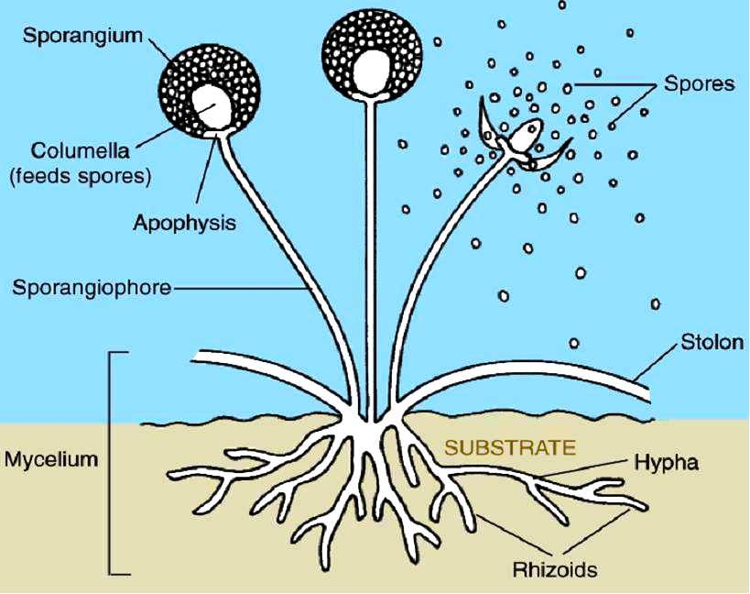
Classification of fungi-Phycomycetes
Kingdom fungi is divided into various classes based on the morphology of the mycelium, mode of spore formation and fruiting bodies such as :
Phycomycetes
Ascomycetes
Basidiomycetes
Deuteromycetes
PHYCOMYCETES
Members of phycomycetes are found in aquatic habitats and on decaying wood in moist and damp places or as obligate parasites on plants.
The mycelium is aseptate and coenocytic,Asexual reproduction takes place by zoospores (motile) or by aplanospores (non-motile).
These spores are endogeneously produced in sporangium.
Zygospores are formed by fusion of two gametes. These gametes are -similar in morphology (isogamous) or dissimilar (anisogamous or oogamous). Examples: Mucor, Rhizopus and Albugo (the parasitic fungi on mustard).

Slide 9
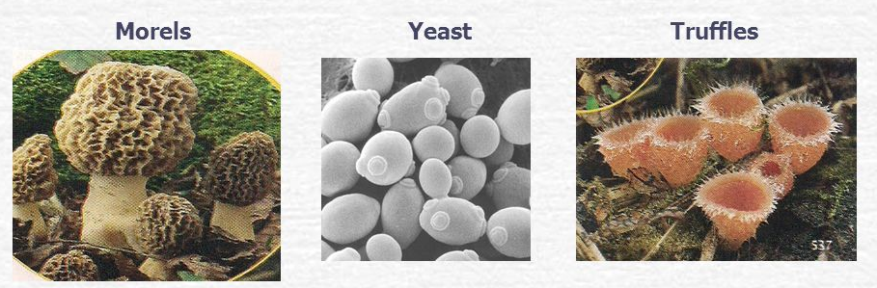
Ascomycetes
Commonly known as sac-fungi, the ascomycetes are unicellular, e.g., yeast (Sacharomyces) or multicellular, e.g., Penicillium.
They are saprophytic, decomposers, parasitic or coprophilous (growing on dung).
Mycelium is branched and septate.
The asexual spores are conidia produced exogenously on the special mycelium called conidiophores.
Sexual spores are called ascospores which are produced endogenously in sac like asci (singular ascus). These asci are arranged in different types of fruiting bodies called ascocarps.
Some examples are Aspergillus, Claviceps and Neurospora. Neurospora is used extensively in biochemical and genetic work. Many members like morels and buffles are edible and are-considered delicacies.

Slide 10
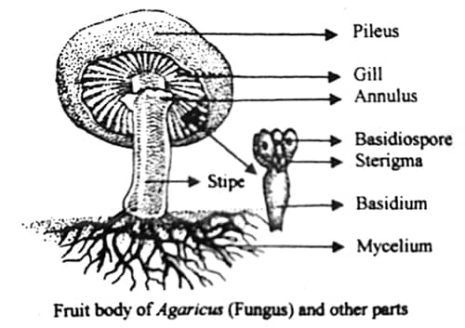
Basidiomycetes
Commonly known forms of basidiomycetes are mushrooms, bracket fungi or puffballs.
They grow in soil, on logs and tree stumps and in living plant bodies as parasites, e.g., rusts and smuts.
The mycelium is branched and septate.
The asexual spores are generally not found, but vegetative reproduction by fragmentation is common.
The sex organs are absent, but plasmogamy is brought about by fusion of two vegetative or somatic cells of different strains or genotypes.
The resultant structure is dikaryotic which ultimately gives rise to basidium.
Karyogamy and meiosis take place in the basidium producing four basidiospores.
The basidiospores are exogenously produced on the basidium.
The basidia are arranged in fruiting bodies called basidiocarps.
Some common members are Agaricus (mushroom), Ustilago (smut) and Puccinia (rust fungus).

Slide 11
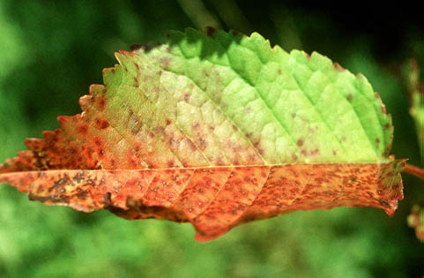
Deuteromycetes
Commonly known as imperfect fungi because only the asexual or vegetative phases of these fungi are known.
The deuteromycetes reproduce only by asexual spores known as conidia.
The mycelium is septate and branched.
Some members are saprophytes or parasites while a large number of them are decomposers of litter and help in mineral cycling. Examples: Alternaria, Colleiotrichum and Trichoderma.

Slide 12
THANKING YOU
ODM EDUCATIONAL GROUP

