Slide 1


SUBJECT:BIOLOGY
CHAPTER:6
CHAPTER NAME: THE CIRCULATORY SYSTEM.
PERIOD-4

Slide 2
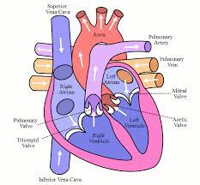
Blood circulation

Slide 3
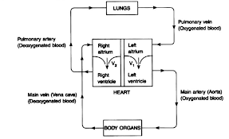

Slide 4
Double circulation
The blood circulation in human beings is an example of double circulation
In human circulatory system the blood from heart to the lungs and back to the heart is called pulmonary circulation and the blood from the heart to the rest part of the body back to the heart is called systemic circulation.This two types of circulation taken together make double circulation.

Slide 5
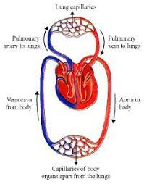

Slide 6
https://www.youtube.com/watch?v=SwHjwO7BnsI

Slide 7
THANKING YOU
ODM EDUCATIONAL GROUP.

