Slide 1


SUBJECT:BIOLOGY
CHAPTER:1
CHAPTER NAME: TRANSPORTATION IN PLANTS.
PERIOD-4

Slide 2
Capillary action:
Capillary action is the movement of liquid through a narrow space like oil rising through the wick of a lamp. Since xylem cells are long and thin, water moves up by capillary action.

Slide 3
Transpiration
All leaves have small pores called stomata on the epidermis. Water is lost by evaporation from these stomata as water vapour by a process called transpiration. This creates a pull on the xylem cells and water rushes to fill the space left by evaporating water molecules. This forces the water to move up due to suctional pull or suction pressure.

Slide 4
Factors affecting the rate of transpiration
Sunlight
Temperature
Wind
Humidity

Slide 5
https://www.youtube.com/watch?v=VMGGAc6sXhs

Slide 6
Importance of transpiration in plants
Cools the surface of the leaves.
Helps in growth and development.
It controls the temperature of the plants.
Allows the movement of minerals from the soil to different parts of the plant.

Slide 7
Uses of water in the plant
The various functions of water in plants include:
maintaining cell turgidity for structure and growth;
transporting nutrients and organic compounds throughout the plant; comprising much of the living protoplasm in the cells;

Slide 8

Importance of minerals
Micronutrients-1- Nitrogen- major constituent of all protein.
Deficiency- Yellowing of leaves, wrinkling of cereal grains.
2-phosphorous- constituent of cell membrane and certain proteins.
Deficiency- purple and red spots on leaves, delay in seed germination.
3- potassium- more abundant in growing tissues, opening and closing of stomata.
Deficiency- poor growth with reduced rate o transpiration.

Slide 9
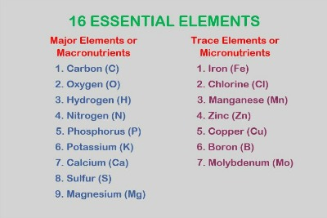
Macronutrients-1- iron- constituent of some proteins.
Deficiency- yellowing of leaves.
2-manganese- constituent of some enzymes
Deficiency -yellowing of leaves with grey spots.
3- zinc- constituent of plant hormones, activates enzymes.
Deficiency- deshaped leaves, yellowing of leaves, stunted plant growth.

Slide 10
Home assignments
Exercise Question No-10 and Long Answer Question No-7,8

Slide 11
THANKING YOU
ODM EDUCATIONAL GROUP.

