Slide 1


REPRODUCTION IN PLANTS .
SUBJECT:BIOLOGY
CHAPTER:2
PARTS OF A TYPICAL FLOWER
PERIOD-4

Slide 2

LEARNING OBJECTIVE
Student will be able to understand the meaning of life processes.
Student will be familiarized with the mechanism of nutrition, respiration, transportation, and excretion.
They will be able to analyze various types of nutrition .
Learners will be sensitized about the difference between prokaryotes and eukaryotes.

Slide 3
WARM UP QUESTIONS
Define living and nonliving.
Categorize the single celled and multi-celled organisms.
Identify the single celled, multi-celled organisms.
list the categories of living and non-living organisms.

Slide 4
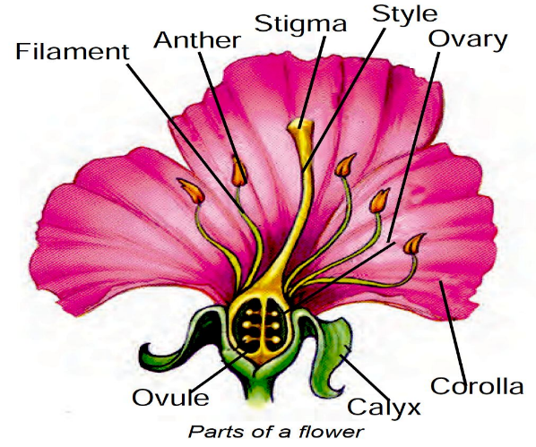
PARTS OF A TYPICAL FLOWER
A flower is a modified shoot with a limited growth. Flowers vary in size, shape,structure and colour. The main parts of a flower are,
1. Calyx
2. Corolla
3. Androecium and
4. Gynoecium.

Slide 5
https://www.youtube.com/watch?v=5O-q3alPFOo

Slide 6
Sepals-Sepals are green structures that protect the inner parts when the flower is in bud stage.
Petals-Petals are colourful and attract the insects for pollination.
Stamens-Stamens are male reproductive parts and produce pollen grains that contain male gametes. Each stamen has two parts—
Filament i.e. stalk and Anther i.e. swollen top part which has large number of pollen grains.

Slide 7
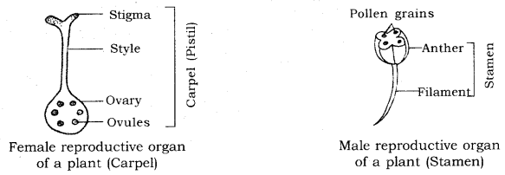
Carpel-The carpel is the female reproductive part and produces ovules that contain female gametes. It has three parts—Stigma which is top sticky part and receives pollen grains during pollination. Style which is the middle long part and ovary which is the swollen part and contains ovules. Each ovule has an egg cell i.e. female gamete.

Slide 8
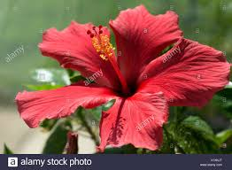
Bisexual Flower.
The flowers may be bisexual i.e. having both stamens and carpels for example; Mustard China Rose (Hibiscus).

Slide 9
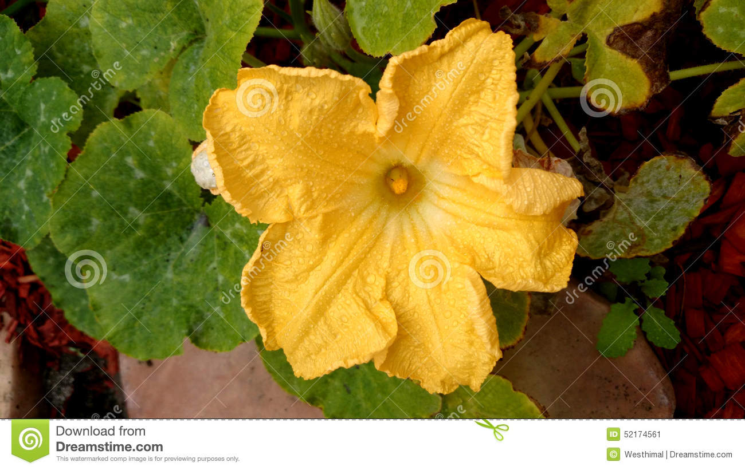
Unisexual flower
-The flower may be unisexual i.e. paving either stamens or carpels for example; Papaya, Watermelon.

Slide 10
HOME ASSIGNMENTS
Exercise Question No- 4 and Long Answer Question No-6

Slide 11
THANKING YOU
ODM EDUCATIONAL GROUP.

