Slide 1


CHEMICAL CONTROL AND INTEGRATION
ADRENAL GLAND AND PANCREAS
SUBJECT : BIOLOGY
CHAPTER NUMBER: 22
CHAPTER NAME : CHEMICAL CONTROL AND INTEGRATION

Slide 2
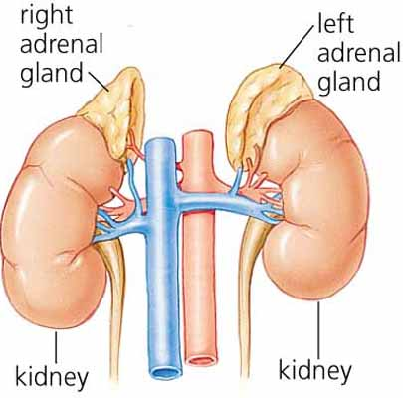

Slide 3
ADERNAL GLAND
Our body has one pair of adrenal glands, one at the anterior part of each kidney.
The gland is composed of two types of tissues. The centrally located tissue is called the adrenal medulla, and outside this lies the adrenal cortex.
Underproduction of hormones by the adrenal cortex alters carbohydrate metabolism causing acute weakness and fatigue leading to a disease called Addison’s disease.

Slide 4
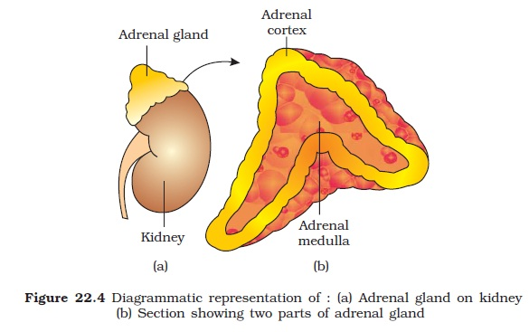

Slide 5
The adrenal medulla secretes two hormones called adrenaline or epinephrine and noradrenaline or norepinephrine.
These are commonly called as catecholamines. Adrenaline and noradrenaline are rapidly secreted in response to stress of any kind and during emergency situations and are called emergency hormones or hormones of Fight or Flight.
These hormones increase alertness, pupilary dilation, piloerection (raising of hairs), sweating etc.
Both the hormones increase the heart beat, the strength of heart contraction and the rate of respiration.

Slide 6
Catecholamines also stimulate the breakdown of glycogen resulting in an increased concentration of glucose in blood.
In addition, they also stimulate the breakdown of lipids and proteins.
The adrenal cortex can be divided into three layers, called zona reticularis (inner layer), zona fasciculata (middle layer) and zona glomerulosa (outer layer).
The adrenal cortex secretes many hormones, commonly called as corticoids.
ADERNAL GLAND

Slide 7
The corticoids, which are involved in carbohydrate metabolism are called glucocorticoids. In our body, cortisol is the main glucocorticoid.
Corticoids, which regulate the balance of water and electrolytes in our body are called mineral corticoids.
Aldosterone is the main mineral corticoid in our body.
Glucocorticoids stimulate gluconeogenesis, lipolysis and proteolysis; and inhibit cellular uptake and utilisation of amino acids.
Cortisol is also involved in maintaining the cardio-vascular system as well as the kidney
functions.
ADERNAL GLAND

Slide 8
Glucocorticoids, particularly cortisol, produces anti-inflammatory reactions and suppresses the immune response. Cortisol stimulates the RBC production.
Aldosterone acts mainly at the renal tubules and stimulates the reabsorption of Na+ and water and excretion of K+ and phosphate ions.
Thus, aldosterone helps in the maintenance of electrolytes, body fluid volume, osmotic pressure and blood pressure.
Small amounts of androgenic steroids are also secreted by the adrenal cortex which play a role in the growth of axial hair, pubic hair and facial hair during puberty.
ADERNAL GLAND

Slide 9
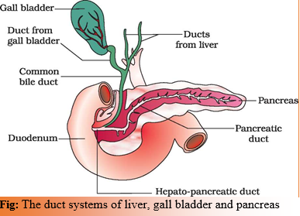
PANCREAS

Slide 10
PANCREAS
Pancreas is a composite gland which acts as both exocrine and endocrine gland. The endocrine pancreas consists of ‘Islets of Langerhans’.
There are about 1 to 2 million Islets of Langerhans in a normal human pancreas representing only 1 to 2 per cent of the pancreatic tissue.
The two main types of cells in the Islet of Langerhans are called:
1. a-cells
2. ß-cells.

Slide 11
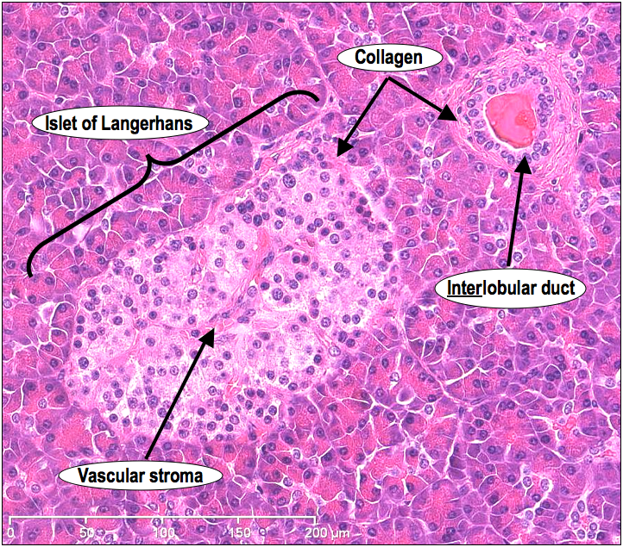
PANCREAS

Slide 12
PANCREAS
The a-cells secrete a hormone called glucagon, while the ß-cells secrete insulin.
Glucagon is a peptide hormone, and plays an important role in maintaining the normal blood glucose levels.
Glucagon acts mainly on the liver cells (hepatocytes) and stimulates glycogenolysis resulting in an increased blood sugar (hyperglycemia).
In addition, this hormone stimulates the process of gluconeogenesis which also contributes to hyperglycemia.
Glucagon reduces the cellular glucose uptake and utilisation. Thus, glucagon is a hyperglycemic hormone.

Slide 13
Insulin is a peptide hormone, which plays a major role in the regulation of glucose homeostasis.
Insulin acts mainly on hepatocytes and adipocytes (cells of adipose tissue), and enhances cellular glucose uptake and utilisation.
As a result, there is a rapid movement of glucose from blood to hepatocytes and adipocytes resulting in decreased blood glucose levels (hypoglycemia).
Insulin also stimulates conversion of glucose to glycogen (glycogenesis) in the target cells.
PANCREAS

Slide 14
The glucose homeostasis in blood is thus maintained jointly by the two – insulin and glucagons.
Prolonged hyperglycemia leads to a complex disorder called diabetes mellitus which is associated with loss of glucose through urine and formation of harmful compounds known as ketone bodies.
Diabetic patients are successfully treated with insulin therapy.

Slide 15
THANKING YOU
ODM EDUCATIONAL GROUP

