Slide 1


EXCRETORY PRODUCTS AND THEIR ELIMINATION
REGULATION OF KIDNEY FUNCTION, MICTURITION
SUBJECT : BIOLOGY
CHAPTER NUMBER: 19
CHAPTER NAME : EXCRETORY PRODUCTS AND THEIR ELEMINATION

Slide 2
Regulation of Kidney Function
The functioning of the kidneys is efficiently monitored and regulated by hormonal feedback mechanisms involving the:
hypothalamus
JGA
heart.

Slide 3
Regulation involving Hypothalamus
When there is change in the blood volume, ionic concentration or there is an excessive loss of fluid, osmoreceptors are activated and they trigger the release of vasopressin or Antidiuretic hormone (ADH) from the neurohypophysis.
ADH stimulates reabsorption of water from the distal parts of the tubules and thereby preventing the water loss and diuresis.
In case of sufficient body fluid, osmoreceptors are switched off hence ADH release is suppressed.
ADH can also cause constriction of blood vessels resulting in an increase in the blood pressure thereby increasing the blood flow in the glomerulus and Glomerular filtration rate.

Slide 4
Regulation involving Juxtaglomerular Apparatus (JGA)
Regulation by JGA is known as Renin-Angiotensin mechanism.
When the blood flow in the glomerulus decreases, Renin is released from juxtaglomerular (JG) cells. Renin converts angiotensin in the blood to angiotensin I and further to angiotensin II. Angiotensin II is a powerful vasoconstrictor and causes an increase in glomerular blood pressure and GFR.
Angiotensin II also stimulates the release of aldosterone from adrenal cortex gland, which facilitates reabsorption of sodium ion and water from the distal parts of the tubule and also and causes an increase in glomerular blood pressure and GFR.
The Atrial Natriuretic factor (ANF) is released when there is an increase in blood flow to the atria of the heart. It causes vasodilation and decreases blood pressure in the blood vessels. The ANF mechanism provides the necessary check to the Renin-Angiotensin mechanism.

Slide 5
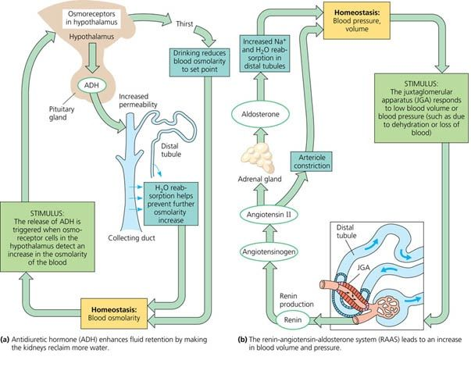
Regulation of Kidney Function

Slide 6
Micturition
Micturition
Urine after its formation, is transported to urinary bladder for temporary storage.
Here in wall of urinary bladder thee are stretch receptors.
When bladder is half filled, these receptors send information to CNS, which send voluntary information to external urethral sphincter as to relax and passage of urine.
The process of passing the urine is micturition .
The neural mechanism involved with it is known as micturition reflex.

Slide 7
Composition of urine
Composition of urine
An adult human excretes, on an average, 1 to 1.5 liters of urine per day.
The urine formed is a light yellow colored watery fluid which is slightly acidic, i.e. pH-6.0 and has a characterestic odour.
The characteristic color of urine is due to urochrome and characteristic odor is due to ammonia present in it.
On an average, 25-30 gm of urea is excreted out per day.
Various conditions can affect the characteristics of urine.
Analysis of urine helps in clinical diagnosis of many metabolic disorders as well as malfunctioning of the kidney.
For example, presence of glucose (Glycosuria) and ketone bodies (Ketonuria) in urine are indicative of diabetes mellitus.

Slide 8
THANKING YOU
ODM EDUCATIONAL GROUP

