Slide 1


HUMAN CIRCULATORY PATHWAY,DOUBLE CIRCULATION,CARDIAC CYCLE
ORGANS OF CIRCULATORY SYSTEM,HEART,SYSTEMIC CIRCULATION,PULMONARY SYSTEM,CARDIAC CYCLE,DURATION OF CARDIAC CYCLE
SUBJECT :BIOLOGY
CHAPTER NUMBER:18
CHAPTER NAME :CIRCULATION AND BODY FLUID

Slide 2
HUMAN CIRCULATORY SYSTEM
Human circulatory system, also called the blood vascular system consists of a muscular chambered
heart, a network of closed branching blood vessels and blood, the fluid which is circulated.
ORGANS OF CIRCULATORY SYSTEM
The human circulatory system comprises of 4 main organs that have specific roles and functions.
The vital circulatory system organs include:
Heart
Blood (technically, blood is considered a tissue and not an organ)
Blood Vessels
Lymphatic system

Slide 3
HEART
Heart, the mesodermally derived organ, is situated in the thoracic cavity, in between the two lungs, slightly tilted to the left, which has the size of a clenched fist.
It is protected by a double walled membranous bag, pericardium, enclosing the pericardial fluid.
Our heart has four chambers, two relatively small upper chambers called atria and two larger lower chambers called ventricles.
A thin, muscular wall called the interatrial septum separates the right and the left atria, whereas a thick-walled, the interventricular septum, separates the left and the right ventricles.
The atrium and the ventricle of the same side are also separated by a thick fibrous tissue called the atrioventricular septum.
Each of these septa are provided with an opening through which the two chambers of the same side are connected.

Slide 4
The opening between the right atrium and the right ventricle is guarded by a valve formed of three muscular flaps or cusps, the tricuspid valve, whereas a bicuspid or mitral valve guards the opening between the left atrium and the left ventricle.
The openings of the right and the left ventricles into the pulmonary artery and the aorta respectively are provided with the semilunar valves.
The valves in the heart allows the flow of blood only in one direction.
The entire heart is made of cardiac muscles and a specialised cardiac musculature called the nodal tissue is also distributed in the heart.
A patch of the tissue is present in the right upper corner of the right atrium called the sinoatrial node (SAN).
Another mass of this tissue is seen in the lower left corner of the right atrium close to the atrioventricular septum called the atrioventricular node (AVN).

Slide 5
Atrioventricular bundle (AV bundle) passes through the atrioventricular septa to emerge on the top of the interventricular septum and immediately divides into a right and left bundle; these branches give rise to minute fibres throughout the ventricular musculature of the respective sides and are called purkinje fibres and fibres along with right and left bundles are known as bundle of HIS.
The SAN can generate the maximum number of action potentials, i.e., 70-75 min^{–1}, and is responsible for initiating and maintaining the rhythmic contractile activity of the heart; hence it is called the pacemaker.
Our heart normally beats 70-75 times in a minute.

Slide 6
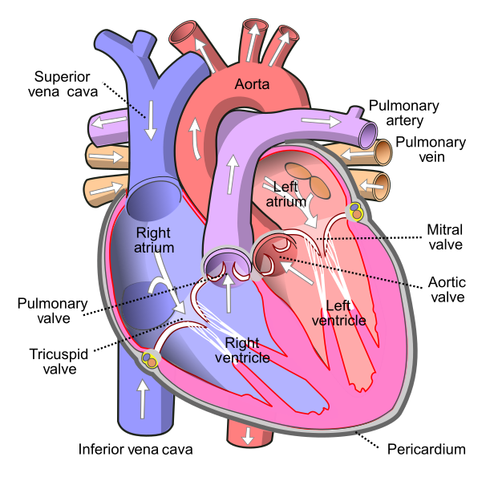

Slide 7
DOUBLE CIRCULATION
Double circulation is an efficient way of circulation as it provides an effective way of circulation.
The main difference is that the blood follows two routes – one for oxygenated blood and the other for deoxygenated blood.
SYSTEMIC CIRCULATION
Systemic circulation carries oxygenated blood from the left ventricles to the tissue capillaries.
The oxygen-rich blood is transferred to the aorta for circulating into various parts of the body.
Later, the veins and venules collect the deoxygenated blood – which is rich in carbon dioxide from various parts of the body.
The deoxygenated blood is pumped back into the superior vena cava and then to the right atrium.
Once after receiving the deoxygenated blood, the right atrium carries blood to the right ventricle for pulmonary circulation.

Slide 8
PULMONARY CIRCULATION
In the pulmonary circulation, the blood circulation starts from the right atrium to the left atrium. In this pathway:
The pulmonary artery collects the blood from the right ventricle and carries to lungs for oxygenation.
Once after the purification process, the oxygenated blood is pumped back to the left atrium through the pulmonary vein which is carried to the left ventricles.
The left ventricles pump the oxygenated blood to the aorta for systemic circulation

Slide 9
Double circulation supports a strict separation of both oxygenated and deoxygenated blood.
Therefore, this circulation ensures that the body always has a dedicated supply of oxygen and also, it improves body efficiency.
This is also one of the reasons why mammals can maintain their body temperatures. Apart from the double circulation, a third portal system also exists to improve circulation efficiency.
HEPATIC PORTAL SYSTEM:
It is the vascular connection between the liver and digestive tract.
The hepatic portal vein collects intestinal blood and transports to the liver followed by systemic
circulation.

Slide 10
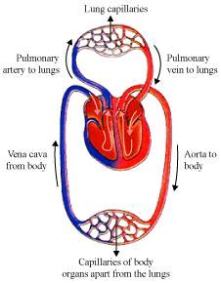

Slide 11
CARDIAC CYCLE
Cardiac cycle refers to the sequence of events that take place when the heart beats
It comprises of diastole, the systole, and the intervening pause.
The occurrence of a cardiac cycle is illustrated by a heart rate, which is naturally indicated as beats per minute.
At the start of the cycle, all the four chambers remain in a relaxed state known as joint diastole
Joint diastole is followed by atrial systole, on the generation of action potential from SAN node.
The action potential then gets transferred to AVN and then to the bundle of His leading to the
contraction of the ventricle, i.e. ventricular systole and at the same time atrial diastole occurs
Ventricular systole causes closure of tricuspid and bicuspid valves. The semilunar valves open resulting
in the flow of blood to vessels in the circulatory pathways.

Slide 12
Ventricular diastole follows with the closure of semilunar valves.
Then bicuspid and tricuspid valves open and the state of joint diastole is achieved once again.
This completes the one full cycle of the cardiac cycle. The SAN generates a new action
potential and the full process repeats.
As the heart beats ~72 times per minute.
Stroke Volume is the amount of blood each ventricle pumps in a cardiac cycle, i.e. 70 ml.
Cardiac Output is the total output of blood from each ventricle in a minute, i.e. stroke
volume multiplied by the no. of heartbeats per minute, which is ~5 L in a healthy
individual.
The cardiac output varies from person to person.
An athlete will have much more cardiac output compared to an ordinary person
In each cardiac cycle, two distinct sounds are produced, ie. ‘lub’ and ‘dub’, which can
be heard using a stethoscope
The cardiac cycle involves a complete contraction and relaxation of both the atria and
ventricles and the cycle lasts approximately 0.8 seconds.

Slide 13
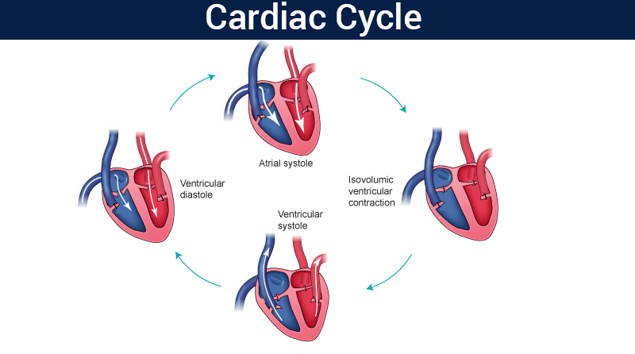

Slide 14
DURATION OF CARDIAC CYCLE
In a normal person, a heartbeat is 72 beats/minute. So, the duration of one cardiac cycle can be calculated as:
1/72 beats/minute=.0139 minutes/beat
At a heartbeat 72 beats/minute, duration of each cardiac cycle will be 0.8 seconds.
Duration of different stages of the cardiac cycle is given below:
Atrial systole: lasts for about 0.1 seconds
Ventricular systole: lasts for about 0.3 seconds
Atrial diastole: lasts for about 0.7 seconds
Ventricular diastole: lasts for about 0.5 seconds

Slide 15
THANKING YOU
ODM EDUCATIONAL GROUP

