Slide 1


ANIMAL KINGDOM
PHYLUM-PLATYHELMINTHES,ASCHELMINTHES, ANNELIDA
SUBJECT : BIOLOGY
CHAPTER NUMBER: 4
CHAPTER NAME : ANIMAL KINGDOM

Slide 2
Characteristics of Platyhelminthes
Platyhelminthes have the following important characteristics:
They are triploblastic, acoelomate, and bilaterally symmetrical.
They may be free-living or parasites.
The body has a soft covering with or without cilia.
Their body is dorsoventrally flattened without any segments and appears like a leaf.
They are devoid of the anus and circulatory system but has a mouth.
They respire by simple diffusion through the body surface.
They have an organ system level of organization.
They do not have a digestive tract.
The space between the body wall and organs is filled with connective tissue which helps in transporting the food material.
They are hermaphrodites, i.e., both male and female organs are present in the same body.
They reproduce sexually by fusion of gametes and asexually by regeneration by fission and regeneration. Fertilization is internal.
The life cycle is complicated with one or more larval stages.
They possess the quality of regeneration.
The flame cells help in excretion and osmoregulation.
The nervous system comprises the brain and two longitudinal nerve cords arranged in a ladder-like fashion.

Slide 3
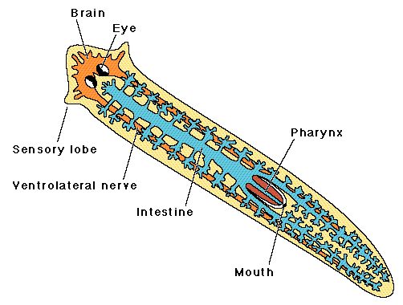
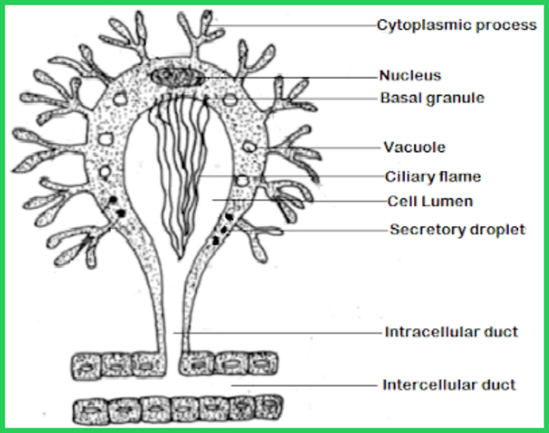
Unique Characteristics of Platyhelminthes
Some of the characteristics that distinguish the organisms belonging to phylum Platyhelminthes from others are:
Presence of flame cells.
Ladder-like nervous system.
Presence of parenchyma in the body cavity.
Self-fertilization
Note : Parenchyma is the tissue made up of cells and intercellular spaces that fills the interior of the body of a flatworm, which is an acoelomate. This is a spongy tissue also known as a mesenchymal tissue, in which several types of cells are lodged in their extracellular matrices.

Slide 4
Parasitic adaptation of Platyhelminthes
Since endoparasites showrestricted movements, thelocomotory organs are generally absent or highly reduced in them. Example: gut parasites such as Fasciola and Taenia.
The presence of attachment organs such as, hooks or suckers for the securely connecting to the organs of the host as in Fasciola and Taenia.
The outer covering of the endoparasite is resistant to the enzymatic digestion of the host. Example: Fasciola
The parasites produce a large number of reproductive bodies such as egg or sperm or cysts than their free-living relatives.Example: e.g., Taenia lays about 35,000 eggs/day., Fasciola hepatica lays about 10,000 eggs/day
Sensory organs are highly reduced in internal parasites since the environmental conditions of endoparasites are relatively constant.
Internal parasites can respire anaerobically in the absence of oxygen or in anaerobic condition.
Reduced digestive system; many internal parasites have the capacity to absorb nutrients through the body surface from host.
.

Slide 5
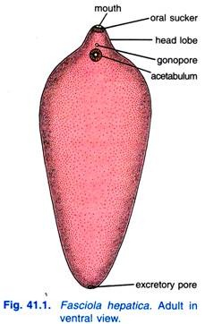
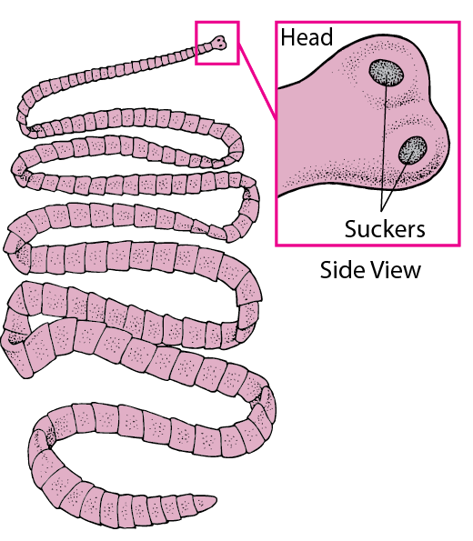
Examples of Platyhelminthes
Fasciola
It is also known as liver fluke since it resides in the liver and bile duct of sheep and goat. It is a hermaphrodite but cross-fertilization takes place.
It causes fascioliasis in animals. In this, the liver of the animal enlarges and the bile ducts are blocked.
Taenia solium
It is also known as the pork tapeworm and is found in all the countries where pork is consumed. They live as parasites in the small intestine of human beings and their larva are found in the muscles of the pigs. It is a hermaphrodite and undergoes self-fertilization.
Taenia solium causes taeniasis where the patient experiences abdominal pain, anaemia, indigestion, restlessness and false appetite.

Slide 6
Characteristics of Aschelminthes
Habitat: They are marine or freshwater animal.
Habit: They are endoparasite. Phylum includes round worms.
Coelom: Pseudocoelomate which means they have a cavity called pseudocoel between the gut and body wall.
Symmetry - bilateral ;Germ layer- triploblastic
Grade of organization: Organ system
They are non-segmented round worm.
Their body is covered with cuticle.
Digestive system: simple type.
The mouth is provided with hooks and suckers. Pharynx is muscular. It is used to suck of food.
Respiratory system and Circulatory system : Absent
Nervous system: poorly developed
Excretory system: Protonephridia and canals
They are unisexual or dioecious animals
Reproduction: sexual by gametic fusion.
Sexual dimorphism is present.Male is smaller than female and curved from its caudal end.Male has Penial spiculas for copulation. Genital tract joins digestive track to form cloaca.Female is larger than male and straight.
Genital track open independently.
Fertilization: internal

Slide 7
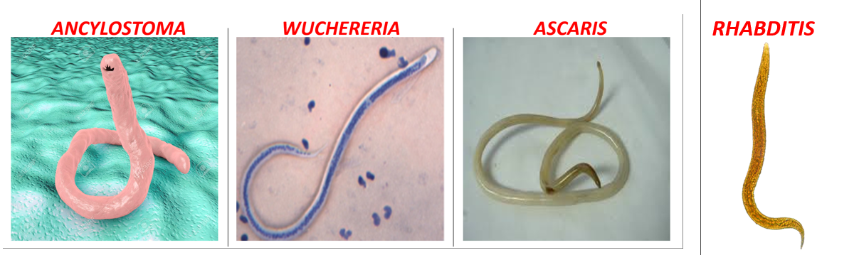
Unique Features
Following are the unique features of aschelminthes :
(i) Syncytial epidermis.
(ii) Muscle layer of body wall consists of longitudinal fibres only.
(iii) Pseudocoel.
Advancement over Flatworms:
(i) Pseudocoel.
(ii) Complete digestive tract.
(iii) Uni­sexual condition.

Slide 8
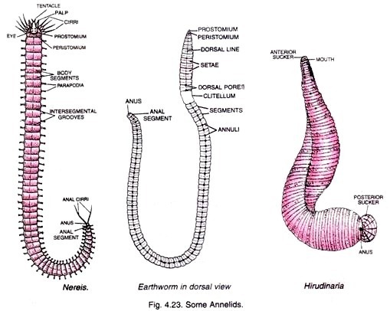
Characteristics of Annelida
Latin anellus, "little ring"
The characteristics of the the Phylum Annelida are as follows:
The Annelids are coelomate and triploblastic.
They exhibit organ level organization.
The body is divided into a numerous segments called the metameres. The segmentation is known as metamerism.
They respire through their body surface.
Nephridia are the excretory organs.
They have a well-developed circulatory and digestive system.
Their body contains haemoglobin, which gives them a red colour.
Nervous system is formed of a pair of cerebral ganglia (brain) and a double ventral nerve cord
Excretory system is formed of segmentally arranged nephridia.
Regeneration is a very common characteristic of the Annelids.
Setae help them in movement.
Hermaphrodite, i.e., male and female organs are present in the same body. They reproduce both sexually and asexually. The others reproduce sexually.Eg., Earthworms, and leeches

Slide 9
Unique Features.
Following are the Unique Features of annelida :
(i) Metameric segmentation.
(ii) Haemoglobin in the plasma.
(iii) Nephridia for excretion and osmoregulation.
(iv) Setae.
Advancement over Roundworms:
(i) Metameric segmentation,
(ii) Circular and longi­tudinal muscles are present in both body wall and the wall of the alimentary canal,
(iii) True coelom,
(iv) Blood vascular system contains red blood.

Slide 10
THANKING YOU
ODM EDUCATIONAL GROUP

