Slide 1


PLANT KINGDOM
BRYOPHYTES-LIVERWORT,MOSSES
SUBJECT : BIOLOGY
CHAPTER NUMBER: 3
CHAPTER NAME : PLANT KINGDOM

Slide 2
CHARACTERISTICS OF BRYOPHYTES
Bryophytes include the various mosses and liverworts that are found commonly growing in moist shaded areas in the hills.
Bryophytes are also called amphibians of the plant kingdom because these plants can live in soil but are dependent on water for sexual reproduction.
They usually occur in damp, humid and shaded localities.
They play an important role in plant succession on bare rocks/ soil.
The plant body of bryophytes is more differentiated than that of algae.
It is thallus-like and prostrate or erect, and attached to the substratum by unicellular or multicellular rhizoids.
They lack true roots, stem or leaves. They may possess root-like, leaf-like or stem-like structures.

Slide 3
CHARACTERISTICS OF BRYOPHYTES
The main plant body of the bryophyte is haploid. It produces gametes, hence is called a gametophyte.
The sex organs in bryophytes are multicellular.
The male sex organ is called antheridium. They produce biflagellate antherozoids.
The female sex organ called archegonium is flask-shaped and produces a single egg.
The antherozoids are released into water where they come in contact with archegonium. An antherozoid fuses with the egg to produce the zygote. Zygotes do not undergo reduction division immediately. They produce a multicellular body called a sporophyte.
The sporophyte is not free-living but attached to the photosynthetic gametophyte and derives nourishment from it.
Some cells of the sporophyte undergo reduction division (meiosis) to produce haploid spores. These spores germinate to produce gametophyte.

Slide 4
DIFFERENCES BETWEEN ANTHERIDIA AND ARCHEGONIA
Antheridia Archegonia
1.They are male organs of bryophytes and pteridophytes. 1.They are female organs of bryophytes,pteridophytes and gymnosperms.
2.Antheridia are generally rounded in outline. 2.Archegonia are usually flask-shaped in outline.
3.Sterile cells are absent inside. 3.Sterile cells occur in the interior of archegonia.
4.An antheridium forms a large number of male gametes. 4.An archegonium encloses a single female gamete.
5.The male gametes produced in an antheridium are usually. 5.The female gamete or egg present in an archegonium motile is usually non-motile.

Slide 5
ECONOMIC IMPORTANCE OF BRYOPHYTES
Bryophytes in general are of little economic importance but some mosses provide food for herbaceous mammals, birds and other animals.
Species of Sphagnum, a moss, provide peat that have long been used as fuel, and because of their capacity to hold water as packing material for trans­shipment of living material.
Mosses along with lichens are the first organisms to colonize rocks and hence, are of great ecological importance. They decompose rocks making the substrate suitable for the growth of higher plants.
Since mosses form dense mats on the soil, they reduce the impact of falling rain and prevent soil erosion.

Slide 6
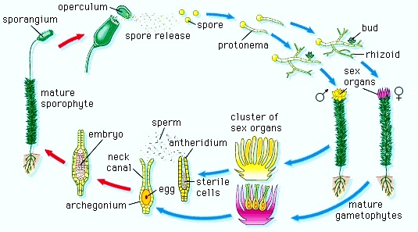
LIFE CYCLE OF BRYOPHYTES
The life cycle of bryophytes consists of two distinct phases - the gametophytic phase and the sporophytic phase.
The haploid gametophyte is dominant, long lived, green and independent whereas the diploid sporophyte is short lived and dependent upon the gametophyte.
The two phases are morphologically distinct.
The gametophytes are either thalloid (i.e., not differentiated into true roots, true stem and true leaves) or leafy shoot having stem-like central axis and leaf-like appendages.
The vascular tissue (xylem and phloem) are completely absent.
The bryophytes are fundamentally terrestrial plants but require presence of water to complete their life cycle.
The water is needed for dehiscence of antheridia, liberation of antherozoids, transfer of antherozoids from antheridia to archegonia, opening of archegonial neck, and the movement of antherozoids into the archegonial neck.

Slide 7
CLASSIFICATION OF BRYOPHYTES
Campbell (1940), Smith (1955), Takhtajan (1953) divided bryophyte, into three classes namely Hepaticae, Anthocerotae and Musci.
Proskauer (1957) changed the names of these classes in accordance with the recommendations of the code, into Hepaticopsida; Anthocerotopsida and Bryopsida.
The Latin word Hepatica means liver. Thus the members of hepticopsida are popularly known as liverworts.
The members of bryopsida are commonly known as mosses.

Slide 8
LIVERWORTS
The liverworts grow usually in moist, shady habitats such as banks of streams, marshy ground, damp soil, bark of trees and deep in the woods.
The plant body of a liverwort is thalloid, e.g., Marchantia. The thallus is dorsiventral and closely appressed to the substrate. The leafy members have tiny leaf-like appendages in two rows on the stem-like structures.
Asexual reproduction in liverworts takes place by fragmentation of thalli, or by the formation of specialised structures called gemmae (sing. gemma).
Gemmae are green, multicellular, asexual buds, which develop in small receptacles called gemma cups located on the thalli. The gemmae become detached from the parent body and germinate to form new individuals.
During sexual reproduction, male and female sex organs are produced either on the same or on different thalli. The sporophyte is differentiated into a foot, seta and capsule.
After meiosis, spores are produced within the capsule. These spores germinate to form free-living gametophytes.

Slide 9
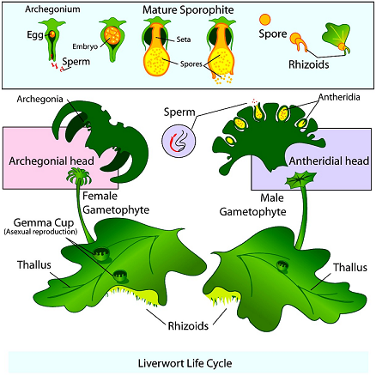
LIVERWORTS

Slide 10
MOSSES
The predominant stage of the life cycle of a moss is the gametophyte which consists of two stages.
The first stage is the protonema stage, which develops directly from a spore. It is a creeping, green, branched and frequently filamentous stage.
The second stage is the leafy stage, which develops from the secondary protonema as a lateral bud.
They consist of upright, slender axis bearing spirally arranged leaves. They are attached to the soil through multicellular and branched rhizoids. This stage bears the sex organs.
Vegetative reproduction in mosses is by fragmentation and budding in the secondary protonema.
In sexual reproduction, the sex organs antheridia and archegonia are produced at the apex of the leafy shoots.
After fertilisation, the zygote develops into a sporophyte, consisting of a foot, seta and capsule.
The capsule contains spores. Spores are formed after meiosis. The mosses have an elaborate mechanism of spore dispersal.
Common examples of mosses are Funaria, Polytrichum and Sphagnum.

Slide 11
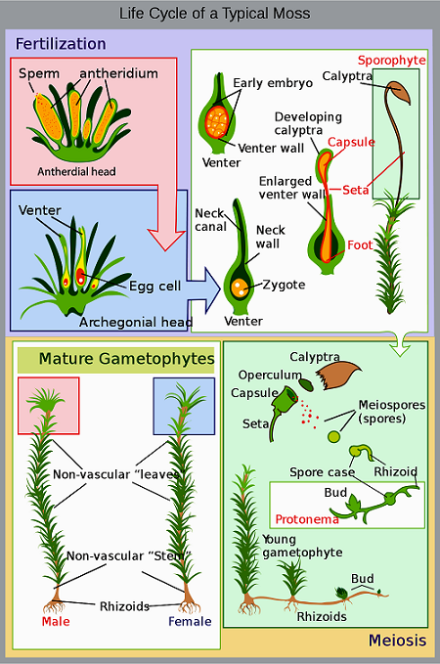
MOSSES

Slide 12
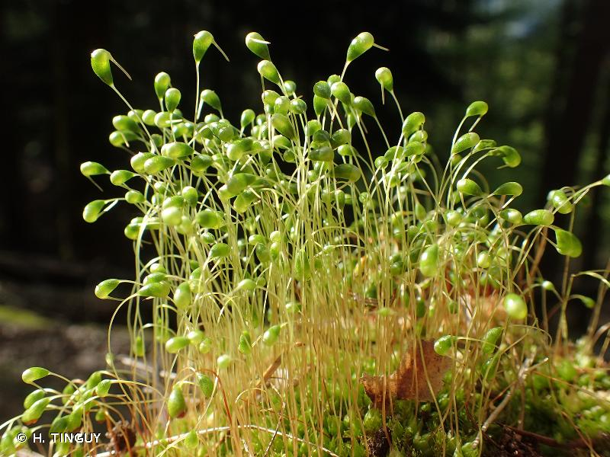
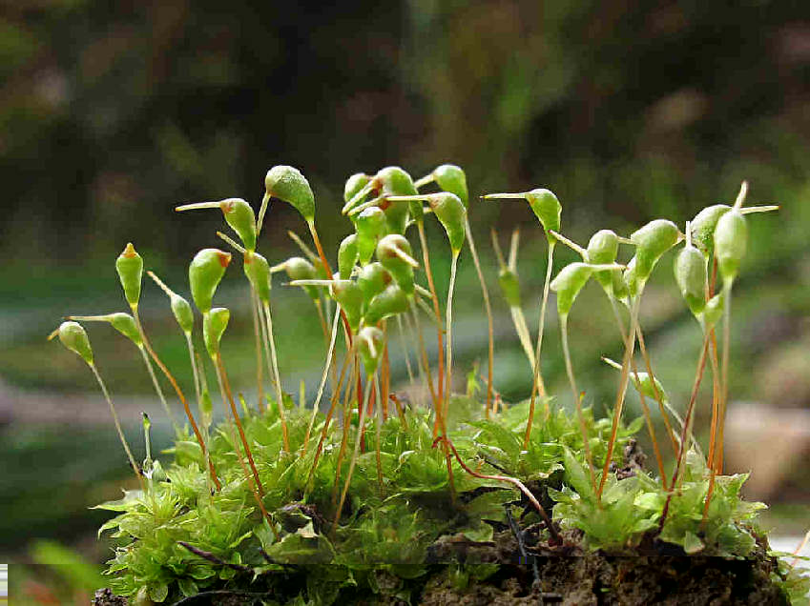
FUNARIA
Funaria is known as common moss or green moss or cord moss.
The main plant body of Funaria is gametophyte and is of two forms.
(1) Juvenile form (creeping protonema)
(2) Adult form (leafy gametophore)
Protonema is the branched filamentous portion which is produced by germination of spores. It is ephemeral or short lived.
Leafy gametophore develop from buds produced on protonema and is made up of axis with spirally arranged leaves. It is 1-3 cm in height, green and is monopodially branched.
The main branch of leafy gametophore bears male reproductive organs, e.g., antheridia and the side branch is female branch.

Slide 13
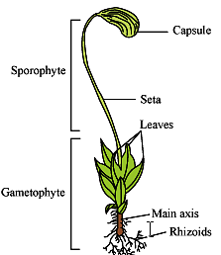
FUNARIA REPRODUCES BOTH BY VEGETATIVE AND
SEXUAL METHODS.
(1) Vegetative reproduction: Vegetative reproduction takes place by fragmentation, primary protonema, secondary protonema, bulbils, gemma and apospory.
(2) Sexual reproduction:
The Funaria plants are monoecious i.e., male (antheridia, club shaped) and female (archegonia, flask shaped) reproductive organs are produced on, the same plant but on different branches. Male organs mature first and hence Funaria plants are Protandrous,
There are two generations in life cycle of Funaria, i.e., gametophytic generation (n) which is independent and complex and sporophytic generation (2n) which is partially dependent upon gametophytic generation.
These two generations follow each other in regular sequence. This is alternation of generations.

Slide 14
THANKING YOU
ODM EDUCATIONAL GROUP

