Slide 1


BIOLOGICAL CLASSIFICATION
KINGDOM PROTISTA
SUBJECT : BIOLOGY
CHAPTER NUMBER:2
CHAPTER NAME : BIOLOGICAL CLASSIFICATION

Slide 2
CHARACTERISTICS OF PROTISTS
Greek word “protistos”, meaning “the very first“.
All Single-celled eukaryotes are placed under Protista, but the boundaries of this kingdom are not well defined.
Members of Protista are primarily aquatic.
This kingdom forms a link with the others dealing with plants, animals and fungi.
Being eukaryotes, the protistan cell body contains a well defined nucleus and other membrane-bound organelles.
Some have flagella or cilia.

Slide 3
CHARACTERISTICS OF PROTISTS
Greek word “protistos”, meaning “the very first“.
Protists reproduce asexually and sexually by, process involving cell fusion and zygote formation.
It may be photosynthetic, holotrophic , saprotrophic , parasitic and symbionts . Some have mixotrophic nutrition (holotrophic + saprotrophic).
The photosynthetic, floating protists are collectively called phytoplankton.
The free-floating, holozoic protozoans are collectively termed zooplankton.
Unicellular protists have been broadly divided in to three major groups:
(a) Photosynthetic Protists : Example: Dinoflagellates , Diatoms, Euglenoids
(b) Consumer Protists : Example: Slime moulds or Myxomycetes
(c) Protozoan Protists: Example: Zooflagellata , Sporozoa , Ciliata

Slide 4
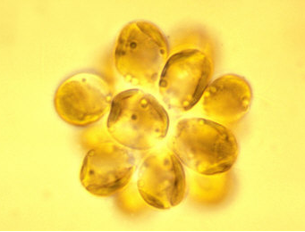
CHRYSOPHYTES
This group includes diatoms and golden algae (desmids).
They are found in fresh water as well as in marine environments.
They are microscopic and float passively in water currents (plankton).
In diatoms the cell walls form two thin overlapping shells, which fit together as in a soap box.
The walls are embedded with silica and thus the walls are indestructible. Thus, diatoms have left behind large amount of cell wall deposits in their habitat; this accumulation over billions of years is referred to as 'diatomaceous earth'.
Being gritty this soil is used in polishing, filtration of oils and syrups.
Diatoms are the chief 'producers' in the oceans.

Slide 5
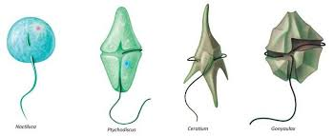
DIANOFLAGELLATES
These organisms are mostly marine and photosynthetic.
They appear yellow, green, brown, blue or red depending on the main pigments present in their cells.
The cell wall has stiff cellulose plates on the outer surface.
Most of them have two flagella; one lies longitudinally and the other transversely in a furrow between the wall plates.
Very often, red dinoflagellates (Example: Gonyaulax) undergo such rapid multiplication that they make the sea appear red (red tides).
Toxins released by such large numbers may even kill other marine animals such as fishes.
Dinoflagellates reproduce asexually through cell division or by the formation of zoospores and cysts..
If sexual reproduction occurs, it is isogamous or anisogamous.

Slide 6
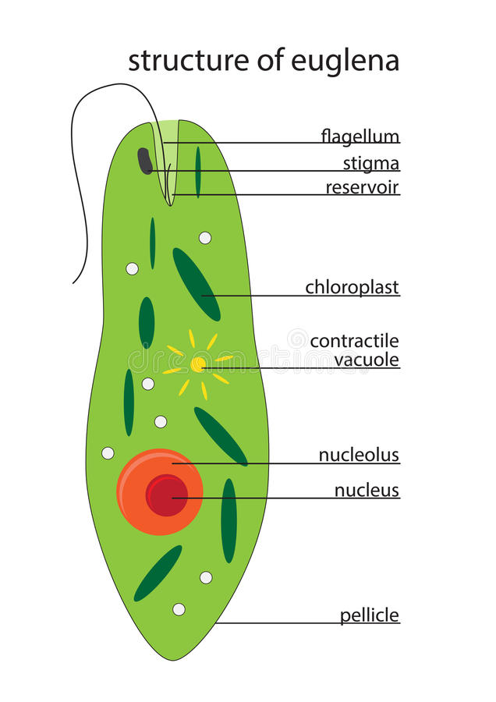
EUGLENOIDS
Majority of them are fresh water organisms found in stagnant water.
Instead of a cell wall, they have a protein rich layer called pellicle which makes their body flexible.
They have two flagella, a short and a long one.
Though they are photosynthetic in the presence of sunlight, when deprived of sunlight they behave like heterotrophs by predating on other smaller organisms. Interestingly, the pigments of euglenoids are identical to those present in higher plants. Example: Euglena. They contain red pigment astaxanthin.
Nutrition is holophytic (photoautotrophic), saprobic (e.g., Rhabdomonas) or holozoic (e.g., Peranema). Even holophytic forms can pick up organic compounds from the outside medium. Such a mode of nutrition is called mixotrophic.
Euglena is a connecting link between animals and plants. Nutrition in Euglena is mixotrophic, when light is available it is photosynthetic, in darkness it is saprophytic absorbing food from surrounding water.

Slide 7
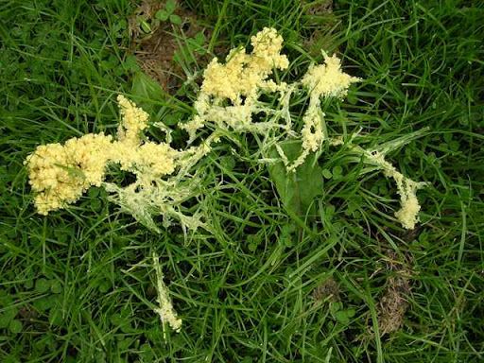
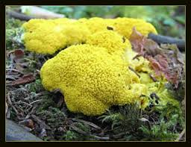
SLIME MOULDS
Slime moulds are saprophytic protists.
The body moves along decaying twigs and leaves engulfing organic material.
Under suitable conditions, they form an aggregation called plasmodium which may grow and spread over several feet.
During unfavourable conditions, the plasmodium differentiates and forms fruiting bodies bearing spores at their tips. The spores possess true walls. The cell wall of spores contain cellulose.
The spores are dispersed by air currents.
They are extremely resistant and survive for many years, even under adverse conditions.
Example- Physarum, Fuligo.
Slime Moulds

Slide 8
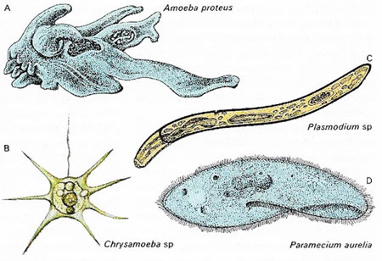
PROTOZOANS
All protozoans are heterotrophs and live as predators or parasites. They are believed to be primitive relatives of animals.
There are four major groups of protozoan
Group 1. Flagellated Protozoans
Characters:
(i) They possess flagella for locomotion.
(ii) They may be free living aquatics, parasites, commensals or symbionts.
(iii) Zooflagellates are generally uninucleate, occasionally multinucleate.
(iv) The body is covered by a firm pellicle.
(v) Nutrition is holozoic, saproboic and parasitic
(vi) Asexual reproduction is by binary fission.

Slide 9
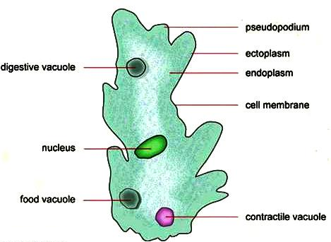
Group 2. Amoebid Protozoans
Characters:
(i) They develop pseudopodia which are temporary protoplasmic outgrowths.
(ii) Pseudopodia are used for locomotion and engulfing food articles.
(iii) Sarcodines are mostly free living, found in fresh water, sea water and on damp soil. Marine forms have silica shells on their surface. Only a few are parasitic.
(iv) The body may be covered with plasmalemma or a shell.
(v) These organisms live in fresh water, sea water or moist soil.
Examples: Amoeba , Entamoeba .

Slide 10
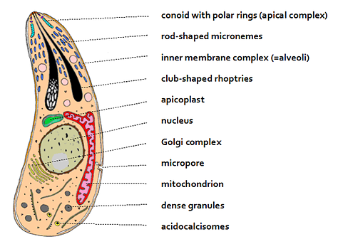
Group 3. Sporozoans
Characters:
(i) All sporozoans are endoparsites.
(ii) Some sporozoans such as Eimeria cause severe diseases like coccidiosis in the birds.
(iii) Locomotory organelles (cilia, flagella , pseudopodia etc.) are absent.
(iv) Nutrition is parasitic (absorptive).
(v) The body is covered with an elastic pellicle or cuticle.
(vi) Contractile vacuoles are absent.
(vii) Asexual reproduction occurs through syngamy.
(ix) Life cycle consists of two distinct asexual and sexual phases. They may be passed in one (monogenetic) or two different hosts (digenetic).
Examples:Plasmodium, monocystis.
Monocystis: Monocystis live as endoparasite in the coelomic epithelial cells and seminal vesicles of earthworm. The fertility of the earthworm is not greatly impaired, since most of the seminal vesicles are not haemorrhage.

Slide 11
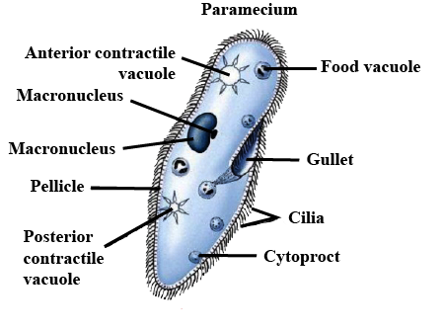
Group 4. Ciliated Protozoans
Characters:
(i) Ciliates are protozoan protists which develop a number of cilia during a part or whole of the life cycle.
(ii) Cilia are used for locomotion and driving food.
(iii) There is a high degree of morphological and physiological specialization.
(iv) Most ciliates are free living individuals in fresh and marine waters. A few are parasitic.
(v) The body is covered by a pellicle.
(vi) Nutrition is holozoic except in the parasitic forms.
(vii)There are definite regions for ingestion and egestion. The region of ingestion consists of an oral groove, cytostome (mouth) and gullet.
Examples: Paramecium, Vorticella.
Paramecium- The slipper organism or slipper Animalcule. Paramecium is a free living ciliate which is found in fresh water. Most widely distributed species are Paramecium caudatum and Paramecium aurelia. Bacteria are its chief feed. Paramecium is a surface feeder. Pellicle maintains the shape. The cilia of the extreme posterior end longer and form a bunch called caudal tuft.

Slide 12
THANKING YOU
ODM EDUCATIONAL GROUP

