Slide 1


THE LIVING WORLD
HERBARIUM,BOTANICAL GARDENS,MUSEUM,ZOOLOGICAL PARKS,KEY
SUBJECT : BIOLOGY
CHAPTER NUMBER: 01
CHAPTER NAME :THE LIVING WORLD

Slide 2
TAXNOMIC AIDS
Taxonomic Aids:- Techniques, procedures and stored information that are useful in identification and classification of organisms are called taxonomic aids.
Study of various species of plants, animals and other organisms are useful in agriculture, forestry, industry, etc.
These studies are useful to know about our bioresources and their diversity.
These help in identification, naming, and classification of organisms.
Following are the taxonomical aids :
Herbarium,
Botanical gardens,
Museum,
Zoological parks,
Key.

Slide 3
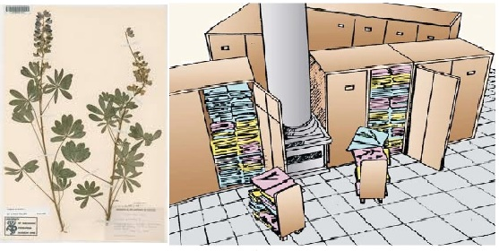
1. HERBARIUM
○ Herbarium is the storehouse of plant specimens.
○ Specimens are dried, pressed, and preserved on sheets.
○ These sheets are arranged systematically according to the universally accepted system of
classification.
○ Herbarium sheet contains information about date and place of the collection, collector’s name, local and scientific name, family, etc.
○ It provides quick referral systems in taxonomical studies.

Slide 4
2. BOTANICAL GARDENS
○ A botanical garden is a place where plants are grow and displayed for the
purposes of research and education.
○ Each plant contains labels indicating their scientific name and family.
Some famous botanical gardens:
○ Indian Botanical Garden, Calcutta
○ National Botanical Research Institute, Lucknow.
○ Garden of Medicinal Plants, North Bengal University, West Bengal
Royal botanical garden, Kew (London)

Slide 5
3. MUSEUM
○ Museum is the place of collection of preserved plant plant and animal specimens for study andreference.
○ Specimens are preserved in containers or jars in preservative solutions and can be preserved as dry also.
○ Insects are preserved in insect boxes after collecting, killing, and pinning.
○ Large animals are stuffed and preserved.

Slide 6
4. ZOOLOGICAL PARKS
○ Zoological park is the place where wild animals are protected under similar to their natural habitat.
○ It provides opportunity for studying the behaviour and food habits of the animals.
Some famous Zoo in India:
○ Zoological Park, Mysore
○ Nehru Zoological Park, Hyderabad
○ Trivandrum Zoo
○ Chennai Zoo
The Role of Zoological Parks In Wildlife Conservation
The regular zoo movement in India began in the year 1885 when the first zoo was set up in Chennai. In the Zoological Park animals enjoy protection, fine sun shine, fresh air and above all ample open space to play about. They have now become repositories of threatened wild life and a store house of the knowledge on animal behavior, their breeding habit, etc. zoological park is the place where they are assured of food, medical care and treatment and where they also feel safe from their natural enemies. Zoological Parks are very useful in spreading knowledge on the wildlife wealth of the country.

Slide 7
5. KEY
○ Keys are used for identification of plants and animals based on similarities and dissimilarities.
○ Keys are analytical in nature and based on contrasting characters in a pair called couplet.
○ Out of two proposed characters, only one which is relevant is accepted while the other is rejected.
○ Each statement in a key is called a lead.
○ Separate taxonomic keys are required for each taxonomic category such as family, genus, order, etc.

Slide 8
OTHER TAXONOMICAL AIDS
○ Flora, manuals, monographs, and catalogues are other taxonomical aids.
○ They help in correct identification
○ Manuals provide information for identification of names of various species in a given area.
○ Monograph contain information on any particular taxon.

Slide 9
THANKING YOU
ODM EDUCATIONAL GROUP

