Slide 1


SUBJECT:BIOLOGY
CHAPTER:4
CHAPTER NAME: ECOSYSTEMS
PERIOD-3

Slide 2
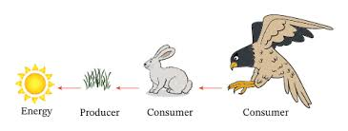
FOOD CHAINS
The sequence of transfers of matter and energy in the form of food from organism to organism.

Slide 3
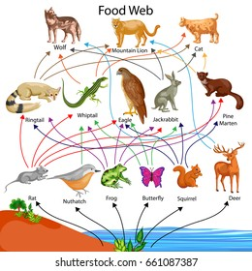
FOOD WEBS
A food chain is a series of organisms that eat one another so that energy and nutrients flow from one to the next.

Slide 4
ADVANTAGES OF FOOD WEBS
Permit alternative foods.
Ensures a better chance of survival of an organism
Provides more stability to an ecosystem than a food chain.

Slide 5
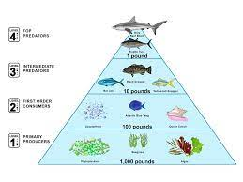
FOOD PYRAMIDS
More commonly known as an energy pyramid, a food pyramid takes the food chain but uses it to show how energy moves through a community.

Slide 6
https://www.youtube.com/watch?v=rC8TwL49RFA

Slide 7
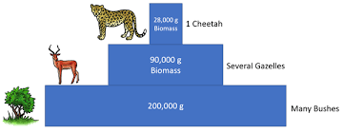
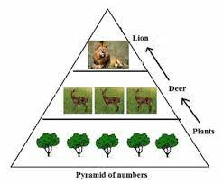
PYRAMID OF NUMBERS AND PYRAMID OF BIOMASS.

Slide 8
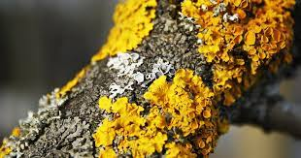
SYMBIOSIS
Symbiosis is the combination of two Greek words 'Sym' means 'with' and 'biosis' means 'living', which means living together. In symbiosis or mutualism two different types of organisms live and work together for their mutual benefit from each other.

Slide 9
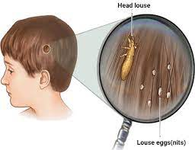
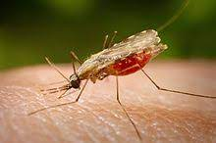
PARASITISM
Parasitism, relationship between two species of plants or animals in which one benefits at the expense of the other, sometimes without killing the host organism.

Slide 10
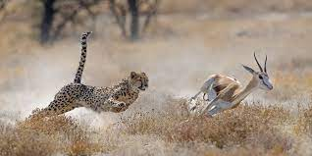
PREDATION
Predation is a biological interaction where one organism, the predator, kills and eats another organism, its prey.

Slide 11
FLORA AND FAUNA
The word "flora" refers to the plants occurring within a given region as well as to the publication of scientific descriptions of those plants.
Animals, especially the animals in a particular area, can be referred to as fauna .

Slide 12
TROPICAL RAIN FOREST
Flora-evergreen trees, bamboos, ferns, shrubs.
Fauna- jungle cats, leopards, monkeys, flying squirrels , snakes, centipeds, millipedes, many insects, snails etc.

Slide 13
TEMPORATE DECIDUOUS FOREST
Flora- teak, sandalwood ,sal
Fauna-moths, beetles, deer, wolves,foxes

Slide 14
CONIFEROUS FORESTS
Flora-fir and pine trees
Fauna-squirrel,deer,goat,wolves, robin ,sparrow

Slide 15
GIR FORESTS
Flora-peepal, acacia,neem
Fauna- crows , kites, cat, rat ,dog,vultures

Slide 16
JIM CORBETT NATIONAL PARK
Flora- pine
Fauna- tiger

Slide 17
JALADPARA SANCTUARY
Flora-banyan trees
Fauna- rhinoceros.

Slide 18
RISKS TO ECOSYSTEM
burning of fossil fuels.
deforestation.
hunting of animals,poaching,etc.
wastage of water.

Slide 19
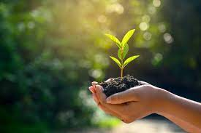
ECOSYSTEM CONSERVATION
(i) Forest should be reserved and more and trees should be planted across the region especially in those areas where deforestation takes place.
(ii) Wildlife must be protected by enacting laws and creating awareness among people.
(iii) Starting various projects to save endangered species of plants and wildlife

Slide 20
THANKING YOU
ODM EDUCATIONAL GROUP.

