Slide 1


SUBJECT:BIOLOGY
CHAPTER:6
CHAPTER NAME: THE CIRCULATORY SYSTEM.
PERIOD-3

Slide 2
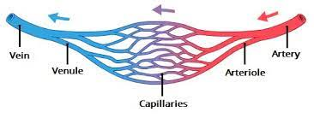
Blood vessels

Slide 3
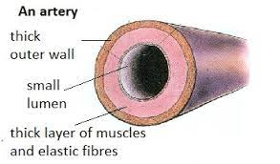
arteries

Slide 4
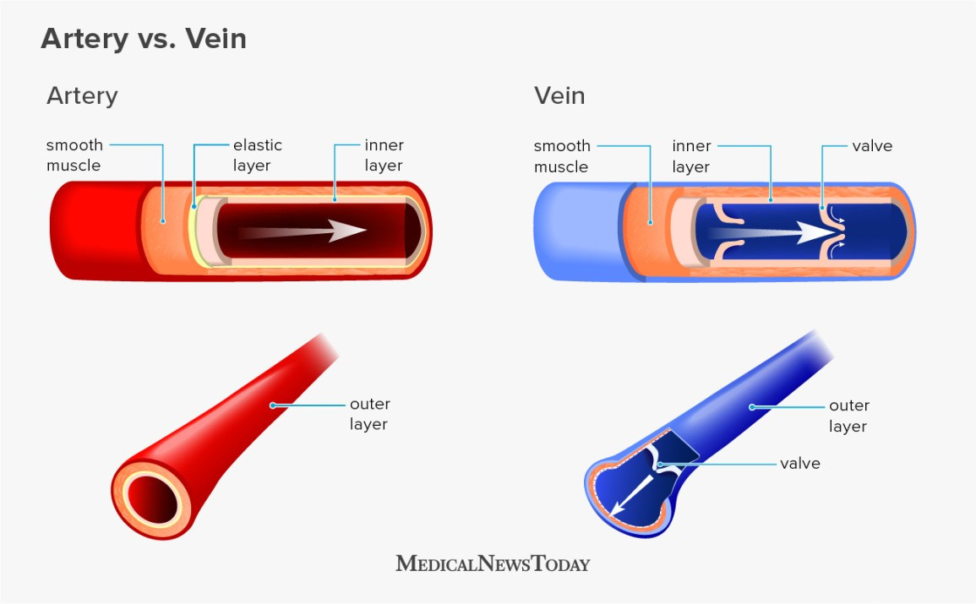
veins

Slide 5
https://www.youtube.com/watch?v=g68QzDBZmjE

Slide 6
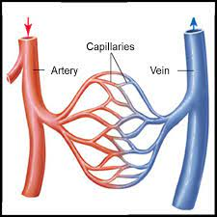
capillaries

Slide 7
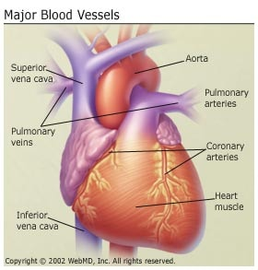

Slide 8
THANKING YOU
ODM EDUCATIONAL GROUP.

