Slide 1


REPRODUCTION IN HUMANS
SUBJECT:BIOLOGY
CHAPTER:3
ASEXUAL REPRODUCTION
PERIOD-1

Slide 2
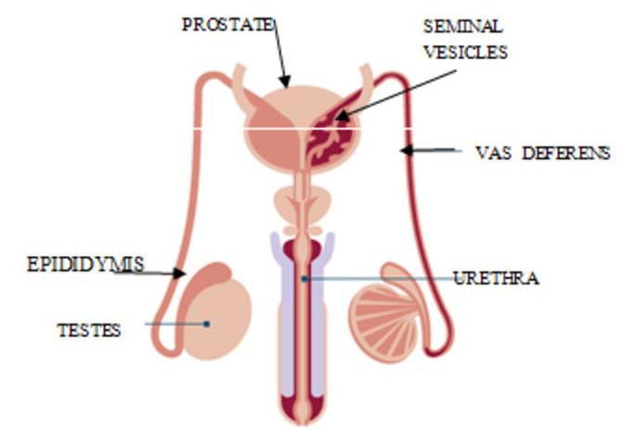

Male Reproductive System:

Slide 3
Male Reproductive System:
The male reproductive system in human beings is composed of following parts:
a-Testis:
There is a pair of testes; which lie in a skin pouch; called scrotum.
Scrotum is suspended outside the body; below the abdominal cavity.
This helps in maintaining the temperature of testes below the body temperature.
This is necessary for optimum sperm production.
Sperms are the male gametes.
Apart from that, testis also produces testosterone.
Testosterone is also called the male hormone, as it is responsible for developing certain secondary sexual characters in boys.

Slide 4
b- epididymis
It is highly coiled structure found on the upper side of the testes.
i- site of sperm maturation : about 10-14 days are required for the sperm to mature.
ii- store mature sperm: sperms may remain in storage for up to 4 weeks .After that they are expelled from the epididymis or reabsorbed.

Slide 5
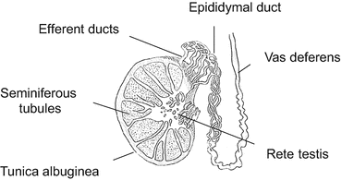
c-Vas Deferens:
Vas deferens is the tube which carries sperms to the seminal vesicle.

Slide 6
d-Seminal Vesicle:
This is the place where sperms are stored.
it provide alkaline substances which contains carbohydrate, proteins and hormones
Carbohydrates provides the energy source for the sperms
Protein helps in sperm coagulation.
Alkaline nature of the fluid protect the sperm from acidic condition.

Slide 7
e – prostate gland
It is present at the base of the urinary bladder which encircling the urethra
It secretes thin , alkaline ,milky substances which contributes to sperm motility and viability.

Slide 8
f- cowper’s glands
It is located under the prostate gland
It secretes the mucus which lubricates the end of the penis during sexual intercourse.

Slide 9
g-Penis:
It is a muscular organ
It carries urine.
Transfers the sperm in to the female body.

Slide 10
semen
Semen is a mixture of sperm and the secretions of seminal vesicles, prostate gland ,and Cowper's gland
It is a milky white fluid.
A single ejaculation contains 2-3 ml semen.
A single ejaculation contains 20,000,000 – 40,000,000 sperms.

Slide 11
THANKING YOU
ODM EDUCATIONAL GROUP.

