Slide 1


REPRODUCTION IN PLANTS .
SUBJECT:BIOLOGY
CHAPTER:2
ARTIFICIAL VEGETATIVE PRODUCTION
PERIOD-3

Slide 2

LEARNING OBJECTIVE
Student will be able to understand the meaning of life processes.
Student will be familiarized with the mechanism of nutrition, respiration, transportation, and excretion.
They will be able to analyze various types of nutrition .
Learners will be sensitized about the difference between prokaryotes and eukaryotes.

Slide 3
WARM UP QUESTIONS
Define living and nonliving.
Categorize the single celled and multi-celled organisms.
Identify the single celled, multi-celled organisms.
list the categories of living and non-living organisms.

Slide 4
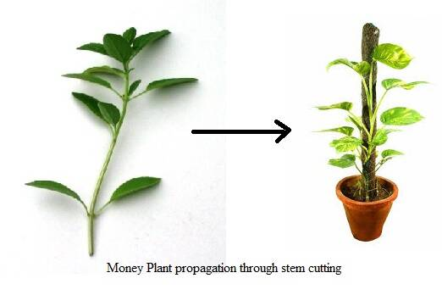
Artificial Vegetative Propagation
Cutting
Cutting is removing a part of the stem and planting it into the soil to allow the growth of roots and buds.
Example: Sugarcane, rose, china rose, pears.

Slide 5
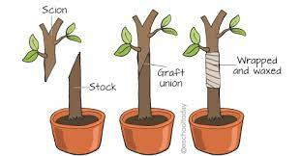
Grafting:
A small branch is cut from the plant to be grown with a wedge-shaped end. This is called scion. Now a V-shaped cut is made in the stem of a rooted called stock. The scion is now fitted into the stock and they are taped together. Soon the graft becomes part of the rooted plant.

Slide 6
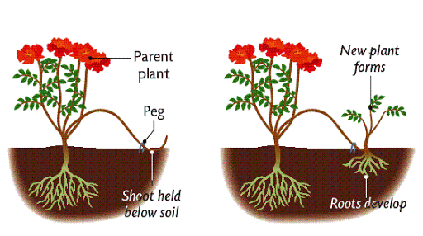
Layering:
The lower branch of a plant is selected and a ring of the bark is removed from the stem. The portion where the bark is removed is bent and covered with soil. The branch is kept covered with the soil for a few days during which new roots start to develop on the branch. The branch is then cut off from the parent plant and allowed to grow as an individual plant.Example: Hibiscus, jasmine, rose, bougainvillea

Slide 7
Grafting:
A small branch is cut from the plant to be grown with a wedge-shaped end. This is called scion. Now a V-shaped cut is made in the stem of a rooted called stock. The scion is now fitted into the stock and they are taped together. Soon the graft becomes part of the rooted plant.

Slide 8
https://www.youtube.com/watch?v=LB6aJLJ5JmE

Slide 9
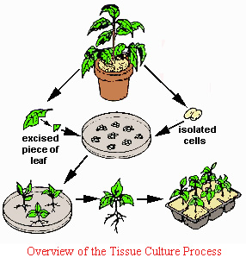
Tissue Culture:
Tissue culture is one of the ways of cloning plants. It works with small pieces of plants, called explants
The technique of developing new plants from a cell or tissue in a nutrient medium under aseptic conditions. The cell or tissue is placed in a nutrient medium where it forms a mass of cells called callus. This callus is then transferred to another nutrient medium where it differentiates and forms a new plant.

Slide 10
Benefits of plant tissue culture technique.
The new plantlets can be grown in a short amount of time.
Only a small amount of initial plant tissue is required.
The new plantlets and plants are more likely to be free of viruses and diseases.
The process is not dependant on the seasons and can be done throughout the year.

Slide 11
Exercise short Question No-4 and Long Answer Question No- 7

Slide 12
THANKING YOU
ODM EDUCATIONAL GROUP.

