Slide 1


CHEMICAL CONTROL AND INTEGRATION
THYROID GLAND AND PARATHYROID
SUBJECT : BIOLOGY
CHAPTER NUMBER: 22
CHAPTER NAME : CHEMICAL CONTROL AND INTEGRATION

Slide 2
THYROID GLAND
The thyroid gland is composed of two lobes which are located on either side of the trachea.
Both the lobes are interconnected with a thin flap of connective tissue called isthmus.
The thyroid gland is composed of follicles and stromal tissues.
Each thyroid follicle is composed of follicular cells, enclosing a cavity.
These follicular cells synthesise two hormones, tetraiodothyronine or thyroxine (T ) and triiodothyronine (T ).
Iodine is essential for the normal rate of hormone synthesis in the thyroid.
Deficiency of iodine in our diet results in hypothyroidism and enlargement of the thyroid gland, commonly called goitre.

Slide 3
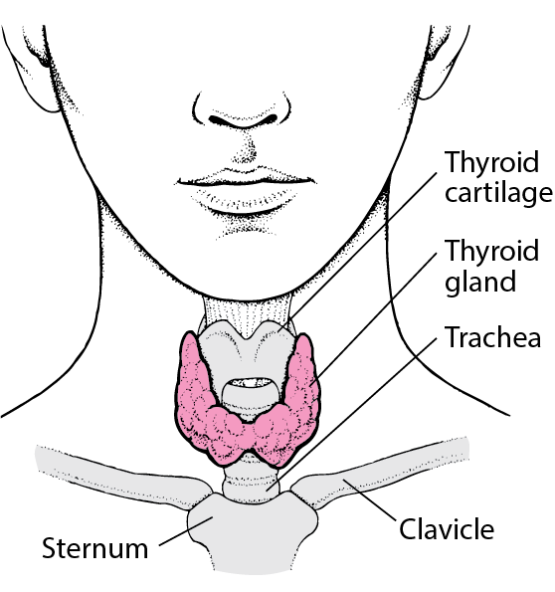

Slide 4
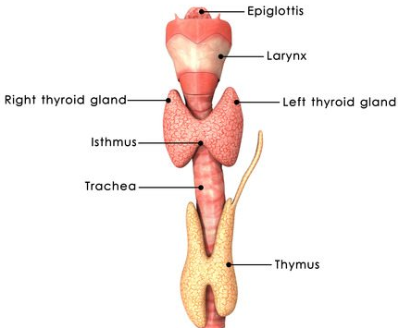

Slide 5
Hypothyroidism during pregnancy causes defective development and maturation of the growing baby leading to stunted growth (cretinism), mental retardation, low intelligence quotient, abnormal skin, deaf-mutism, etc.
In adult women, hypothyroidism may cause menstrual cycle to become irregular.
Due to cancer of the thyroid gland or due to development of nodules of the thyroid glands, the rate of synthesis and secretion of the thyroid hormones is increased to abnormal high levels leading to a condition called hyperthyroidism which adversely affects the body physiology.
THYROID GLAND

Slide 6
Exopthalmic goitre is a form of hyperthyroidism, characterised by enlargement of the thyroid gland, protrusion of the eyeballs, increased basal metabolic rate, and weight loss, also called Graves’ disease.
Thyroid hormones play an important role in the regulation of the basal metabolic rate.
These hormones also support the process of red blood cell formation.
Thyroid hormones control the metabolism of carbohydrates, proteins and fats.
Maintenance of water and electrolyte balance is also influenced by thyroid hormones.
Thyroid gland also secretes a protein hormone called thyrocalcitonin (TCT) which regulates the blood calcium levels.

Slide 7
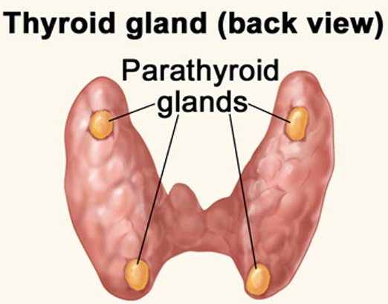
PARATHYROID GLAND

Slide 8
PARATHYROID GLAND
In humans, four parathyroid glands are present on the back side of the thyroid gland, one pair each in the two lobes of the thyroid gland.
The parathyroid glands secrete a peptide hormone called parathyroid hormone (PTH).
The secretion of PTH is regulated by the circulating levels of calcium ions.
Parathyroid hormone (PTH) increases the calcium level in blood.

Slide 9
PTH acts on bones and stimulates the process of bone resorption (dissolution/
demineralisation).
PTH also stimulates reabsorption of calcium by the renal tubules and increases calcium absorption from the digested food. It is, thus, clear that PTH is a hypercalcemic hormone, i.e., it increases the blood calcium levels.
Along with TCT, it plays a significant role in calcium balance in the body.
PARATHYROID GLAND

Slide 10
THANKING YOU
ODM EDUCATIONAL GROUP

