Slide 1


COAGULATION OF BLOOD,LYMPH,CIRCULATORY PATHWAY
BLOOD CLOTTING CASCADE,COMPOSITION OF LYMPH,OPEN CIRCULATORY SYSTEM,CLOSED CIRCULATORY SYSTEM
SUBJECT : BIOLOGY
CHAPTER NUMBER:18
CHAPTER NAME :CIRCULATION AND BODY FLUID

Slide 2
BLOOD CLOTTING
Blood Coagulation is the process of forming a clot or thrombus in order to prevent excess loss of blood from the body.
It is a gel-like mass which is formed by the platelets and fibrin in the blood.
When an injury is caused to a blood vessel bleeding starts which is stopped by a process called blood clotting.
An injury or trauma stimulates the platelets in the blood to release certain factors that activate the mechanism of coagulation.
Calcium playS important role in blood clotting

Slide 3
PROCESS OF BLOOD COAGULATION
The mechanism which helps the body in order to prevent itself from constant loss of blood is known as hemostasis.
The entire process is divided here into three major steps:
The primary hemostasis involves the process of vasoconstriction in response to the injury of the body in the vascular wall.
Once injured, the vascular walls react immediately by reducing the amount of blood flow in the infected area.
Next, the platelets play a key role in covering the injured area to stop the bleeding. They also activate a process which forms a fibrin clot known as the secondary hemostasis. This leads to release of stored granules content which includes ADP and thromboxane which results in further activation of platelets in the blood plasma.

Slide 4
PROCESS OF BLOOD COAGULATION
Since the platelets alone could not secure the damages caused in the vessel walls, thus a blood clot should be formed necessarily. This formation of the blood clots depends on several clotting factors which activate each other in the clotting cascade.
This cascade results in the formation of fibrinogen, which is a soluble plasma protein.
These fibrin proteins finally stick together to form a clot.
If the protein comprises of platelets only, it is termed white thrombus and if the red blood cells are present, it is called red thrombus.

Slide 5
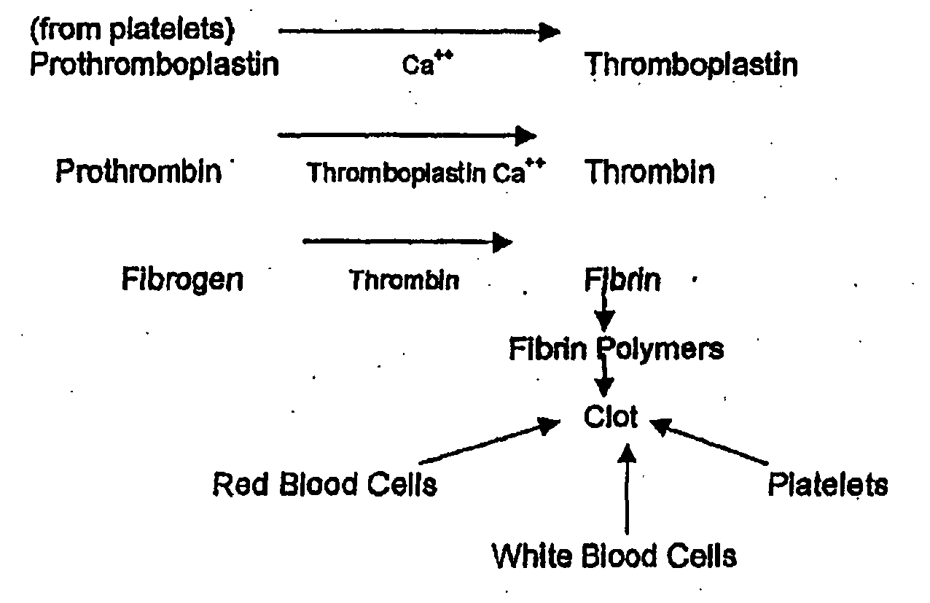
CLOTTING CASCADE

Slide 6
LYMPH
Lymph is a clear to pale-white fluid which circulates throughout the lymphatic system.
The main role of the lymphatic system is to act as a filter against microbes, organic wastes and other debris.
COMPOSITION OF LYMPH
Lymph Plasma
It consists of less calcium, few blood proteins, less phosphorus, and high glucose concentration.
Globulin proteins which are actual antibodies are found in lymph plasma.
Other substances include organic and inorganic substances.
Lymph Corpuscles
These comprise leucocytes and amoeboid cells

Slide 7
OTHER COMPONENTS OF LYMPH
Carbohydrates
Lymphocytes
Creatinine
Water – 94%
Urea
Chlorides
Enzymes
Very low amount of fat
Proteins – Albumin, globulin, and fibrinogen
Non-protein nitrogenous substances.

Slide 8
TYPES OF CIRCULATORY SYSTEMS
Circulatory system is of two types:
Open Circulatory system.
Closed circulatory system.
Open Circulatory System- Blood flows through parts of the body cavity, and not in closed vessels. This system is commonly found in insects, invertebrates except annelids.
Closed Circulatory System- Blood flows through closed tube-like vessels under sufficiently high pressure. This system is found in all the vertebrates and annelids

Slide 9
THANKING YOU
ODM EDUCATIONAL GROUP

