Slide 1


MECHANISM OF BREATHING,EXCHANGE OF GASES
STEPS OF RESPIRATION,INSPIRATION,EXPIRATION,RESPIRATORY VOLUME AND CAPACITIES
SUBJECT : BIOLOGY
CHAPTER NUMBER:17
CHAPTER NAME :BREATHING AND EXCHANGE OF GASES

Slide 2
STEPS OF RESPIRATION
Breathing is a process in which Oxygen rich atmospheric air is diffused in and Carbon dioxide rich alveolar air is diffused out.
Diffusion of gases across alveolar membrane.
Transport of gases through blood.
Diffusion of oxygen and Carbon dioxide between blood and tissues.
Utilization of oxygen by cells to obtain energy and release of Carbon dioxide (cellular respiration)

Slide 3
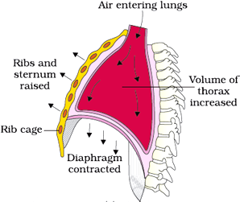
MECHANISIM OF BREATHING
Inspiration and expiration
Breathing involves inspiration and expiration. During inspiration atmospheric air is drawn in and during expiration, alveolar air is released out.
Movement of air in and out takes place due to difference in pressure gradient.
Inspiration occurs when pressure inside the lung is less and expiration occurs when pressure is more in lungs than outside.
The diaphragm and external and internal intercostal muscles between the ribs help in developing pressure gradient due to change in volume.

Slide 4
RESPIRATORY VOLUME
Tidal volume (TV) – volume of air inspired or expired during a normal respiration. It is about 500mL in healthy man.In 1 minute we exchange around 6000ml air.
Inspiratory Reserve Volume (IRV) – additional volume of air a person can inspire by forceful inspiration. It is about 2500 mL to 3000mL.
Expiatory Reserve Volume (ERV) – additional volume of air a person can expire by forceful expiration. It is about 1000 mL to 1100mL.
Residual Volume (RV) – volume of air remaining in lungs even after a forcible expiration. It is about 1100mL to 1200mL.

Slide 5
RESPIRATORY CAPACITIES
Inspiratory Capacity (IC): Total volume of air a person can inspire after a normal expiration, which includes tidal volume and inspiratory reserve volume ( TV+IRV).
Expiratory Capacity (EC): Total volume of air a person can expire after a normal inspiration, which includes tidal volume and expiratory reserve volume (TV+ERV).
Functional Residual Capacity (FRC): Volume of air that will remain in the lungs after a normal expiration, which includes ERV+RV.
Vital Capacity (VC): The maximum volume of air a person can breathe in after a forced expiration, which includes ERV, TV and IRV.
Total Lung Capacity: Total volume of air accommodated in the lungs at the end of a forced inspiration, which includes RV, ERV, TV and IRV.

Slide 6
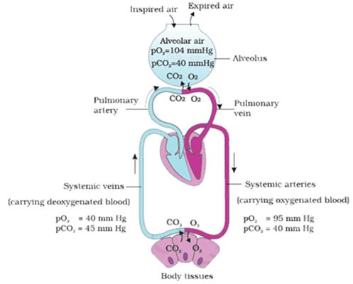

Slide 7
EXCHANGE OF GASES
Exchange of gases takes place at two sites
Alveoli to blood
Between blood and tissues.

Slide 8
EXCHANGE OF GASES
Alveoli are the primary sites of exchange of gases.
O₂ and CO₂ are exchanged in these sites by simple diffusion mainly based on pressure/concentration gradient.
Pressure contributed by an individual gas in a mixture of gases is called partial pressure and is represented as pO₂ for oxygen and pCO₂ for carbon dioxide.
A gradient is present for CO₂ in the opposite direction, i.e., from tissues to blood and blood to alveoli.
As the solubility of CO₂ is 20-25 times higher than that of O₂, the amount of CO₂ that can diffuse through the diffusion membrane per unit difference in partial pressure is much higher compared to that of O₂.
The diffusion membrane is made up of three major layers
1.the thin squamous epithelium of alveoli,
2. the endothelium of alveolar capillaries
3. the basement substance in between them.
All the factors in our body are favourable for diffusion of O₂ from alveoli to tissues and that of CO₂ from tissues to alveoli.

Slide 9
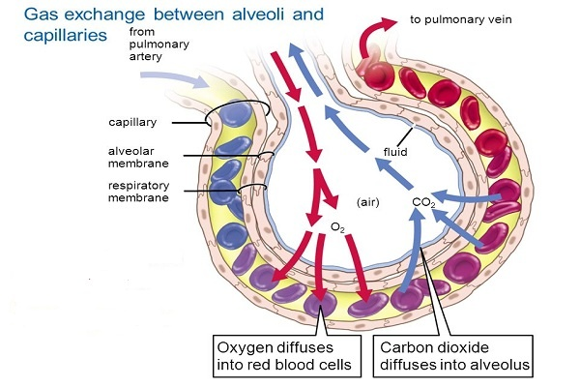

Slide 10
THANKING YOU
ODM EDUCATIONAL GROUP

