Slide 1


MORPHOLOGY OF FLOWERING PLANTS
LEAF,INFLORESCENCE AND FLOWER
SUBJECT : BIOLOGY
CHAPTER NUMBER:05
CHAPTER NAME :MORPHOLOGY OF FLOWERING PLANTS

Slide 2
THE LEAF
The leaf is a lateral, generally flattened structure borne on the stem.
It develops at the node and bears a bud in its axil. The axillary bud later develops into a branch.
Leaves originate from shoot apical meristems and are arranged in an acropetal order.
They are the most important vegetative organs for photosynthesis.

Slide 3
LEAF STRUCTURE
A typical leaf consists of three main parts: leaf base, petiole and lamina.
The leaf is attached to the stem by the leaf base and may bear two lateral small leaf like structures called stipules.
In monocotyledons, the leaf base expands into a sheath covering the stem partially or wholly.
In some leguminous plants the leaf base may become swollen, which is called the pulvinus.
The petiole help hold the blade to light. Long thin flexible petioles allow leaf blades to flutter in wind, thereby cooling the leaf and bringing fresh air to leaf surface.

Slide 4
LEAF STRUCTURE
The lamina or the leaf blade is the green expanded part of the leaf with veins and veinlets.
There is, usually, a middle prominent vein, which is known as the midrib.
Veins provide rigidity to the leaf blade and act as channels of transport for water, minerals and food materials.
The shape, margin, apex, surface and extent of incision of lamina varies in different Leaves.

Slide 5
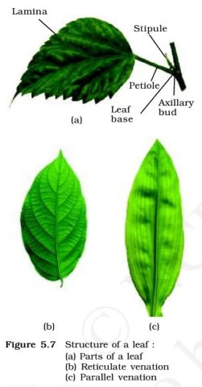

Slide 6
LEAF VENATION
The arrangement of veins and the veinlets in the lamina of leaf is termed as venation.
When the singlets form a network, the venation is termed as Reticulate.
When the veins run parallel to each other within a lamina, the venation is termed as parallel.
Leaves of dicotyledonous plants generally possess reticulate venation, while parallel venation is the characteristic of most monocotyledons.

Slide 7
TYPES OF LEAF
SIMPLE LEAF
A leaf is said to be simple, when its lamina is entire or when incised, the incisions do not touch the midrib.
A bud is present in the axil of petiole in both simple and compound leaves, but not in the axil of leaflets of the compound leaf.

Slide 8
COMPOUND LEAF
When the incisions of the lamina reach up to the midrib breaking it into a number of leaflets, the leaf is called compound.
The compound leaves may be of two types
(i) In a pinnately compound leaf a number of leaflets are present on a common axis, the rachis, which represents the midrib of the leaf as in neem.
(ii) In palmately compound leaves, the leaflets are attached at a common point, i.e., at the tip of petiole, as in silk cotton.

Slide 9
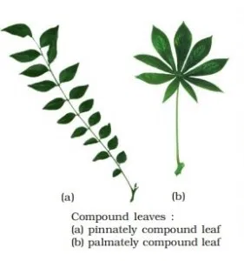
LEAF STRUCTURE

Slide 10
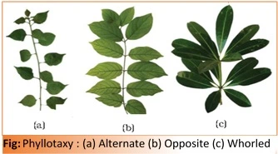
PHYLLOTAXY

Slide 11
MODIFICATION OF LEAF
Leaves are often modified to perform functions other than photosynthesis.
They are converted into tendrils for climbing as in peas or into spines for defence as in cacti.
The fleshy leaves of onion and garlic store food.
In some plants such as Australian acacia, the leaves are small and short-lived. The petioles in these plants expand, become green and synthesise food.
Leaves of certain insectivorous plants such as pitcher plant, venus-fly trap are also modified leaves

Slide 12
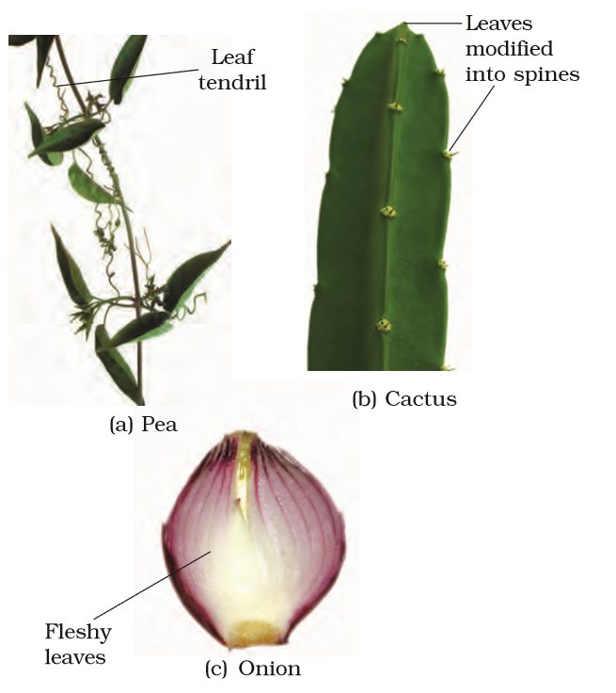

Slide 13
INFLORESCENCE
The arrangement of flowers on the floral axis is termed as inflorescence.
Depending on whether the apex gets developed into a flower or continues to grow, two major types of inflorescences are defined – racemose and cymose.
RACEMOSE AND CYMOSE
In racemose type of inflorescences the main axis continues to grow, the flowers are borne laterally in an acropetal succession.
In cymose type of inflorescence the main axis terminates in a flower ,hence is limited in growth. The flowers are borne in a basipetal order .

Slide 14
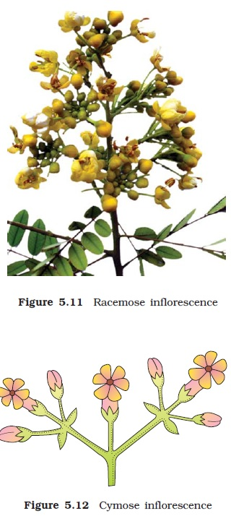

Slide 15
FOUR WHORLS OF A FLOWER
The flower is the reproductive unit in the angiosperms.
A typical flower has four different kinds of whorls arranged successively on the swollen end of the stalk or pedicel, called thalamus or receptacle.
Calyx and corolla are accessory organs,while androecium and gynoecium are reproductive organs.
In some flowers like lily, the calyx and corolla are not distinct and are termed as perianth.
When a flower has both androecium and gynoecium, it is bisexual.
A flower having either only stamens or only carpels is unisexual.

Slide 16
FLOWER-SYMMETRY
When a flower can be divided into two equal radial halves in any radial plane passing through the centre, it is said to be actinomorphic, e.g., mustard, datura, chilli.
When it can be divided into two similar halves only in one particular vertical plane, it is zygomorphic, e.g., pea, gulmohur, bean, Cassia.
A flower is asymmetric (irregular) if it cannot be divided into two similar halves by any vertical plane passing through the centre, as in Canna.
A flower may be trimerous, tetramerous or pentamerous when the floral appendages are in multiple of 3, 4 or 5, respectively. Flowers with bracts-reduced leaf found at the base of the pedicel-are called bracteate and those without bracts, ebracteate
.

Slide 17
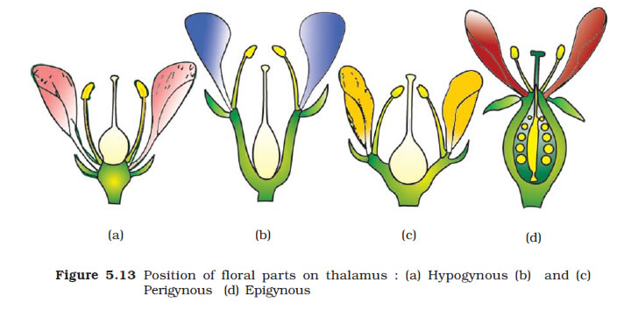
POSITION OF THE FLORAL PARTS ON THALAMUS
Based on the position of calyx, corolla and androecium in respect of the ovary on thalamus, the flowers are classified . In the hypogynous flower the gynoecium occupies the highest position while the other parts are situated below it. The ovary in such flowers is said to be superior, e.g., mustard, china rose and brinjal.

Slide 18
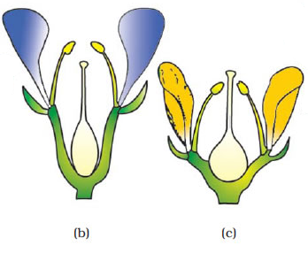
POSITION OF THE FLORAL PARTS ON THALAMUS
If gynoecium is situated in the centre and other parts of the flower are located on the rim of the thalamus almost at the same level, it is called perigynous. The ovary here is said to be half inferior
e.g., plum, rose, peach.

Slide 19
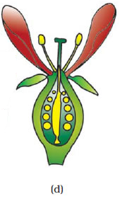
POSITION OF THE FLORAL PARTS ON THALAMUS
In epigynous flowers, the margin of thalamus grows upward enclosing the ovary completely and getting fused with it, the other parts of flower arise above the ovary. Hence, the ovary is said to be inferior as in flowers of guava and cucumber, and the ray florets of sunflower.

Slide 20
THANKING YOU
ODM EDUCATIONAL GROUP

