Slide 1


ANIMAL KINGDOM
Phylum-Porifera, Coelenterata, Ctenophora
SUBJECT : BIOLOGY
CHAPTER NUMBER: 4
CHAPTER NAME : ANIMAL KINGDOM

Slide 2
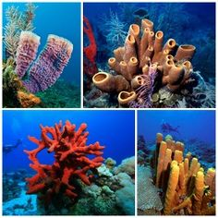
Phylum Porifera
Phylum Porifera are the lowest multicellular animals belonging to the kingdom Animalia.
The word “Porifera” mainly refers to the pore bearers or pore bearing species. Based on the embryological studies, sponges are proved as animals and are classified into a separate Phylum in the animals
This phylum includes about 5000 species. Poriferans are pore-bearing first multicellular animals. The pores are known as Ostia.
The poriferans have a spongy appearance and are therefore called sponges. They are attached to the substratum and do not move. They have the ability to absorb and withhold fluids.
They were initially regarded as plants due to the green colour and their symbiotic relationship with algae. Later, their life cycle and feeding system were discovered, and they were included in the animal kingdom.

Slide 3
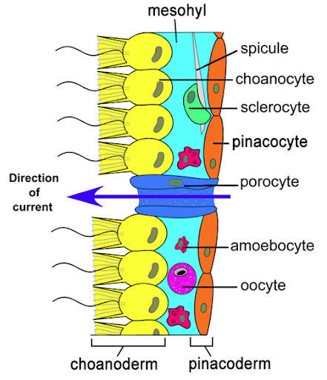
Body Organisation
Body wall consists of:
(1) Outer Dermal layer or Pinacoderm.
(a) Pinacocytes (Flat cell)
(b) Porocytes (oval)
(2) Inner Choanocytic layer or Choanoderm, Collar cell or Choanocytes (Flagellated)
(a) It is a characteristic of Porifera
(b) Choanocytes discovered by- H.J. Clark
(3) Between these two layers gelatinous material Mesenchyme is there. Consist of Amoebocytes.
(4) Body wall encloses a large cavity, the spongocoel or paragastric cavity with small cavil Choanocytes with flagella is lined in spongocoel and radial canal.
(5) Ceaselless beating of flagellate caused current of water enter through ostia perforating porocytes and various canals and enters in spongocoel and finally leave through large aperture osculum.

Slide 4
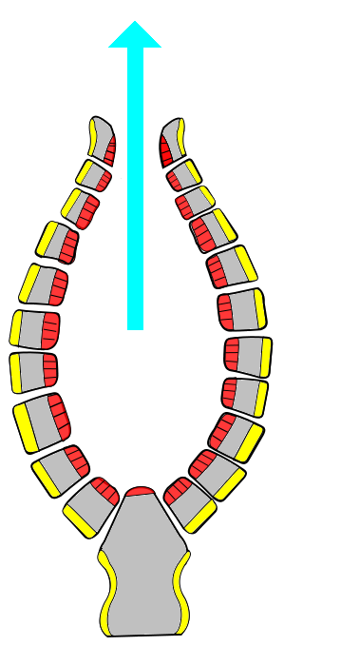
Canal System in porifera
Canal System
Body of all sponges is the perforated by large number of apertures through which water enters Inside body and flows through a system of criss-crossing canals collectively forming the canal system which is a characteristic feature of poriferan
Role of Canal System:
(i) Nutrition:The sponges are holozoic and bring various kinds of microscopic or­ganisms as food such as bacteria, diatoms, protozoans and other organic particles with the water current inside the body. The se­lected food are digested by choanocytes of the flagellated chambers and serves the pur­pose of nutrition.
(ii) Respiration:A continuous flow of water brings oxygen inside, and exchange of gases takes place between the dissolved oxy­gen of the flowing water and the cells of the sponge along the course of water flow.
(iii) Excretion:The outgoing flow of water current removes the various kinds of meta­bolic waste materials such as ammonia, urea, uric acid and other nitrogenous excretory products.
(iv) Reproduction:The incoming water current brings sperms which are captured by the choanocytes and help in fertilization.

Slide 5
Phylum Porifera
Phylum porifera has the following salient features:
(1) All the sponges are Aquatic, Sedentary, Asymmetrical or Radially, First multicellular organisms and have cellular grade of organization.
(2) They are diploblastic. Ectoderm is formed by pinacocyte and endoderm is formed by choanocyte. Both layers are called pinacoderm and choandoderm.
(3) The body is perforated by numerous minute pores called ostia.
(4) The ostia open into a large cavity called spongocoel.
(5) The spongocoel opens to the outside by a large opening called osculum.
(6) The sponges possess an endoskeleton in the form of calcareous spicules.
(7) Excretion and respiration occur by diffusion.
(8) They have greater power of regeneration.
(9) Reproduction takes place by asexual or sexual methods.
(A) Asexual - By Budding - Special cell mass gemmules containing archaeocytes.Endogenous budding of asexual reproduction in sponge is known as Gemmulation.
(B) Sexual - Sponges are hermaphrodite, fertilization internal and cross fertilization.
(10) Development is indirect or direct.

Slide 6
Phylum Porifera-Unique Features
Unique Features
1. Pores all over the body
2. Cellular level of body organisation.
3. A canal system of intercommunicating cavities for the passage of a water current.
4. Lack of mouth and digestive cavity.
5. Choanocytes lining the main cavity (spongocoel) or certain canals (radial canals).
6. Presence of spongin fibres.

Slide 7
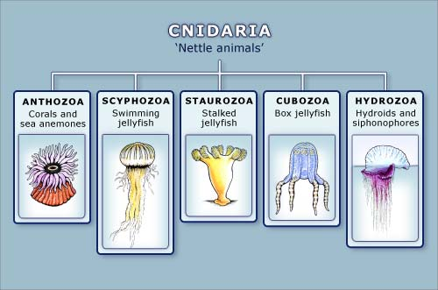
Introduction to Phylum Coelenterata
- “Tissue grade” eumetazoans with a radial symmetry.
- The term “Coelenterata” signifies the presence of a single internal cavity called coelenteron, or gastrovascular cavity, combining functions of both digestive and body cavities.
- The term “Cnidaria” indicates the presence of stinging cells (Gr., knide = nittle or stinging cells). About 9,000 species known.

Slide 8
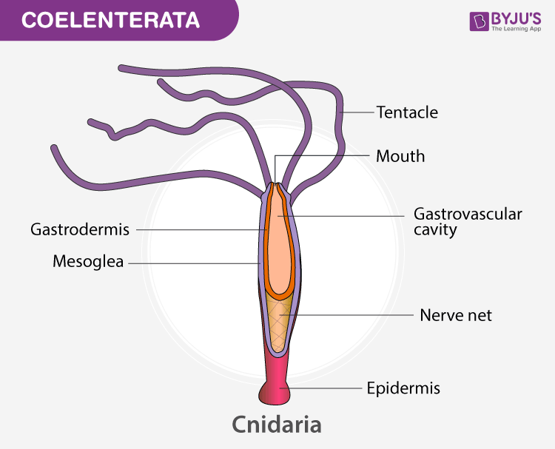
Characteristics of Coelenterata
These are mostly aquatic animals.
The mouth is surrounded by short and thin tentacles.
They exhibit a tissue-level organization.
They are diploblastic, i.e., the body is made up of two layers of cells- One layer makes up the cells outside the body (ectoderm), and the other forms the inner lining of the body (endoderm).
They have cavities in their body.The body is radially symmetrical.
The digestion is both intracellular and extracellular.
The nervous system and the circulatory system is absent.
The excrete and respire through simple diffusion.
They reproduce asexually through budding. Sexual reproduction is seen in a few Coelenterates.
Exhibit two body forms : polyp and medusa Example: Hydra, Aurelia.
Alternation of generation between body forms called metagenesis ocurs in Obelia where :
Example: Physalia, Adamsia, Pennatula, Gorgonia,Meandrina , Hydra,

Slide 9
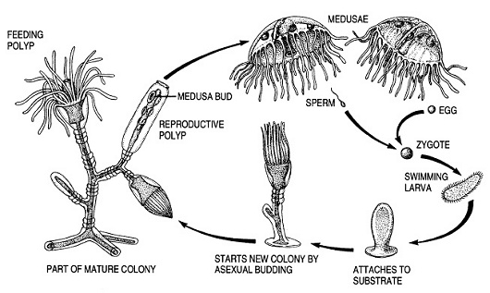
Characteristics of Coelenterata
Metagenesis is the reproduction cycle of an organism that alternates between sexual and asexual generations. An example of metagenesis is the reproduction cycle of a cnidarian.
The life cycle of Obelia represents a remarkable example of alternation of generation where the asexual and sessile phase of Obelia reproduces asexually by budding and gives rise to sexual and free-swimming medusa. ... This phenomenon of alternation between two diploid phases is termed as metagenesis.

Slide 10
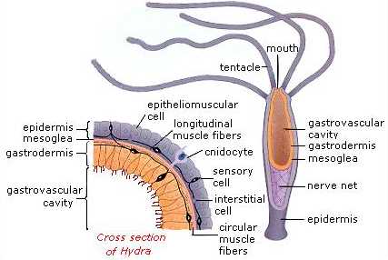
Nematocysts
Nematocysts (Gr. Nema = thread + kystis = bladder) are specialized stinging cells specific to Coelenterates that act as organs of offence and defense. They are also called Cnidae and hence the coelenterates are also called Cnidarians. The cells that produce nematocysts are called nematoblasts.
STRUCTURE
A Cnidoblast is an oval or rounded cell with a conspicuous nucleus lying on basal side. Inside the cnidoblast is present an oval or pyriform sac or bladder that is filled with a toxin called hypnotoxin.
The outer end of the capsule is invaginated into a long, hollow and tubular filament or thread tube, coiled like a watch-spring inside the sac itself. The base of the thread tube is which carries spines.
The bladder is covered on the top by a lid or operculum, near which lies a hair-like process, the cnidocil that acts like a trigger for the discharge of the thread tube.
Cytoplasm of cnidoblast may contain contractile muscle fibrils and a restraining thread at the base, called lasso, which prevents the nematocyst from being thrown out of cell.
Nematocysts may occur scattered throughout the body surface, except the basal disc. They are abundant on the tentacles and hypostome.

Slide 11
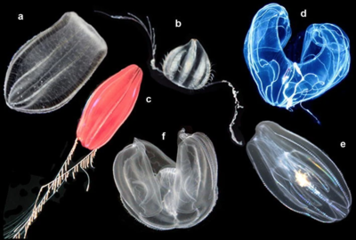
Phylum Ctenophora
Ctenophora is a small phylum.
- It contains only about 80 species.
- It includes a set of marine animals commonly called comb jellies or sea walnuts.
- These animals exhibit the characters of Coelenterata and platyhelminthes.

Slide 12
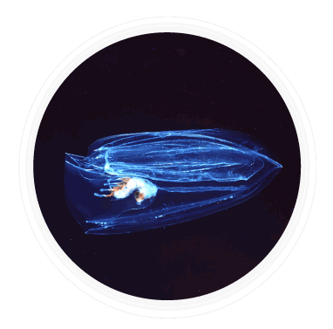
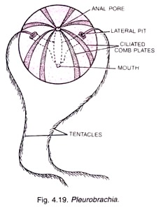
Phylum Ctenophora
→ Also called as sea walnuts or comb jellies.
→ Are exclusively marine, radially symmetrical.
→ Have tissue level organisation, are diploblastic.
→ Digestion both extra and intracellular.
→ Body has eight external rows of ciliated comb plates for locomotion.
→ Show Bioluminescence (Property of living organisms to emit light).
→ Hermaphrodite (sexes are not separate).
→ Only sexual reproduction occurs. External fertilization. Indirect development.
Example: Ctenoplana, Pleurobrachia.

Slide 13
THANKING YOU
ODM EDUCATIONAL GROUP

