Slide 1


THE LIVING WORLD
TAXONOMIC CATEGORIES
SUBJECT : BIOLOGY
CHAPTER NUMBER: 01
CHAPTER NAME :THE LIVING WORLD

Slide 2
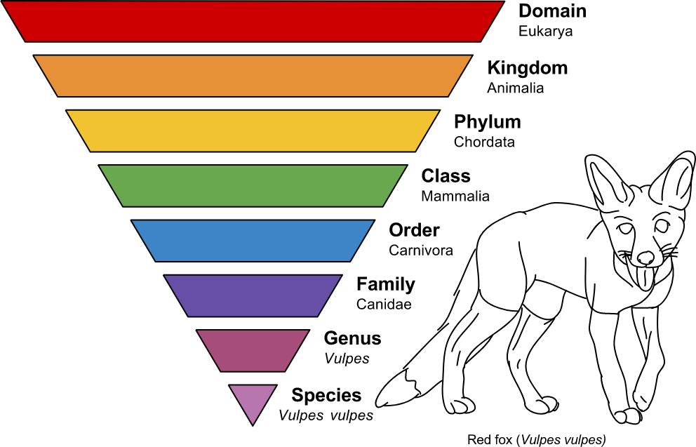
TAXNOMIC CATEGORIES
A taxonomic category is a rank or level in the hierarchical classification of organism. There are seven obligate categories and some intermediate categories. Since the category is a part of overall taxonomic arrangement, it is called taxonomic category and all categories together constitute the taxonomic hierarchy.
Various steps of the classification hierarchy are called taxonomic categories
Taxonomic hierarchy is shown below:-
Note: Domain divided into eukaryotes and prokaryotes

Slide 3
SPECIES AND GENUS
Species
Species are the natural population of individuals or a group of population which resemble one another in all essential morphological and reproductive characters so that they are able to interbreed freely and produce fertile offspring.
For Mango tree indica is species of genus Mangifera (Mangifera indica).
Genus-
it is a group of related species which resemble one another in certain correlated characters. All species of genus presumed to have evolved from a common ancestor.
Lion, Tiger, Leopard are closely related species and placed in same genus Panther.

Slide 4
FAMILY AND ORDER
Family
It is a taxonomic category which contains one or more related genera.
All genera of a family have some common features or correlated characters.
Family Solanacaeae contains a number of genera like Solanum, Withania, Datura etc.
Order-
This category includes one or more related families.
Families felidae and canidae are included in same order carnivore.
Plant families like Convolvulaceae, Solanaceae are included in the order Polymoniales.

Slide 5
CLASS,PHYLUM,KINGDOM
Class-
A class is made of one or more related orders.
The class dicotyledoneae of flowering plants contains all dicots which are grouped into several orders.
Class mammalia has a number of orders like carnivora , rodentia , primata , insectivora , etc. All possess mammary glands, external ears and hair.
Division/Phylum-
The term phylum is used for animals while division is used for plants.
They are formed of one or more class.
The phylum chordate of animals contains not only the mammals but also aves , reptiles, amphibians, etc.

Slide 6
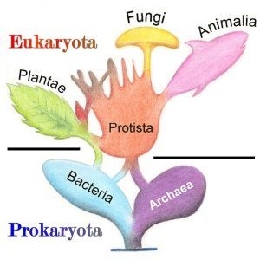
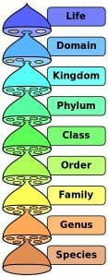
KINGDOM
Kingdom-
It is the highest taxonomic category.
All of life, thought to come from a single origin, can be broken down into highest levels of classification, such as a kingdom or phylum.
Each consecutive level represents a more related group of organisms. This structure has evolved from only a few kingdom taxon with 3 or 4 lower divisions, to kingdom being the highest division and having 6 divisions within that structure.
The four commonly recognized Kingdoms are Protista, Animalia, Plantae, and Fungi.
The bacteria and archaea are sometimes grouped into one kingdom, the Monera, and sometimes given their own separate kingdom.
Under the view that Monera belong to separate domains, they should be given separate kingdoms to reflect the structure of the taxonomical hierarchy.
All plants are included in the kingdom Plantae while all animals belong to kingdom Animalia.

Slide 7
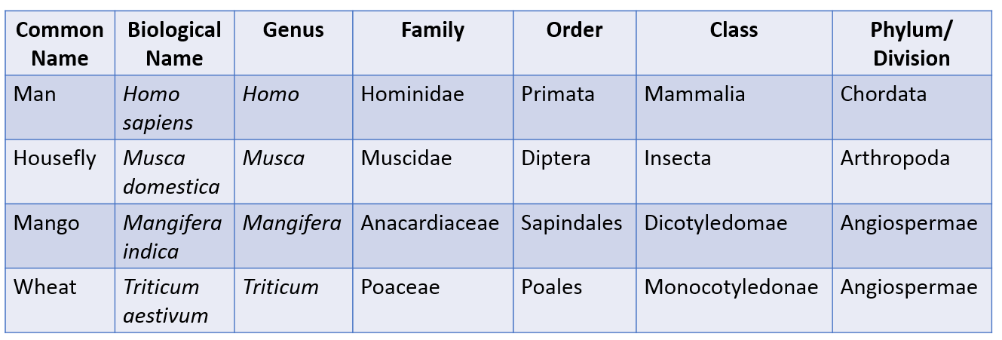

Slide 8
THANKING YOU
ODM EDUCATIONAL GROUP

