Slide 1


SUBJECT:BIOLOGY
CHAPTER:4
CHAPTER NAME: ECOSYSTEMS.
PERIOD-2

Slide 2
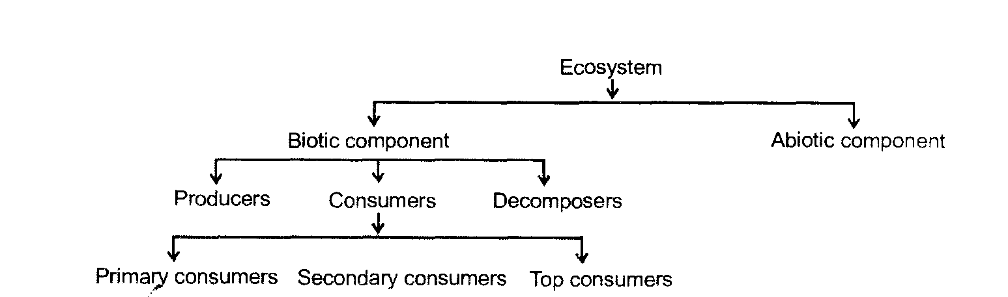
COMPONENTS OF AN ECOSYSTEM

Slide 3
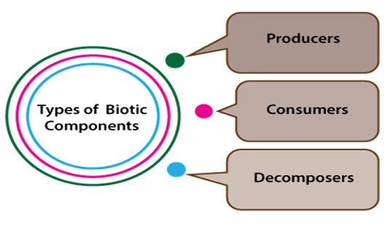
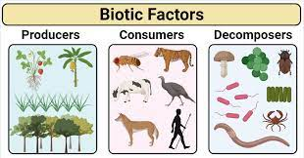
BIOTIC COMPONENTS
Biotic components are the living things that have a direct or indirect influence on other organisms in an environment. For example plants, animals, and microorganisms and their waste materials.

Slide 4
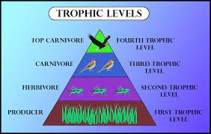
TROPHIC LEVEL

Slide 5
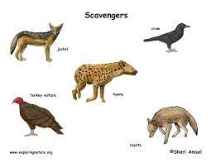
SCAVENGERS

Slide 6
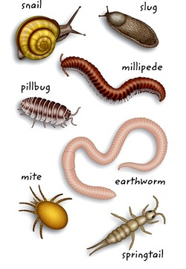
DETRITIVORES

Slide 7
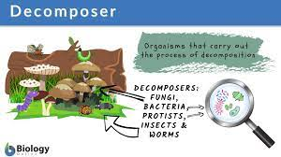
DECOMPOSERS

Slide 8
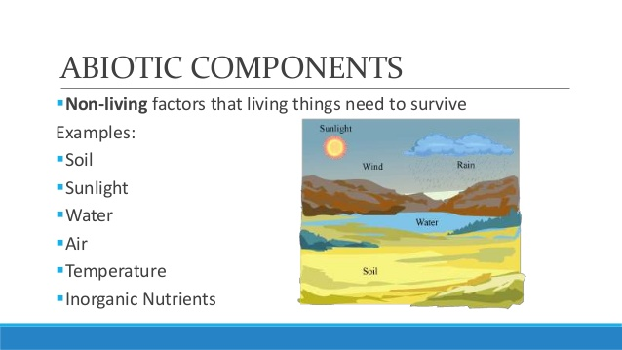
ABIOTIC COMPONENTS
Abiotic components of an ecosystem include all chemical and physical elements i.e. non-living components. Abiotic components can vary from region to region, from one ecosystem to another. They mainly take up the role of life supporter

Slide 9
https://www.youtube.com/watch?v=k-pH7yRk8SI

Slide 10
THANKING YOU
ODM EDUCATIONAL GROUP.

