Slide 1


SUBJECT:BIOLOGY
CHAPTER:6
CHAPTER NAME: THE CIRCULATORY SYSTEM.
PERIOD-2

Slide 2
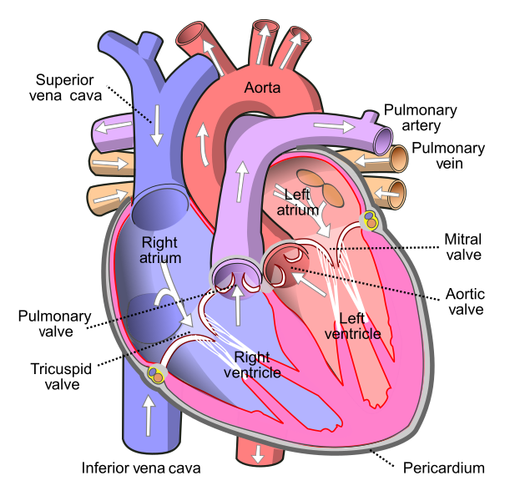

Slide 3
Circulation of Blood through the heart:
Systemic Vein → Sinus Venosus → Right Auricle → Right Ventricle → Pulmonary Artery → Lungs → Pulmonary Vein → Left Auricle → Left Ventricle → Trunchus Arteriosus → SystemicCirculation

Slide 4
https://www.youtube.com/watch?v=zUam38Zk-6Q
https://www.youtube.com/watch?v=SwHjwO7BnsI

Slide 5
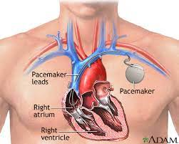
Pacemaker

Slide 6
THANKING YOU
ODM EDUCATIONAL GROUP.

