Slide 1


REPRODUCTION IN HUMANS
SUBJECT:BIOLOGY
CHAPTER:3
ASEXUAL REPRODUCTION
PERIOD-1

Slide 2

Sexual reproduction
Requires the interaction between two organisms (two parents) to produce an offspring. Reproduction occurs due to the union of morphologically distinct male and female gametes to form a zygote.

Slide 3
Spermatogenesis: The process of production of sperms in the gonads of males.
Oogenesis: The process of production of eggs in the gonads of females.

Slide 4
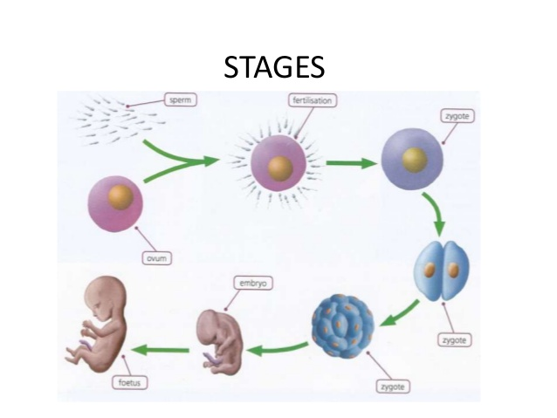
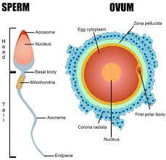
Fusion of gamets

Slide 5
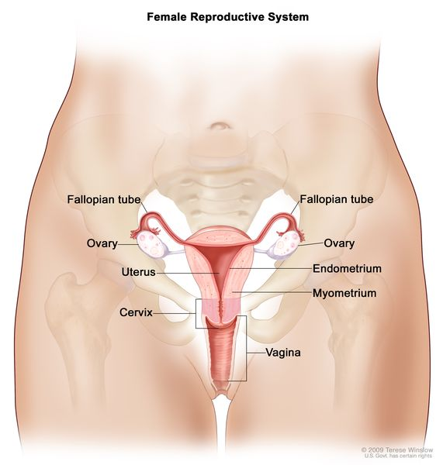
Female Reproductive System:

Slide 6
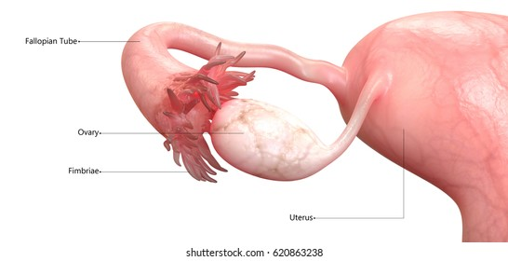
Female Reproductive System:
The female reproductive system in human beings is composed of following parts:
a-Uterus:
This is pear-shaped hollow muscular organ.
Uterus is the place where the embryo gets implanted and develops into a new-born baby.
The wall of the uterus provides safety and nutrition to the growing foetus.

Slide 7
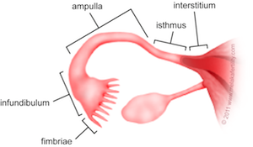
b-Fallopian Tubes:
One fallopian tube comes out from each side at the top of the uterus.
The fallopian tubes end in finger-like structures; called fimbriae.
Fertilization happens in the fallopian tube.

Slide 8
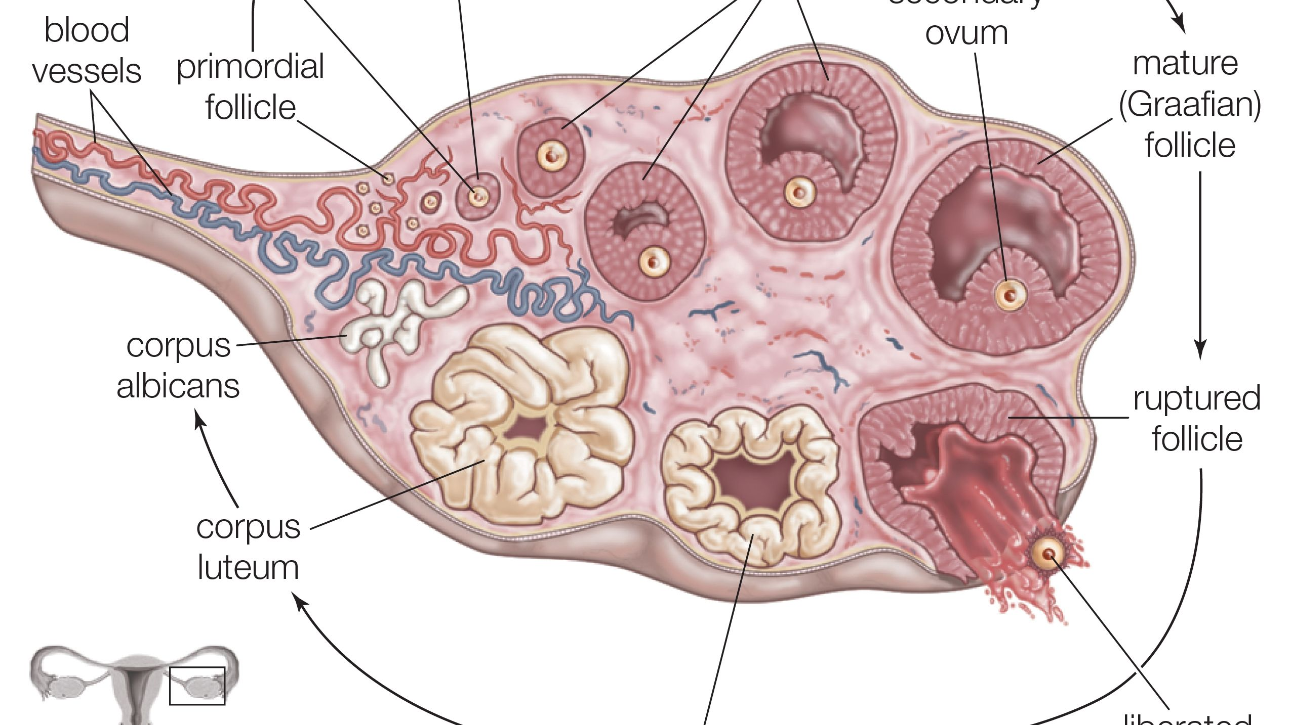
c-Ovary:
There are two ovaries; one near each fallopian tube.
Ovary produces the eggs or the female gametes.

Slide 9
d-Vagina:
The cervix (mouth of the uterus) opens into the vagina.
Vagina is a muscular tube-like organs; which serves as the passage for the sperms and also as the canal during the child birth.

Slide 10
THANKING YOU
ODM EDUCATIONAL GROUP.

