Slide 1


REPRODUCTION IN PLANTS .
SUBJECT:BIOLOGY
CHAPTER:2
VEGETATIVE REPRODUCTION
PERIOD-2

Slide 2

LEARNING OBJECTIVE
Student will be able to understand the meaning of life processes.
Student will be familiarized with the mechanism of nutrition, respiration, transportation, and excretion.
They will be able to analyze various types of nutrition .
Learners will be sensitized about the difference between prokaryotes and eukaryotes.

Slide 3
WARM UP QUESTIONS
Define living and nonliving.
Categorize the single celled and multi-celled organisms.
Identify the single celled, multi-celled organisms.
list the categories of living and non-living organisms.

Slide 4
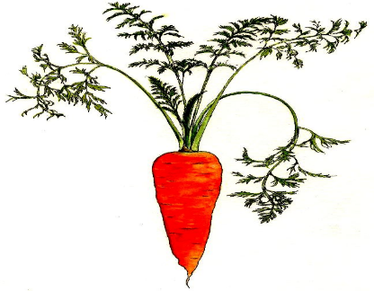
Vegetative reproduction by roots -
Vegetative reproduction by roots -Carrot and sweet potato are examples of modifications of roots; for food storage. These roots can give rise to new plants; when kept under the soil.

Slide 5
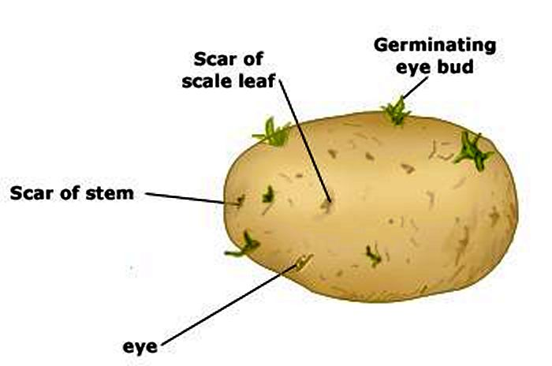
Vegetative reproduction by stem

Slide 6
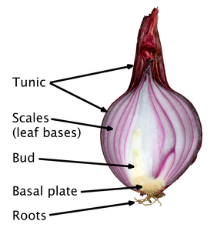
Bulbs of onion:
This has a thick short stem in the form of a condensed disc covered by scale leaves. The disc has buds which can grow into new plants.

Slide 7
https://www.youtube.com/watch?v=VN_p20dDrnY&t=125s

Slide 8
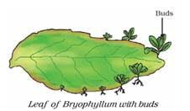
Vegetative reproduction by leaves
Bryophyllum bears buds on its leaf margins. When these fall on the ground, they develop into new plants.

Slide 9
Advantages of vegetative reproduction
Useful to grow seedless varieties.
Faster and easier than the natural process.
The only method of reproduction for plants which do not produce seeds Example: Banana and rose
Offspring resemble the parent exactly.

Slide 10
Disadvantages of vegetative reproduction
Being identical in all respects, these plants may be prone to disease at the same time.
Dispersal cannot occur naturally so there tends to be overcrowding.

Slide 11
HOME ASSIGNMENTS.
Exercise Long Answer Question No-3

Slide 12
THANKING YOU
ODM EDUCATIONAL GROUP.

