Slide 1


EXCRETORY PRODUCTS AND THEIR ELIMINATION
INTRODUCTION & MODES OF EXCRETION,HUMAN EXCRETORY SYSTEM
SUBJECT : BIOLOGY
CHAPTER NUMBER: 19
CHAPTER NAME : EXCRETORY PRODUCTS AND THEIR ELEMINATION

Slide 2
Introduction - Excretion
Every living organism existing on the planet earth eliminate their body waste and other excess waste in different ways. Excretion is an essential process which is carried out in all living organisms, including the plants, animals, birds, insects and also in unicellular organisms.
What is Excretion?
Excretion is the physiological process of elimination of metabolic waste from the body. The excretory products include amino acids, urea, uric acid, carbon dioxide, water, and ammonia.
Some Molluscs and Echinoderms excrete waste products from the body in the form of amino acids
Ammonia is the primary excretory product in animals, it is derived from the proteins present in the food we eat. It is the most toxic nitrogenous waste and is excreted by diffusion by most of the amphibians and aquatic animals.
Mammals excrete nitrogenous waste as urea. It is less toxic and comparatively less soluble in water. Birds and reptiles excrete nitrogenous waste as uric acid.

Slide 3
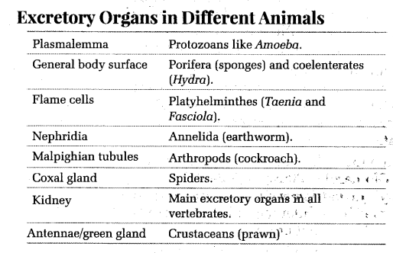
The excretory organs of different organisms

Slide 4
Modes of Excretion
Organisms consume food for survival, growth and repair. Most of the food is digested and utilised by the body for the production of energy; the rest is expelled out from the body by the digestive system in the form of faeces. This process is NOT called excretion, though; it is called egestion (also known as defecation).
Excretion Meaning
On the contrary, excretion is the process where metabolic wastes are eliminated from an organism. In humans, this function is performed through kidneys, lungs and skin.
In animals, the main excretory products are:
Ammonia
Carbon Dioxide
Urea
Uric Acid
Guanine
Creatine

Slide 5
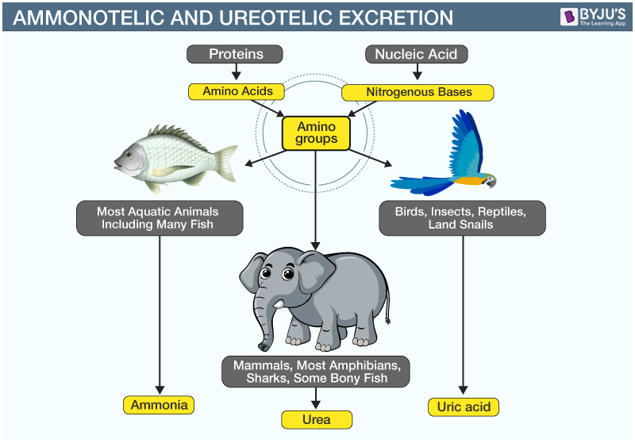

Slide 6
Modes of Excretion
Based on the excretory product, five modes of excretion are known in animals. They are:
Ammonotelism (Type of excretion- ammonia)
Ureotelism (Type of excretion – urea)
Uricotelism (Type of excretion – uric acid)
Aminotelism (Type of excretion – amino acids)
Guanotelism (Type of excretion – guanine)

Slide 7
Ammonotelism and Ureotelism
Ammonotelism
The process of eliminating ammonia from the body is known as ammonotelism, and the organisms which exhibit this nature are called ammonotelic.
Most fish, protozoans, echinoderms, poriferans and crustaceans fall into this category.
Aquatic animals excrete ammonia directly into the environment; where the compound is quickly diluted. It is also very toxic to tissues.
Ureotelism
In some mammals and amphibians, urea is excreted as the metabolic waste products. Such organisms are called ureotelic.
In these organisms, ammonia that is produced is converted to urea in the liver of animals and is released back into the blood. The kidneys filter the urea and are expelled outside the body.
Some of the urea is retained in the matrix of the kidney to maintain a desired osmolarity in the organisms. Humans are ureotelic as we expel the urea through urine. Moreover, urea is comparatively less toxic than ammonia.

Slide 8
Uricotelism , Aminotelism , Guanotelism
Uricotelism
Uricotelic animals remove nitrogenous wastes as uric acid in the form of pellets or paste.
Metabolically, this process is quite costly; however, the water loss is minimal, and it is the least toxic.
Moreover, since uric acid is not readily soluble in water, the excrements form pasty white suspensions. Most reptiles, birds, and insects are classified as uricotelics.
Aminotelism
Certain molluscs and echinoderms excrete excess amino acids. This feature is called aminotelism.
Guanotelism
Spiders convert the ammonia into guanine before excretion. This characteristic is also found in some reptiles, birds and earthworms.
It is also insoluble in water; hence no water is required for its excretion.

Slide 9
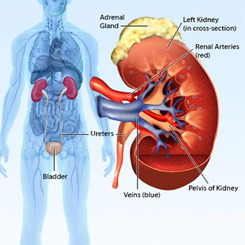
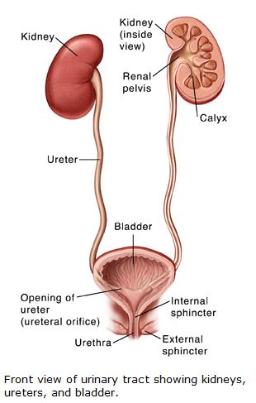
Excretory System Organs
The human excretory system organs include:
A pair of kidneys
A pair of ureters
A urinary bladder
A urethra
Kidneys

Slide 10
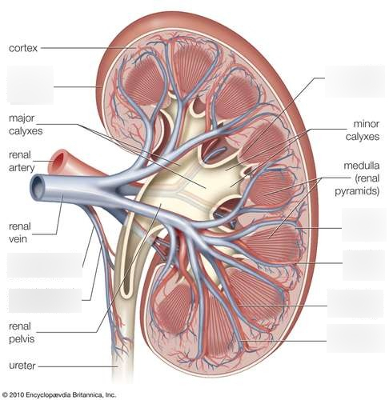
Structure of kidney
Kidneys are bean-shaped structures located on either side of the backbone and are protected by the ribs and muscles of the back.
Each human adult kidney has a length of 10-12 cm, a width of 5-7 cm and weighs around 120-170g.
The kidneys have an inner concave structure.
The blood vessels, ureter and nerves enter the kidneys through the hilum, which is a notch at the inner concave surface of the kidney.
The renal pelvis, a large funnel-shaped space is present inner to the hilum, is has many projections known as calyces.
The outer layer is called the capsule. Inside the kidney, there are two zones- the outer zone is the cortex and the inner zone is the medulla.
The cortex extends in between the medullary pyramids as renal columns called Columns of Bertini.
Each kidney has nearly one million complex tubular structures called nephrons , which are the functional units.
Each nephron has two parts – the glomerulus and the renal tubule.

Slide 11
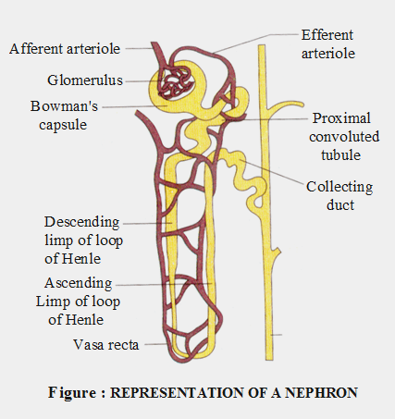
Nephron
What is Nephron?
A nephron is the basic structural and functional unit of the kidney. They are the microscopic structure composed of a renal corpuscle and a renal tubule.
The word nephron is derived from the Greek word – nephros, meaning kidney. There are about millions of nephrons in each human kidney.
The structure of nephron comprises two major portions:
Renal Tubule
Renal Corpuscle

Slide 12
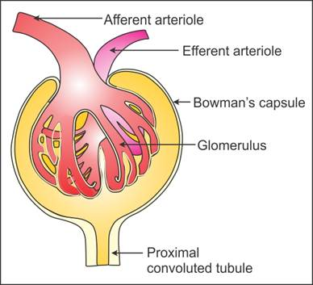
Renal Corpuscle
The renal corpuscle consists of a glomerulus surrounded by a Bowman’s capsule.
The glomerulus arises from an afferent arteriole and empties into an efferent arteriole.
The smaller diameter of an efferent arteriole helps to maintain high blood pressure in the glomerulus.
The Bowman’s capsule is divided into three layers:
Outer Parietal layer: It is made up of epithelial cells with minute pores of diameter 12nm.
Middle Basement membrane: This layer is selectively permeable.
Inner Visceral Layer: It consists of large nucleated cells called podocytes which bear finger-like projections called podocel.

Slide 13
Renal Tubule
The renal tubule is a long and convoluted structure that emerges from the glomerulus and can be divided into three parts based on function.
The first part is called the proximal convoluted tubule (PCT) due to its proximity to the glomerulus; it stays in the renal cortex.
The second part is called the loop of Henle, or nephritic loop because it forms a loop (with descending and ascending limbs) that goes through the renal medulla.
The third part of the renal tubule is called the distal convoluted tubule (DCT) and this part is also restricted to the renal cortex.
The capillaries of the glomerulus are enclosed by a cup-like structure called Bowman’s capsule. This structure extends to form highly coiled tubules called PCT. PCT continues to form the loop of Henle which ascends to DCT, which in turn opens into the collecting duct.
The major function of tubules is reabsorption and the process can either be through active transport or passive transport. In addition, secretions by tubules help in the urine formation without affecting the electrolyte balance of the body.

Slide 14
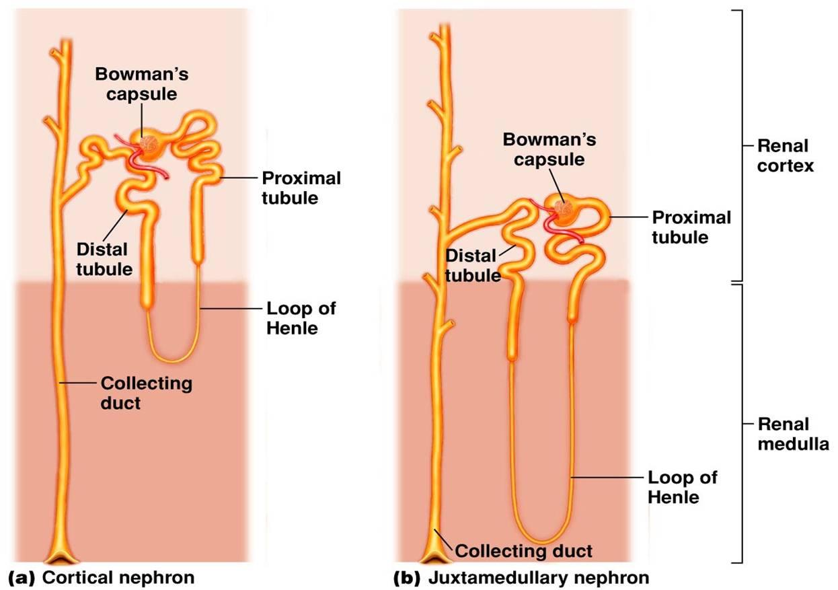
Types of Nephron
There are two types of nephron:
Cortical nephron
These are the nephrons present within the cortex. These are short and comprise about 80% of the total nephrons.
Juxtamedullary nephron
These have long loops of Henle and extend into the medulla. These are about 20%.

Slide 15
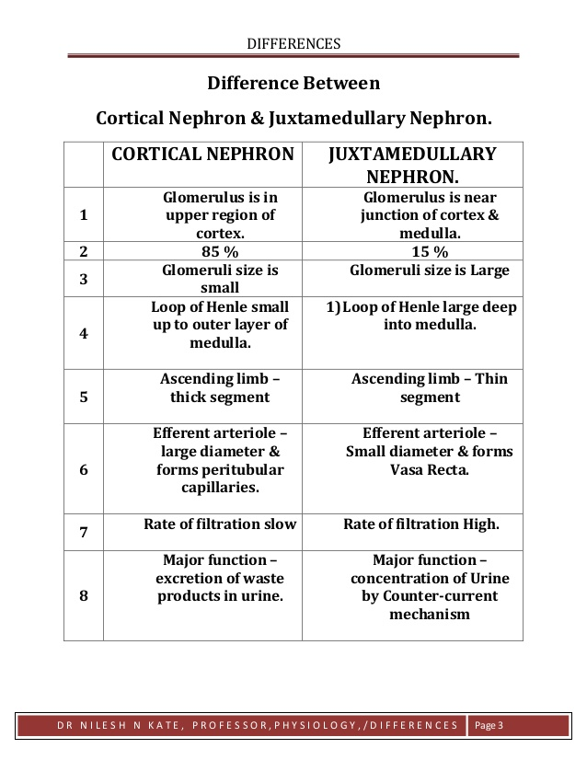
Cortical nephron vs Juxtamedullary nephron

Slide 16
Functions of Nephron
Functions of Nephron are as following :
The primary function of nephron is removing all waste products including the solid wastes, and other excess water from the blood, converting blood into the urine, reabsorption, secretion, and excretion of numerous substances.
As the blood passes through the glomerulus with high pressure, the small molecules are moved into the glomerular capsules and travel through a winding series of tubules.
The cell present in each tube absorbs different molecules excluding the glucose, water, and other beneficial molecules which are called ass the ultrafiltrate. As the ultrafiltrate molecules travel down the tubules they become more and more hypertonic, which results in more amount of water to be extracted from the ultrafiltrate before it exits the nephrons.
The blood surrounding the nephron travels back into the body through the renal blood vessels, which are free of toxins and other excess substances. The obtained ultrafiltrate is urine, which travels down via the collecting duct to the bladder, where it will be stored and released through the urethra.

Slide 17
THANKING YOU
ODM EDUCATIONAL GROUP

