Slide 1


STRUCTURAL ORGANISATION IN ANIMALS
EPITHELIAL TISSUE AND ITS TYPES
TYPES OF EPITHELIAL TISSUE,GLANDULAR EPITHELIUM,CELL JUNCTIONS
SUBJECT :BIOLOGY
CHAPTER NUMBER:07
CHAPTER NAME :STRUCTURAL ORGANISATION IN ANIMALS

Slide 2
ANIMAL TISSUE
The structure of the cells vary according to their function.
Therefore, the tissues are different and are broadly classified into four types :
(i) Epithelial
(ii) Connective
(iii) Muscular and
(iv) Neural.

Slide 3
EPITHELIAL TISSUE
We commonly refer to an epithelial tissue as epithelium (pl.: epithelia).
This tissue has a free surface, which faces either a body fluid or the outside environment and thus provides a covering or a lining for some part of the body.
The cells are compactly packed with little intercellular matrix.
There are two types of epithelial tissues namely simple epithelium and compound epithelium.
Simple epithelium is composed of a single layer of cells and functions as a lining for body cavities, ducts, and tubes.
The compound epithelium consists of two or more cell layers and has protective function as it does in our skin.

Slide 4
Simple epithelium
On the basis of structural modification of the cells, simple epithelium is further divided into three types
Squamous
Cuboidal
Columnar

Slide 5
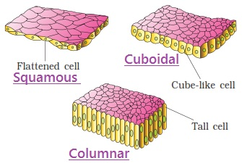
TYPES OF EPITHELIAL TISSUE
SQUAMOUS EPITHELIAL TISSUE
The squamous epithelium is made of a single thin layer of flattened cells with irregular boundaries.
They are found in the walls of blood vessels and air sacs of lungs and are involved in functions like forming a diffusion boundary.

Slide 6
CUBOIDAL EPITHELIAL TISSUE
The cuboidal epithelium is composed of a single layer of cube-like cells.
This is commonly found in ducts of glands and tubular parts of nephrons in kidneys and its main functions are secretion and absorption.
The epithelium of proximal convoluted tubule (PCT) of nephron in the kidney has microvilli.

Slide 7
COLUMNAR EPITHELIAL TISSUE
The columnar epithelium is composed of a single layer of tall and slender cells.
Their nuclei are located at the base.
Free surface may have microvilli.
They are found in the lining of stomach and intestine and help in secretion and absorption.
If the columnar or cuboidal cells bear cilia on their free surface they are called ciliated epithelium whose main function is to move particles or mucus in a specific direction over the epithelium. They are mainly present in the inner surface of hollow organs like bronchioles and fallopian tubes.
Column like cells

Slide 8
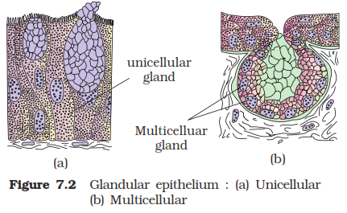
GLANDULAR EPITHELIAL TISSUE
Some of the columnar or cuboidal cells get specialised for secretion and are called glandular epithelium.
They are mainly of two types:
1. Unicellular, consisting of isolated glandular cells (goblet cells of the alimentary canal),
2. Multicellular, consisting of cluster of cells (salivary gland).

Slide 9
GLANDULAR EPITHELIAL TISSUE
On the basis of the mode of pouring of their secretions, glands are divided into two categories namely:
1. Exocrine
2. Endocrine glands.
Exocrine glands secrete mucus, saliva, earwax, oil, milk, digestive enzymes and other cell products. These are released through ducts or tubes.
Endocrine glands do not have ducts. In contrast, the products called hormones are secreted directly into the fluid bathing the gland.

Slide 10
COMPOUND EPITHELIAL TISSUE
Compound epithelium is made of more than one layer (multi-layered) of cells and thus has a limited role in secretion and absorption.
Their main function is to provide protection against chemical and mechanical stresses.
They cover the dry surface of the skin, the moist surface of buccal cavity, pharynx, inner lining of ducts of salivary glands and of pancreatic ducts.
All cells in epithelium are held together with little intercellular material.

Slide 11
CELL JUNCTIONS
In nearly all animal tissues, specialised junctions provide both structural and functional links between its individual cells.
Three types of cell junctions are found in the epithelium and other tissues.
These are:
1. Tight,
2. Adhering
3. Gap junctions.

Slide 12
CELL JUNCTIONS
Tight junctions help to stop substances from leaking across a tissue.
Adhering junctions perform cementing to keep neighbouring cells together.
Gap junctions facilitate the cells to communicate with each other by connecting the cytoplasm of adjoining cells, for rapid transfer of ions, small molecules and sometimes big molecules.

Slide 13
THANKING YOU
ODM EDUCATIONAL GROUP

