Slide 1


BASIS OF CLASSIFICATION
LEVEL OF ORGANISATION, SYMMETRY, GERM LAYERS, COELOM, SEGMENTATION, NOTOCHORD
SUBJECT : BIOLOGY
CHAPTER NUMBER: 4
CHAPTER NAME : ANIMAL KINGDOM

Slide 2
Introduction
Inspite of differences in structure and form of different animals, there are fundamental features common to various individuals in relation to the arrangement of cells, body symmetry, nature of coelom, patterns of digestive, circulatory or reproductive systems. These features are used as the basis of animal classification and some of them are discussed here.
Millions of species of animals have been described and it becomes more necessary to classify them to assign a systematic position.
Animals are classified on the basis of arrangement of cells, body symmetry, nature of coelom, pattern of digestive, circulatory and reproductive system.

Slide 3
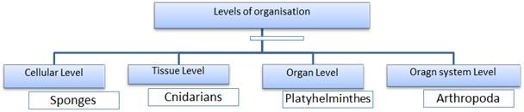
Levels of Organisation
(a) Cellular level : Cells are arranged as loose cell aggregates.
Example: sponges.
(b) Tissue level : The cells performing the same function are arranged into tissues.
Example: Coelenterates.
(c) Organ level : Tissues are grouped together to form organs, each specialised for a particular function. Example: platyhelminthes.
(d) Organ system level : Organs are associated to form functional systems like Annelids, Arthropoda , Molluscs, Echinoderms and Chordates. Example: Circulatory System.
• Open type: Blood pumped out through heart. Not confined to blood vessels. Cells and tissues are directly bathed in it.
• Closed types: Blood is circulated through blood vessels (arteries,veins and capillaries)

Slide 4
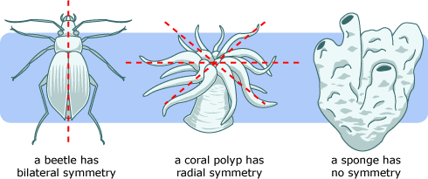
Symmetry
Animals can be categorised on the basis of their symmetry.
Sponges are mostly asymmetrical, i.e., any plane that passes through the centre does not divide them into equal halves.
Symmetry refers to a correspondence of body parts, in size, shape, and relative position, on opposite sides of a dividing line or distributed around a central point or axis.
When any plane passing through the central axis of the body divides the organism into two identical halves, it is called radial symmetry. Coelenterates, ctenophores and echinoderms have this kind of body plan .
Animals like annelids, arthropods, etc., where the body can be divided into identical left and right halves in only one plane, exhibit bilateral symmetry

Slide 5
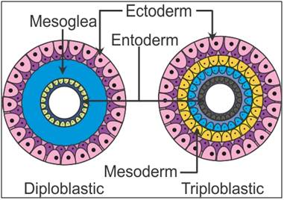
CLASSIFICATION ON THE BASIS OF GERM LAYER
The animals in which cells are arranged in two embryonic layer, external ectoderm and internal endoderm are called diploblastic. Eg. Porifera and Cnidaria.
The animals in which developing embryo has a third germinal layer, mesoderm besides ectoderm and endoderm are called triploblastic. Eg. Platyhelminthes, Chordates.

Slide 6
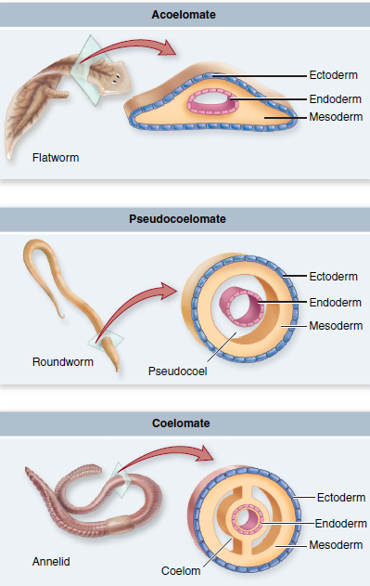
COELOM
The body cavity which is lined by mesoderm is called coelom.
Animals possessing coelom are called coelomate (Annelida, Chordates, Mollusca).
In some animals cavity is not lined by mesoderm but scattered as pouches in between ectoderm and endoderm, are called pseudocoleomate (Aschelminthes).
The animals in which body cavity is absent are called acoelomate (Platyhelminthes).

Slide 7
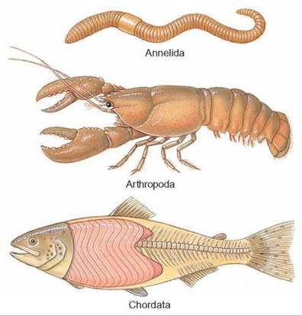
Segmentation
True metamerism
→ Found in Annelida,Arthropoda, Chordata.
→ Segmentation is external as well as a internal in Annelids.
→ Segmentation is external in Arthropods.
→ Segmentation is internal in chordates.
Metamerism: If body is externally and internally divided into segments (metameres) with serial repetition of atleast some organs, the phenomenon is called metamerism.
Example: Earthworm.

Slide 8
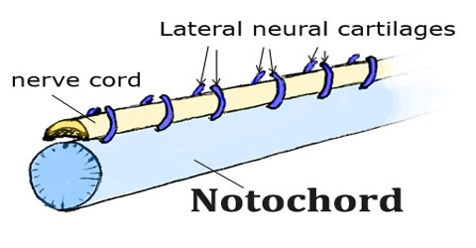
Notochord
Notochord is a mesodermally derived rod-like structure formed on the dorsal side during embryonic development in some animals.
Animals with notochord are called chordates and those animals which do not form this structure are called non-chordates, e.g., porifera to echinoderms.

Slide 9
THANKING YOU
ODM EDUCATIONAL GROUP

