Slide 1


BIOLOGICAL CLASSIFICATION
INTRODUCTION TO TWO KINGDOM SYSTEM & FIVE KINGDOM SYSTEM OF CLASSIFICATION
SUBJECT : BIOLOGY
CHAPTER NUMBER:2
CHAPTER NAME : BIOLOGICAL CLASSIFICATION

Slide 2
WHAT IS BIOLOGICAL CLASSIFICATION?
Biological classification is the scientific procedure of arranging organisms into groups and subgroups on the basis of their similarities and dissimilarities and placing the group in a hierarchy of categories.
It is the systematic grouping of organisms. It is also called biosystematics. Biosystematics deals with the identification, nomenclature & classification of organisms based on their similarities & differences.
Importance of classification-
It is not possible to study every organism.
Study of one or two organism of a group gives sufficient information about the essential features of the group.
It helps in identification of new organism.
Classification helps in knowing the relationship amongst different groups of organisms.
The organism of past cannot be studied without a proper system of classification.

Slide 3
CLASSIFICATION
Classification types :
Artificial system of classification
Natural system of classification
Phylogenetic system of classification
I. Artificial system of classification- Only one or two morphological characters for grouping of organism is used. Aristotle classification proposed.
a. Enaima (Animals with red blood) b. Anaima (Animals without red blood)
a. Ovipary (Egg laying) b. Vivipary (Giving birth to young ones)..
II. Natural system of classification- Takes into consideration comparable study of a number of characters so as to bring out natural similarities and dissimilarities and hence natural relationships among the organisms.
Bentham and Hooker classification, etc.
Cryptogams (non flowering plants) • Phanerogams (seed bearing plants)
III. Phylogenetic System of Classification- Based on the evolutionary relationship of organisms. In this system organism are classified on the basis of their evolution on earth from primitive to highly evolved.
Engler and Prantl classification and Hutchinson classification, etc.
Classified bacteria & all plants under 14 divisions.

Slide 4
TWO KINGDOM SYSTEM AND THREE KINGDOM SYSTEM
TWO KINGDOM SYSTEM: (CAROLUS LINNAEUS‐1758)
Kingdom plantae : It includes Bacteria, Mycoplasma Mycoplasma, fungi & photosynthetic photosynthetic plants.
Kingdom animalia : It includes includes unicellular & multicellular animals.
THREE KINGDOM SYSTEM: (ERNEST HAECKEL‐1866)
Kingdom protista: It includes unicellular & colonial eukaryotes such as bacteria, algae, fungi & protozoans.
Kingdom plantae: It includes multicellular photosynthetic plants.
Kingdom animalia: It includes multicellular animals.
FOUR KINGDOM SYSTEM: (COPELAND‐1956)
Kingdom monera: It includes unicellular or filamentous prokaryotes such as bacteria, mycoplasma & cyanobacteria.
Kingdom protista: It includes unicellular eukaryotes.
Kingdom plantae: Multicellular autotrophic eukaryotes
Kingdom animalia: Multicellular heterotrophic eukaryotes

Slide 5
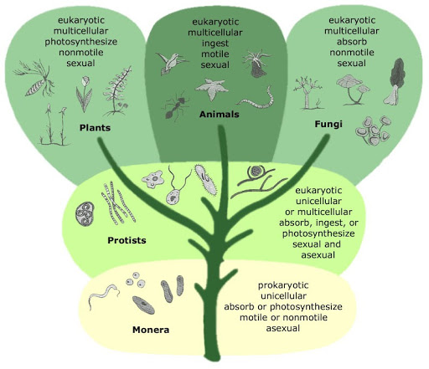
FIVE KINGDOM SYSTEM CLASSIFICATION OF R H WHITTAKER
FIVE KINGDOM SYSTEM (R H WHITTAKER‐1969)
The five kingdoms are :
Kingdom monera
Kingdom protista
Kingdom fungi
Kingdom plantae
Kingdom animalia
Classification based on the following main criteria of the five kingdom classification :
Cell structure, prokaryotic or eukaryotic
Body organisation , unicellular or multicellular
Mode of nutrition and
Reproduction, sexual or asexual
Phylogenetic relationships(refers to the relative times in the past that species shared common ancestors.)

Slide 6
ADVANTAGES OF FIVE KINGDOM CLASSIFICATION
The main advantages of five kingdom classification are as follows:
Prokaryotes differ from all other living organisms in their cellular structure, physiology, biochemical and reproduction process. Prokaryotes have got a separate place as kingdom Monera in five kingdom classification.
Unicellular and multicellular organisms are kept separate.
Fungi are placed in a separate kingdom as their mode of nutrition differs from all other plants.
Autotrophs and heterotrophs are placed in separate groups.
Five kingdom classification is based on bio composition and mode of nutrition, thus it shows series of evolution.

Slide 7
DISADVANTAGES OF FIVE KINGDOM CLASSIFICATION
The main disadvantages of five kingdom classification are as follows:
A distinction between unicellular and multicellular organisms is not possible in case of algae. It is because of this that unicellular green algae have not been included in kingdom Protista by Whittaker.
Each group has so many diversities that it is difficult to keep them together. For example, monera and protista contain both walled and wall-less organisms, photosynthetic and non-photosynthetic organisms, unicellular and filamentous or mycelial organisms.
Viruses have not been included in this system of classification.
Archaebacteria differ from other bacteria in structure, composition and physiology.
Mycoplasmas are quite different from bacteria where they have been placed along with prokaryotes.

Slide 8
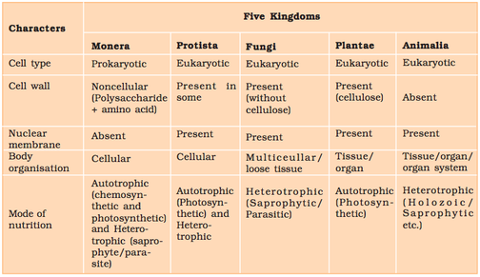

Slide 9
THANKING YOU
ODM EDUCATIONAL GROUP

