Slide 1


SUBJECT:BIOLOGY
CHAPTER:4
CHAPTER NAME: ECOSYSTEMS
PERIOD-1

Slide 2
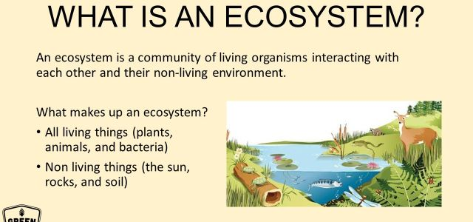

Slide 3
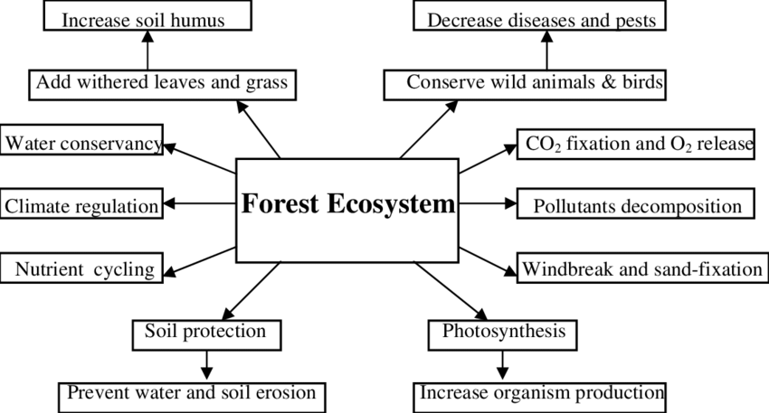
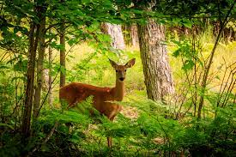

Slide 4
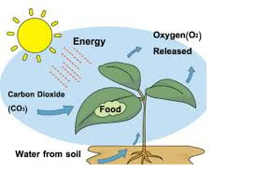
AUTOTROPHS
An autotroph is an organism that can produce its own food using light, water, carbon dioxide, or other chemicals. Because autotrophs produce their own food, they are sometimes called producers.

Slide 5
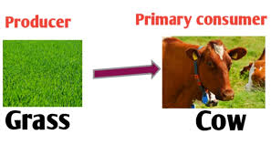
PRIMARY CONSUMERS
The organisms that eat the producers are the primary consumers. ... The primary consumers are herbivores (vegetarians).

Slide 6
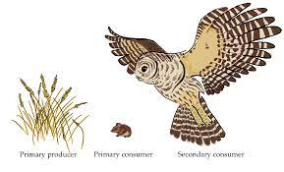
SECONDARY CONSUMERS
Secondary consumers are organisms that eat primary consumers for energy.
secondary consumers can either be carnivores or omnivores. Carnivores only eat other animals, and omnivores eat both plant and animal matter.

Slide 7
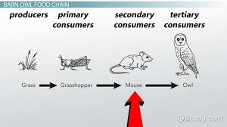
TERTIARY CONSUMERS
A tertiary consumer is an animal that obtains its nutrition by eating primary consumers and secondary consumers. Usually tertiary consumers are carnivorous predators, although they may also be omnivores, which are animals that feed on both meat and plant material.

Slide 8
https://www.youtube.com/watch?v=eGG7hyx_HlA

Slide 9
THANKING YOU
ODM EDUCATIONAL GROUP.

