Slide 1


SUBJECT:BIOLOGY
CHAPTER:6
CHAPTER NAME: THE CIRCULATORY SYSTEM.
PERIOD-1

Slide 2
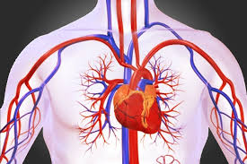

CIRCULATORY SYSTEM
The system that contains the heart and the blood vessels and moves blood throughout the body. This system helps tissues get enough oxygen and nutrients, and it helps them get rid of waste products.

Slide 3
PRINCIPAL FLUIDS
Blood
Tissue fluid
Lymph.

Slide 4
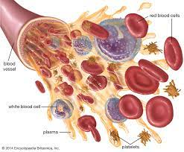
blood

Slide 5
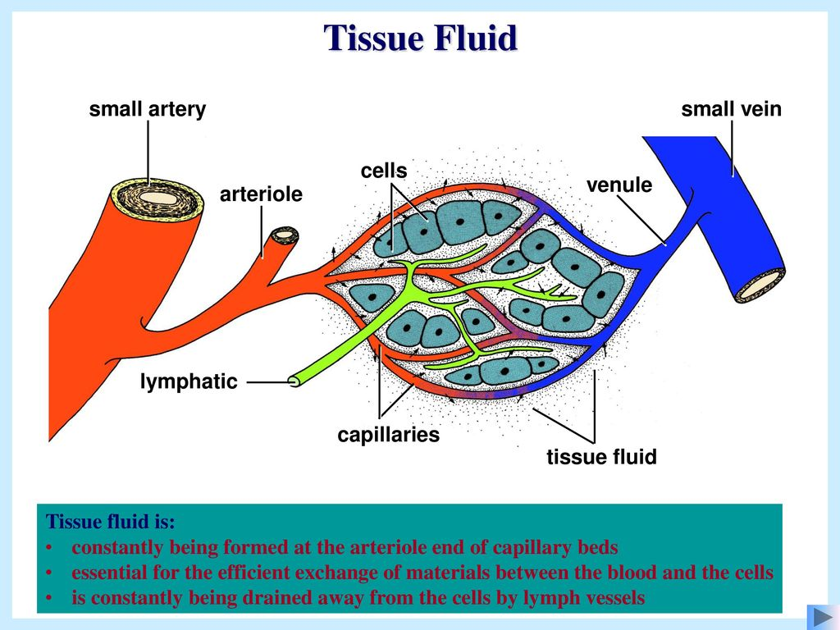
Tissue fluid

Slide 6
lymph
Lymph is a clear to pale-white fluid which circulates throughout the lymphatic system. The main role of the lymphatic system is to act as a filter against microbes, organic wastes and other debris.
The lymph comprises lymph plasma, lymph corpuscles and lymphoid organs.

Slide 7
https://www.youtube.com/watch?v=HjvCv3syWq4

Slide 8
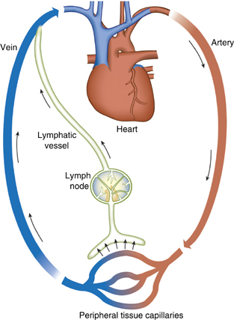
Blood and lymph circulation.

Slide 9
https://www.youtube.com/watch?v=cCPyWFK0IKs&t=104s

Slide 10
THANKING YOU
ODM EDUCATIONAL GROUP.

