Slide 1


REPRODUCTION IN HUMANS
SUBJECT:BIOLOGY
CHAPTER:3
ASEXUAL REPRODUCTION
PERIOD-1

Slide 2
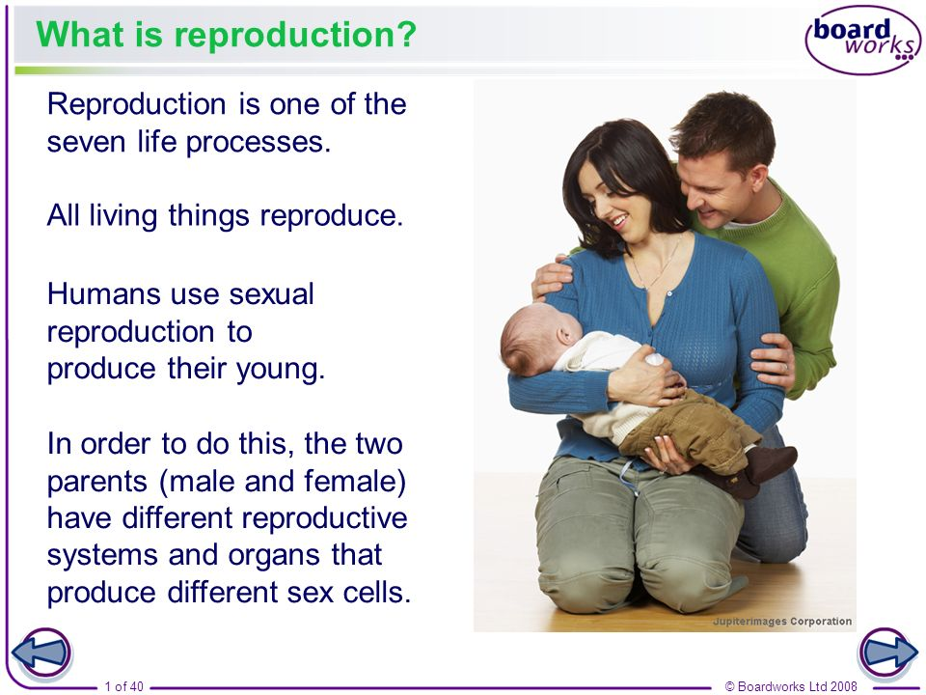
Introduction-

Slide 3
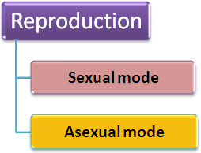
Types of reproduction

Slide 4
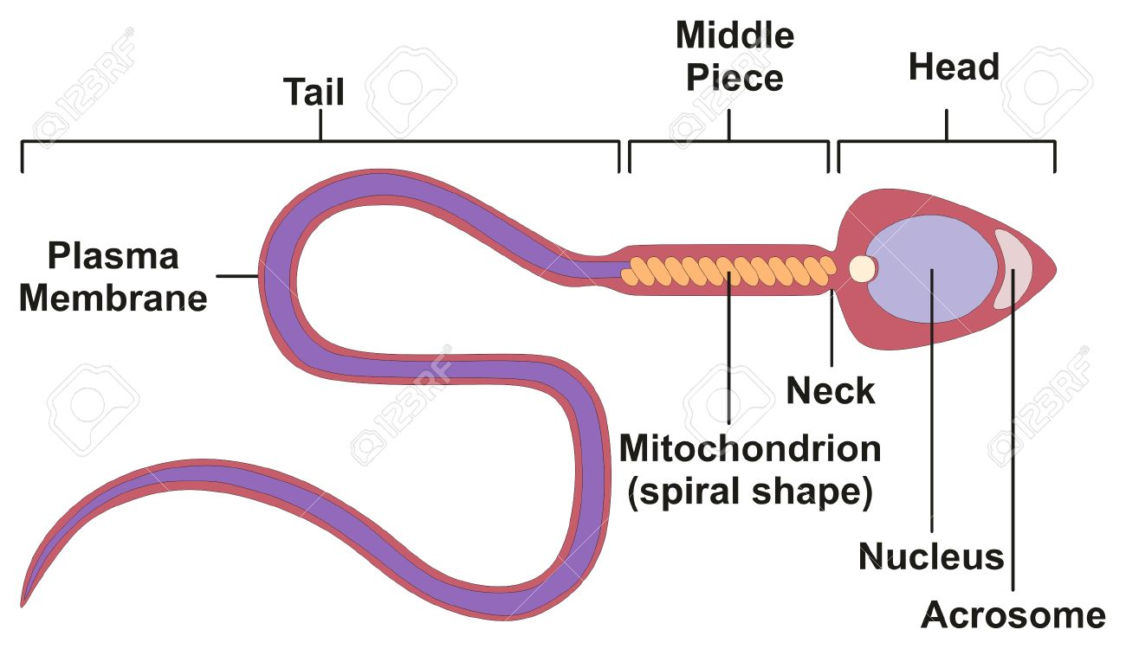
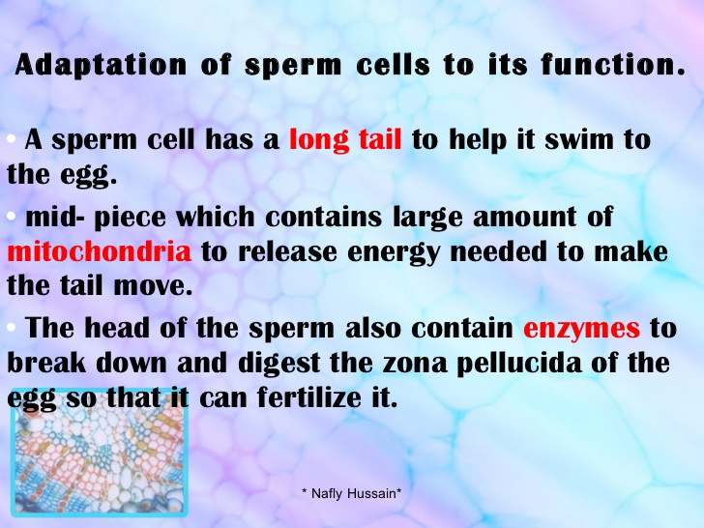
Reproductive cells(Gametes)

Slide 5
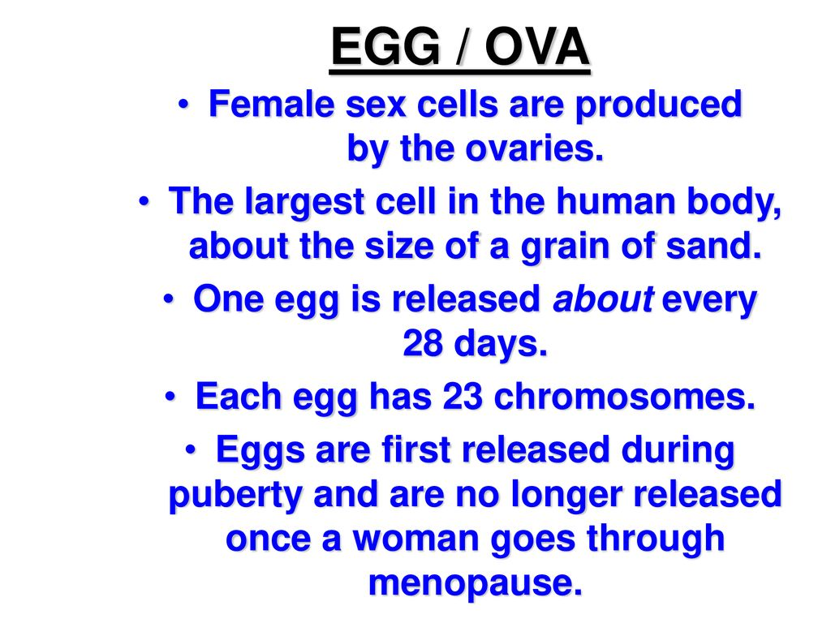
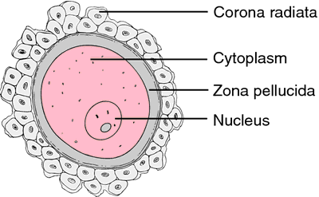
ova

Slide 6
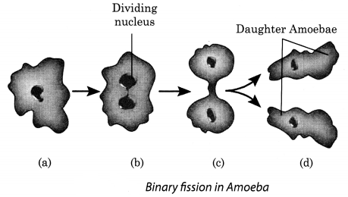
Asexual Reproduction in animals Binary Fission:

Slide 7
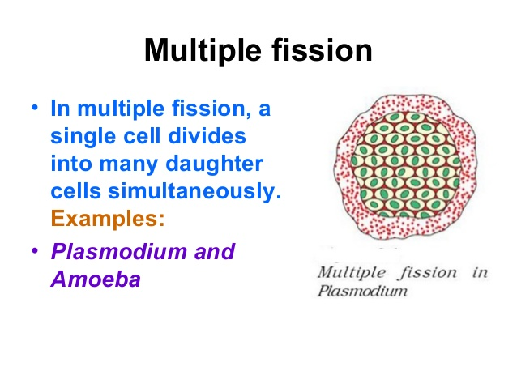

Slide 8
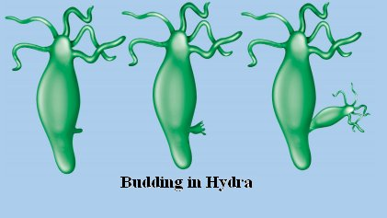
Budding in hydra-

Slide 9
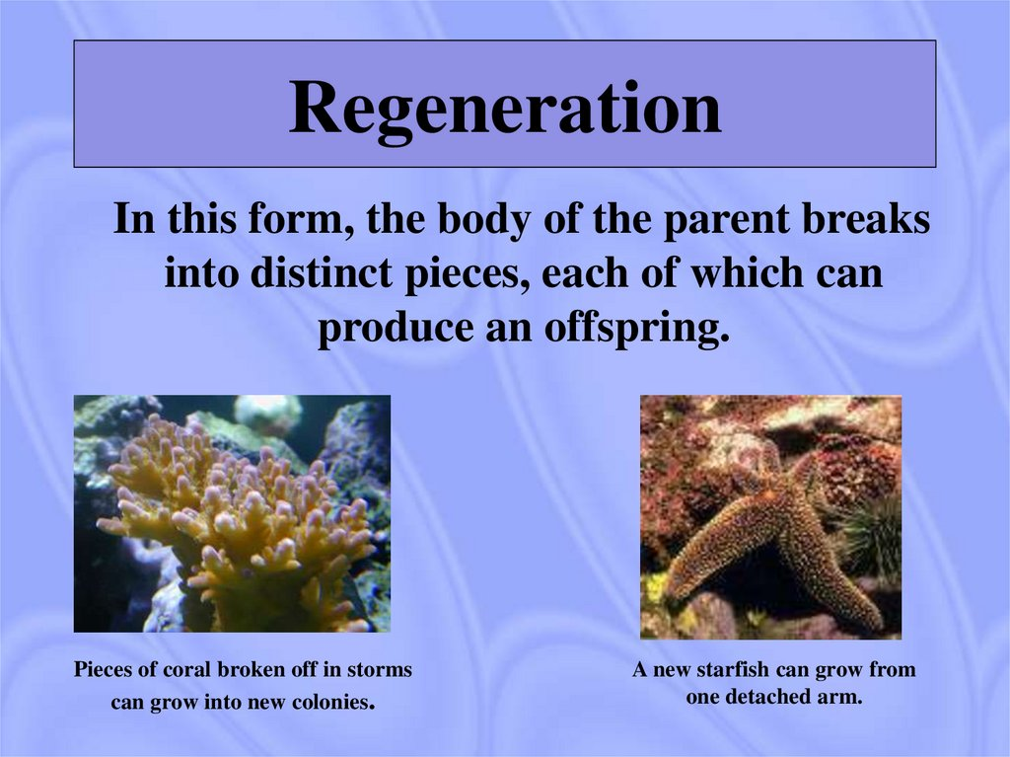
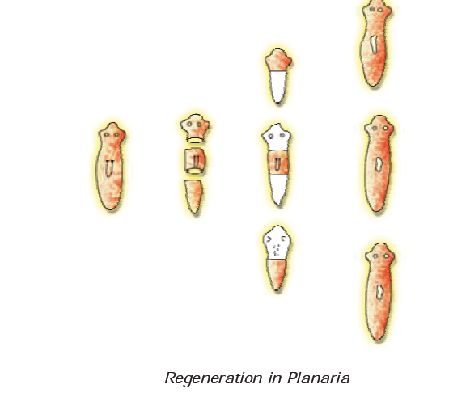
Regeneration in planaria.

Slide 10
https://www.youtube.com/watch?v=hTC1eNTBXvE

Slide 11
THANKING YOU
ODM EDUCATIONAL GROUP.

