Slide 1


REPRODUCTION IN PLANTS .
SUBJECT:BIOLOGY
CHAPTER:2
IMPORTANCE OF REPRODUCTION
PERIOD-1

Slide 2

LEARNING OBJECTIVE
Student will be able to understand the meaning of life processes.
Student will be familiarized with the mechanism of nutrition, respiration, transportation, and excretion.
They will be able to analyze various types of nutrition .
Learners will be sensitized about the difference between prokaryotes and eukaryotes.

Slide 3
WARM UP QUESTIONS
Define living and nonliving.
Categorize the single celled and multi-celled organisms.
Identify the single celled, multi-celled organisms.
list the categories of living and non-living organisms.

Slide 4
INTRODUCTION-
Reproduction is an integral feature of all living beings. The process by which a living being produces its own like is called reproduction.

Slide 5
IMPORTANCE OF REPRODUCTION:
Reproduction is important for each species, because this is the only way for a living being to continue its lineage. Apart from being important for a particular individual, reproduction is also important for the whole ecosystem. Reproduction helps in maintaining a proper balance among various biotic constituents of the ecosystem. Moreover, reproduction also facilitates evolution because variations come through reproduction; over several generations.

Slide 6
TYPES OF REPRODUCTION:
There are two main types, viz. asexual and sexual reproduction.
Asexual Reproduction: When a single parent is involved and no gamete formation takes place; the method is called asexual reproduction. No meiosis happens during asexual reproduction
Asexual reproduction occurs through,
Budding
Binary fission
Fragmentation.
Spore formation
Vegetative Propagation

Slide 7
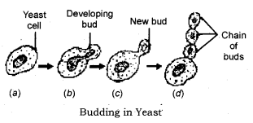
BUDDING
Budding: Seen in Yeast (a fungus). The parent yeast cell develops a protrusion or an outgrowth at its upper end. The nucleus of the parent cell divides and one of them moves into the outgrowth which grows bigger and finally separates from the parent cell to lead an independent existence. Very often if the conditions are highly favorable, a chain of buds is formed.

Slide 8
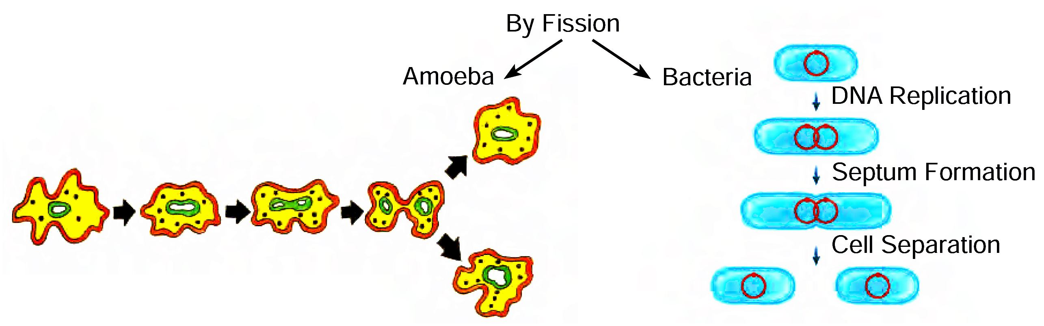
BINARY FISSION
Binary Fission: Seen in bacteria, protozoa like Amoeba, Paramecium. (In these first pseudopodia withdrawn (karyokinesis) the nucleus of the parent cell divides and then the cytoplasm divides (cytokinesis) resulting in the formation of two daughter cells).

Slide 9
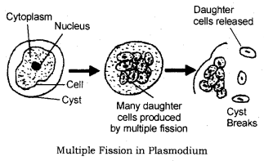
MULTIPLE FISSION.
Multiple Fission: Seen in Plasmodium, (a malarial parasite). In this during unfavourable conditions, the parent cell develops a thick resistant wall around itself forming a cyst. Within the wall, the cytoplasm divides many times to form many plasmodia.

Slide 10
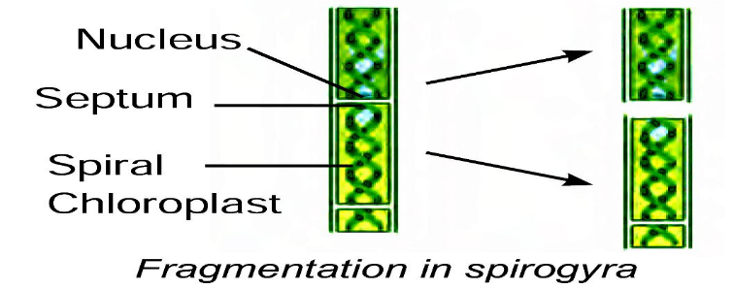
FRAGMENTATION.
Fragmentation -Spirogyra breaks into smaller pieces on maturation and each fragment grows into a new individual

Slide 11
https://www.youtube.com/watch?v=7zzp37y5DFg&t=10s

Slide 12
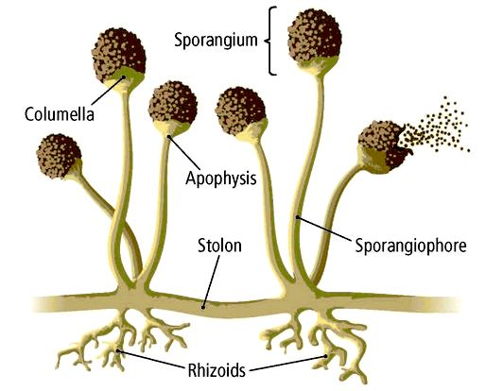
Spore formation
In plants like ferns, spores are formed on the underside of the leaves. These are capable of developing into new plants when they are carried by the wind to other places with suitable conditions for growth

Slide 13
HOME ASSIGNMENTS.
Exercise Short Question No-1 and Long Answer Question No- 1,9

Slide 14
THANKING YOU
ODM EDUCATIONAL GROUP.

