Slide 1


SUB TOPIC: SET CONCEPT
SUBJECT : MATHEMATICS
CHAPTER NUMBER: 06
CHAPTER NAME : SET CONCEPT
PERIOD : 03

Slide 2
LEARNING OUTCOME
Students will be able to Understand
How set is used in our daily life to sort the things.

Slide 3
If A = {4, 5, 6, 7, 8} and B = {6, 8, 10, 12}, find :
(i) A∪B
(ii) A∩B
(iii) A-B
(iv) B-A

Slide 4

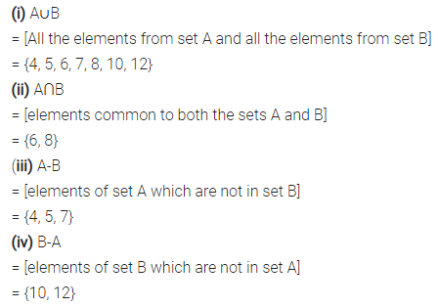

Slide 5
If P = {x : x is a factor of 12} and Q = {x: x is a factor of 16}, find :
(i) n(P)
(ii) n(Q)
(iii) Q – P and n(Q – P)

Slide 6

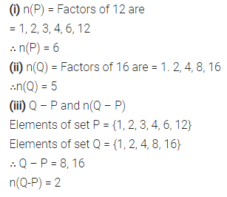

Slide 7
Let A and B be two sets such that n(A) = 75, M(B) = 65 and n(A ∩ B) = 45, find :
(i) n(A∪ B)
(ii) n(A – B)
(iii) n(B – A)

Slide 8
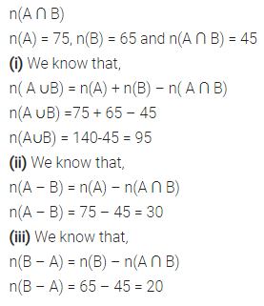

Slide 9
HOME ASSIGNMENT
EX 6 D Question 1 TO 10

Slide 10
THANKING YOU
ODM EDUCATIONAL GROUP

