Slide 1


SUB TOPIC: RATIO AND PROPORTION
SUBJECT : MATHEMATICS
CHAPTER NUMBER: 7
CHAPTER NAME : RATIO AND PROPORTION

Slide 2
LEARNING OUTCOME
Students will be able to
Relation between two quantities of the same kind
And the equality of two ratios

Slide 3
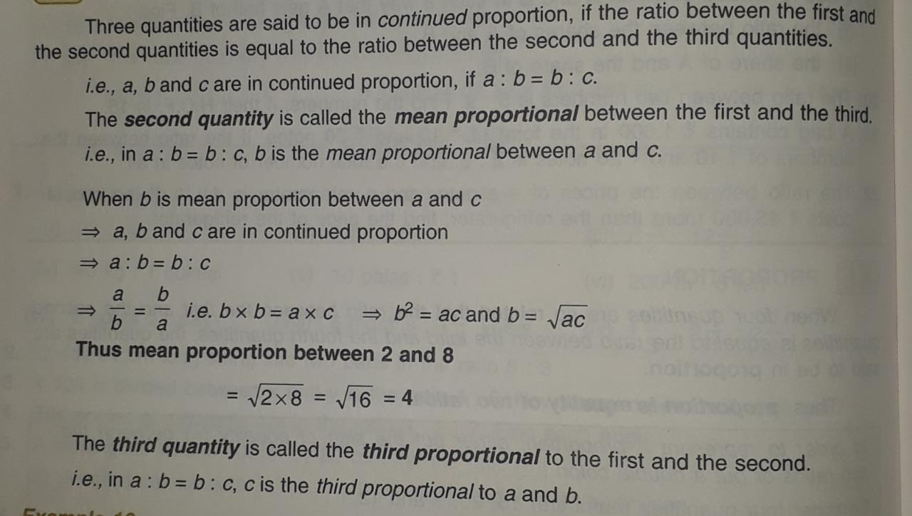
PROPORTION
CONTINUED PROPORTION

Slide 4

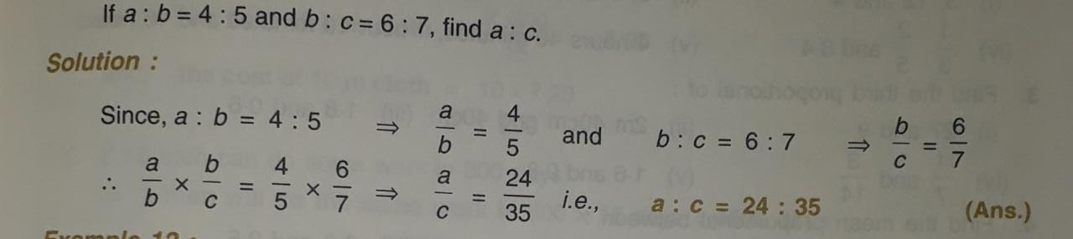

Slide 5
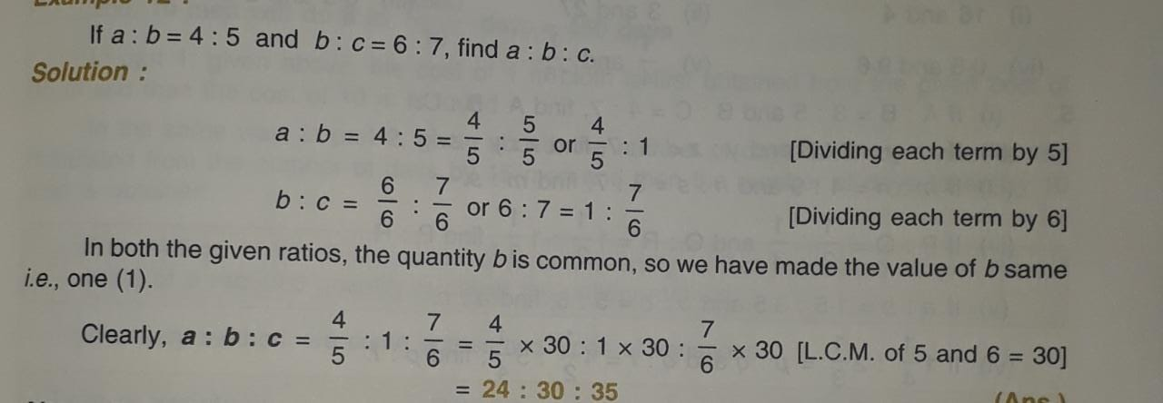

Slide 6
HOME ASSIGNMENT
EX 7Bquestion 1 to 8

Slide 7
THANKING YOU
ODM EDUCATIONAL GROUP

