Slide 1


THE EAR AND MECHANISM OF HEARING
SUBJECT : BIOLOGY
CHAPTER NUMBER: 21
CHAPTER NAME :NEURAL CONTROL AND COORDINATION

Slide 2
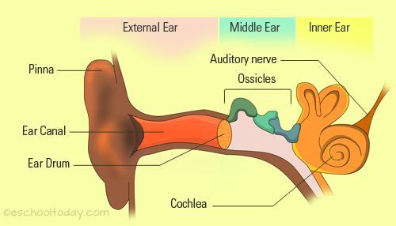
The ear
Ears are one of the five sensory organs of our body. Other than hearing, the main function is to maintain the balance of the body.
The hair cells present in the inner ear of mammals help in sensing the position of the body, in accordance with gravity and maintain the equilibrium.
The ear has three main sections: the outer ear, middle ear and inner ear.

Slide 3
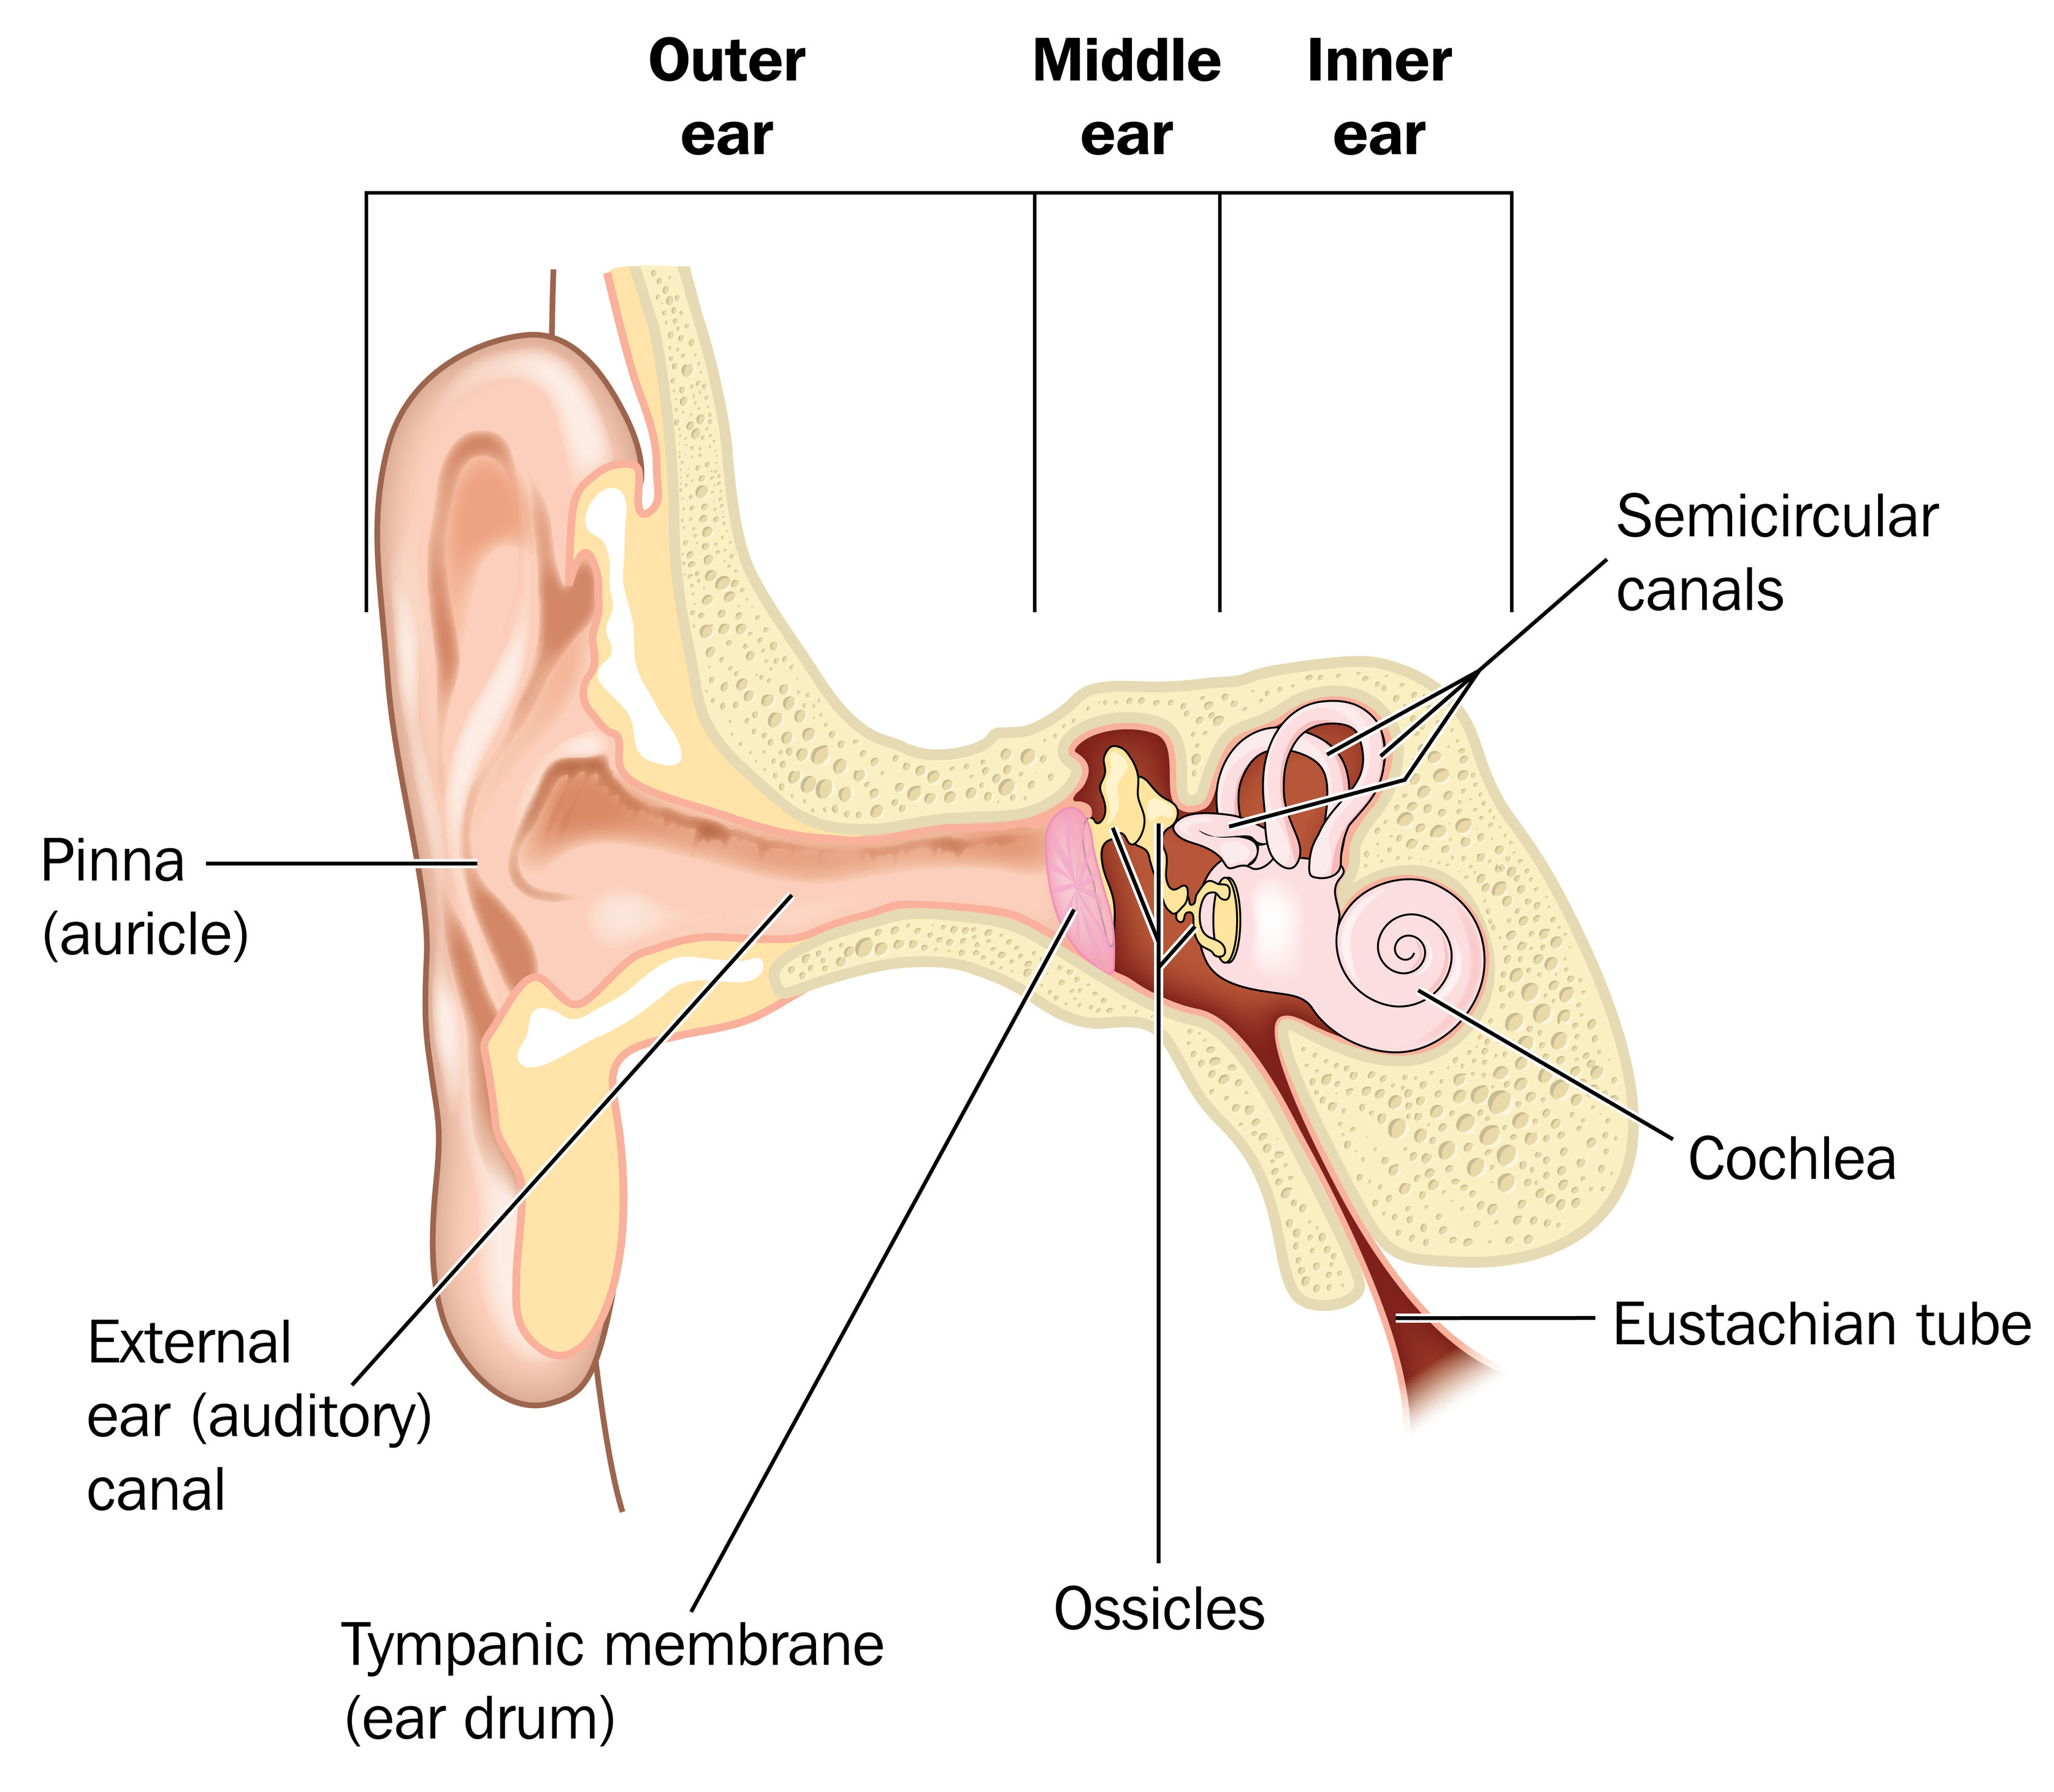
Structure of Ear
The human ear consists of three parts:
External ear
Middle ear
Internal ear
The human ear parts are explained below:
External Ear
The external ear is further divided into the following parts:
1.Auricle (Pinna)
The auricle comprises a thin plate of elastic cartilage covered by a layer of skin. It consists of funnel-like curves that collect sound waves and transmits them to the middle ear. The lobule consists of adipose and fibrous tissues supplied with blood capillaries.
2.External Auditory Meatus
It is a slightly curved canal supported by bone in its interior part and cartilage in the exterior part. The meatus or the canal is lined with stratified epithelium and wax glands.
3.Tympanic Membrane
This membrane separates the middle ear and the external ear. This part receives and amplifies the sound waves.

Slide 4
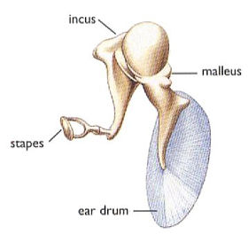
Middle Ear
The middle ear comprises the following parts:
Tympanic Cavity
It is a narrow air-filled cavity separated from the external ear by tympanic membrane and from inner ear by the bony wall. The tympanic cavity has an auditory tube known as the eustachian tube in its anterior wall.
Eustachian Tube
The eustachian tube is a 4cm long tube that equalizes air pressure on either side of the tympanic membrane. It connects the tympanic cavity with the nasopharynx.
Ear Ossicles
These are responsible for transmitting sound waves from the eardrum to the middle ear. There are three ear ossicles in the human ear:
Malleus: A hammer-shaped part that is attached to the tympanic membrane through the handle and incus through the head. It is the largest ear ossicle.
Incus: An anvil-shaped ear ossicle connected with the stapes.
Stapes: It is the smallest ossicle and also the smallest bone in the human body.

Slide 5
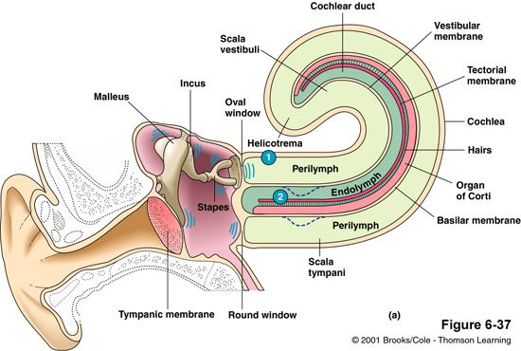
Inner Ear
The inner ear is called the labyrinth. It is composed of a group of interconnected canals and sacs
It comprises two parts:
Bony labyrinth
Membranous labyrinth
Bony Labyrinth
The bony labyrinth comprises a vestibule, three semi-circular canals, and spirally coiled cochlea. It is filled with perilymph.
Membranous labyrinth
The bony labyrinth surrounds the membranous labyrinth. It comprises sensory receptors responsible for balance and hearing. The membranous labyrinth is filled with endolymph and comprises three semi-circular ducts, cochlear duct, saccule and utricle. The sensory receptors include cristae, an organ of corti, and ampullaris maculae.

Slide 6
Cochlea (Auditory organ)
The Cochlea is a coiled portion of the membranous labyrinth, which looks like a snail.
The cochlea is made up of three canals, upper vestibular canal or scala vestibuli, middle cochlear duct or scala media and the lower tympanic canal or scala tympani, which are separated by thin membranes
The scala vestibuli is filled with the perilymph and terminates at the oval window
The scala tympani is also filled with the perilymph and ends at the opening in the middle ear, i.e. round window
The Reissner’s membrane separates scala media and scala vestibuli
The scala media is filled with endolymph and contains the auditory organ, the organ of Corti
Each organ of Corti contains ~18000 hair cells. Hair cells are present in the basilar membrane, which separates scala media from scala tympani
Stereocilia project from the hair cells and extend till the cochlear duct. There is another membrane called the tectorial membrane present above hair cells
Hair cells present in the cochlea detect pressure waves, there are sensory receptors (afferent nerves) present at the base of hair cells that send signals to the brain

Slide 7
Vestibular apparatus (Equilibrium organ)
Vestibular apparatus maintains the equilibrium and is present above the cochlea. It is present in the membranous labyrinth. It has two sac-like chambers called saccule and utricle and three semicircular canals
Saccule and utricle have macula, which is a projecting ridge
Macula has hair cells, which are sensory. Stereocilia protrude out from the hair cells
Stereocilia are covered by ampullary cupula, which is gelatinous and otoliths are embedded in it
Otoliths are calcium ear stones, which press stereocilia against the gravity and play an important role in spatial orientation
Each semicircular canal is filled with endolymph and present at the right angle to each other and connects to the utricle. The base of canals is swollen and known as the ampulla
Crista ampullaris is present in each of the ampulla and responsible for sensing angular rotation. It has hair cells
There are no otoliths present in cristae like maculae of saccule and utricle and stereocilia of hair cells are stimulated by the movement of endolymph in the canals

Slide 8
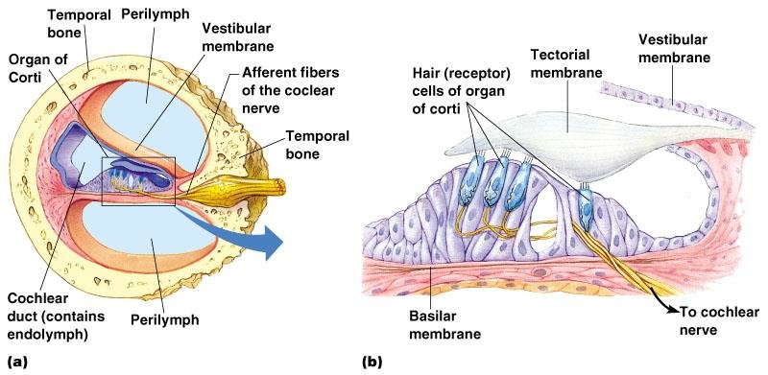
Physiology of Ear
Ears perform two main functions, hearing and equilibrium maintenance.
The organ of Corti (Cochlea) is responsible for hearing function
Maculae (Saccule and Utricle) are responsible for static equilibrium
Cristae (semicircular canals) are responsible for dynamic equilibrium

Slide 9
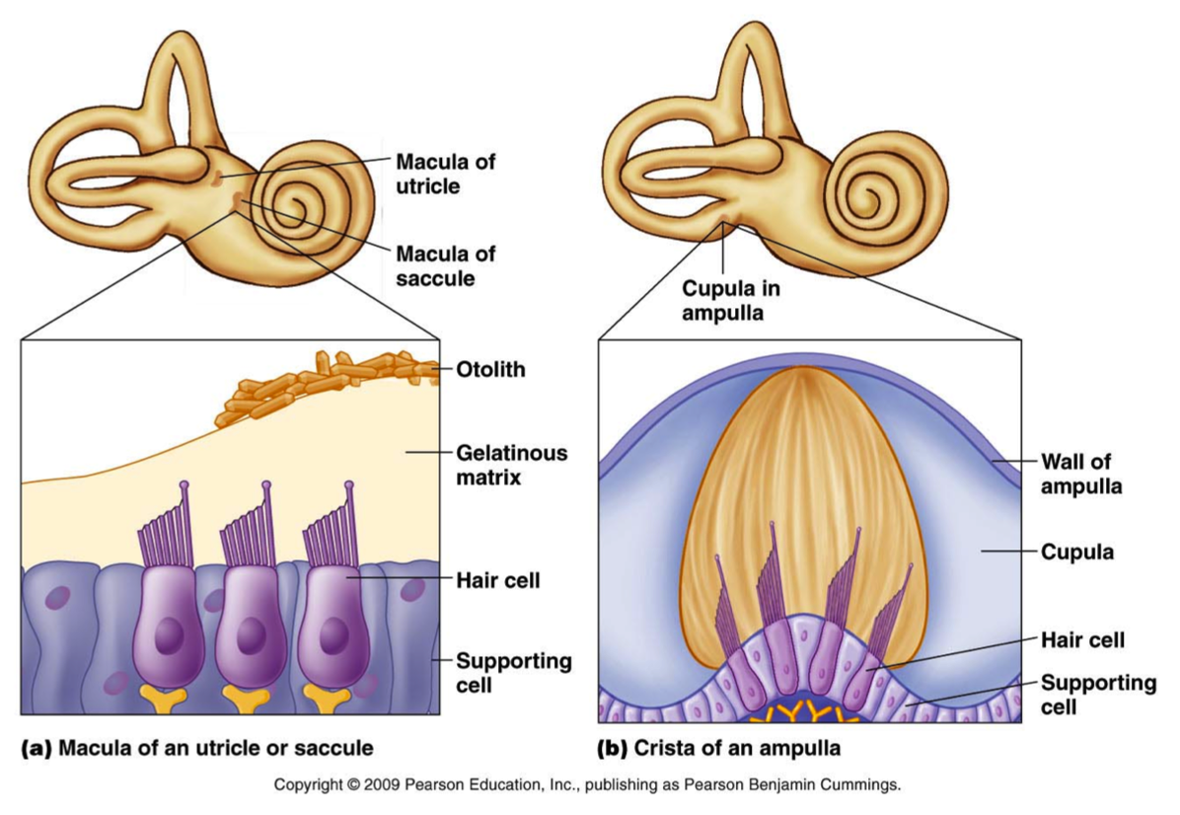

Slide 10
Mechanism of Hearing
The pinna receives the sound waves and it reaches the tympanic membrane through the meatus
The eardrum vibrates and these vibrations get transmitted to the three ossicles present in the middle ear
Malleus, incus and stapes amplify the sound waves
These vibrations then reach the perilymph (scala vestibuli) through the oval window
Then the pressure waves get transferred to the endolymph of scala media and reach basilar membrane and then to perilymph of scala tympani. This movement of fluid is facilitated by the round window present at the end of scala tympani
The basilar membrane movement causes rubbing of stereocilia against the tectorial membrane
Stereocilia are bent resulting in the opening of ion channels in the plasma membrane of hair cells. Glutamate, a neurotransmitter, is released due to Ca++ ion movement inside the cell

Slide 11
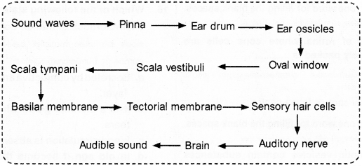
Mechanism of Hearing
These neurotransmitters bind to the receptors of afferent neurons, which synapse with hair cells causing depolarization of neurons.
A nerve impulse is generated and transmitted to the auditory cortex of the brain through auditory nerve (cranial nerve VIII)
The brain analyses the impulses and we hear the sound.
The brain not only recognises the sound but also judges the direction, loudness and pitch of the sound

Slide 12
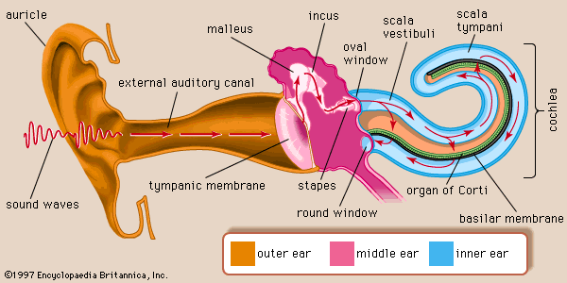
Mechanism of Hearing

Slide 13
Function of Ear
Following are the important function of the ear:
1.Hearing
The mechanism of hearing involves the following steps:
The sound waves pass through the auditory canal and reach the eardrum.
The vibrations produced pass through the tympanic membrane to the tympanic cavity.
The ear ossicles in the tympanic cavity receive the vibrations and the stapes pushes the oval window in and out.
This action is passed on to the organ of corti, the receptor of hearing, that contains tiny hair cells that translate the vibrations into an electrical impulse that are transmitted to the brain by sensory nerves.
2.Balance
The eustachian tube and the vestibular complex are the important parts of the ear responsible for the balance.
The eustachian tube equalizes the air pressure in the middle ear and maintains the balance.
The vestibular complex contains receptors that maintain body balance.

Slide 14
THANKING YOU
ODM EDUCATIONAL GROUP

