Slide 1


JOINTS & DISORDERS
SUBJECT : BIOLOGY
CHAPTER NUMBER: 20
CHAPTER NAME : LOCOMOTION AND MOVEMENT

Slide 2
Joints
Joints are points of contact between bones, or between bones and cartilages. Force generated by the muscles is used to carry out movement through joints where the joint acts as a fulcrum.
The movability at these joints vary depending on different factors.
Joints have been classified into three major structural forms, namely,
Fibrous,
Cartilaginous
Synovial.
Fibrous joints do not allow any movement. This type of joint is shown by the flat skull bones which fuse end-to-end with the help of dense fibrous connective tissues in the form of sutures, to form the cranium.
In cartilaginous joints, the bones involved are joined together with the help of cartilages. The joint between the adjacent vertebrae in the vertebral column is of this pattern and it permits limited movements

Slide 3
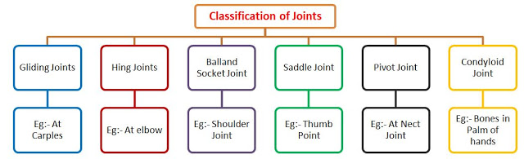
Synovial joints
Synovial joints are characterised by the presence of a fluid filled synovial cavity between the articulating surfaces of the two bones.
Such an arrangement allows considerable movement. These joints help in locomotion and many other movements. Ball and socket joint (between humerus and pectoral girdle), Hinge joint (knee joint), Pivot joint (between atlas and axis), Gliding joint (between the carpals) and Saddle joint (between carpal and metacarpal of thumb) are some examples.

Slide 4
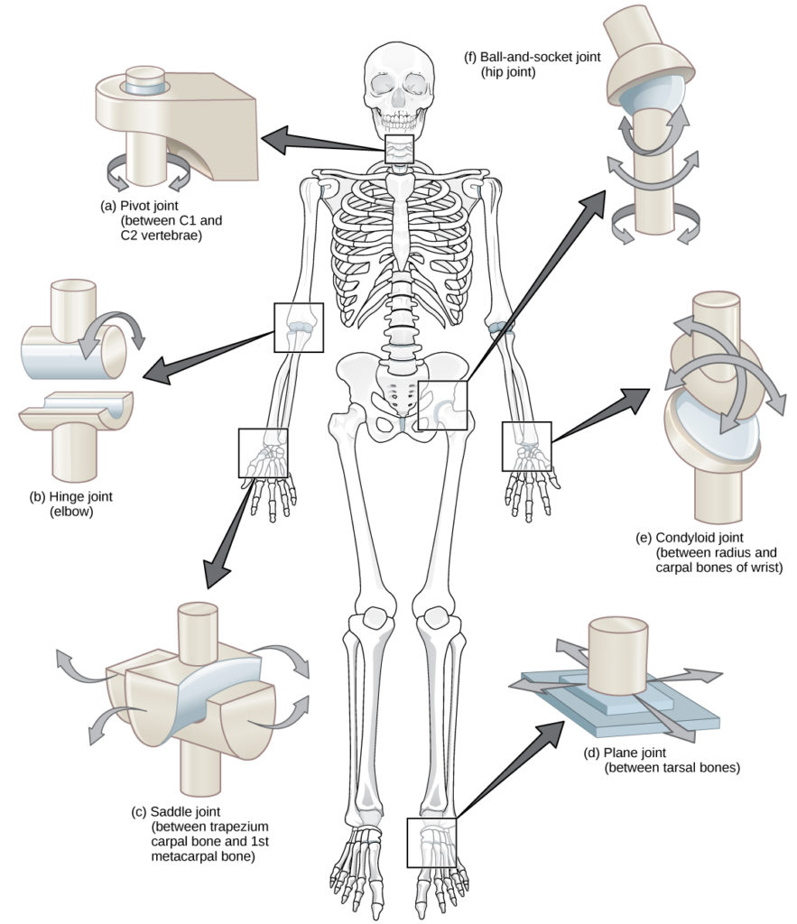
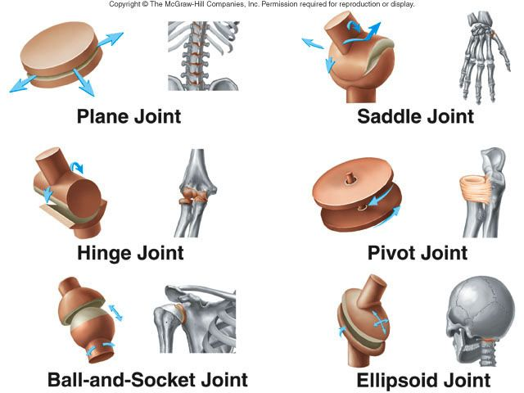
Synovial joints

Slide 5
Muscular and Skeletal Disorders
A disorder can be defined in layman terms as a deviation from an order or an abnormality.
This disorder can afflict any machine or human body.
The human body, like most machines, undergoes wear and tear over time, because of age or misuse.
This wear and tear lead to disorders.
The muscular and skeletal system is also subject to diseases and this affects the human body adversely.

Slide 6
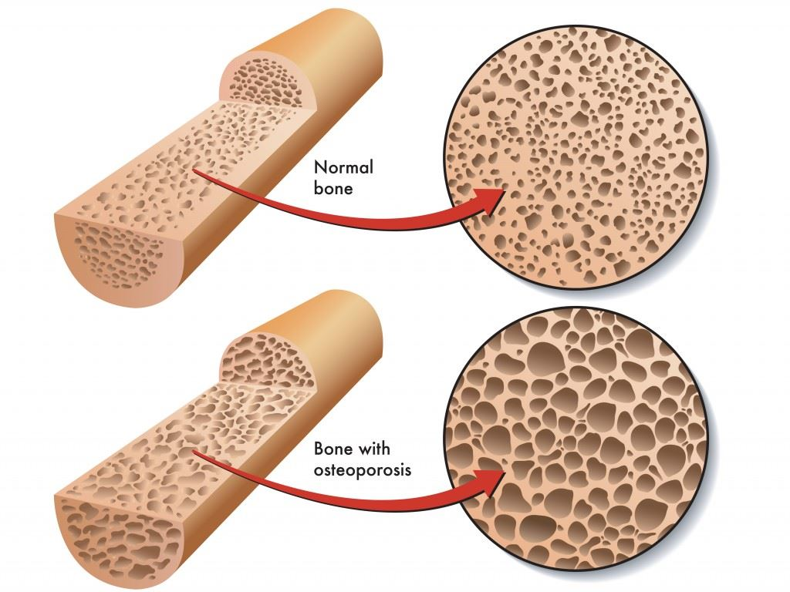
Disorders
Myasthenia gravis: It is the abnormal weakening and rapid fatigue of certain muscles. It is due to a breakdown in communication between nerves and muscles.
Muscular Dystrophy: This is mostly hereditary. It causes progressive weakness and degeneration of skeletal muscle, which controls movement.
Tetany: It is caused due to low blood calcium and is characterized by rapid or wild spasms.
Arthritis: Inflammation of one or more joints. Arthritis leads to the limited movement of joints and pain.
Osteoporosis: The chances of contracting this disease increases with age, resulting in reduced bone mass and fragile bones, thus increasing chances of fracture. Low levels of estrogen are a common cause.
Gout: This too is the inflammation of joints, but due to an accumulation of uric acid crystals.

Slide 7
THANKING YOU
ODM EDUCATIONAL GROUP

