Slide 1


REFLEX ACTION & REFLEX ARC, SENSORY RECEPTION & PROCESSING AND EYE
SUBJECT : BIOLOGY
CHAPTER NUMBER: 21
CHAPTER NAME :NEURAL CONTROL AND COORDINATION

Slide 2
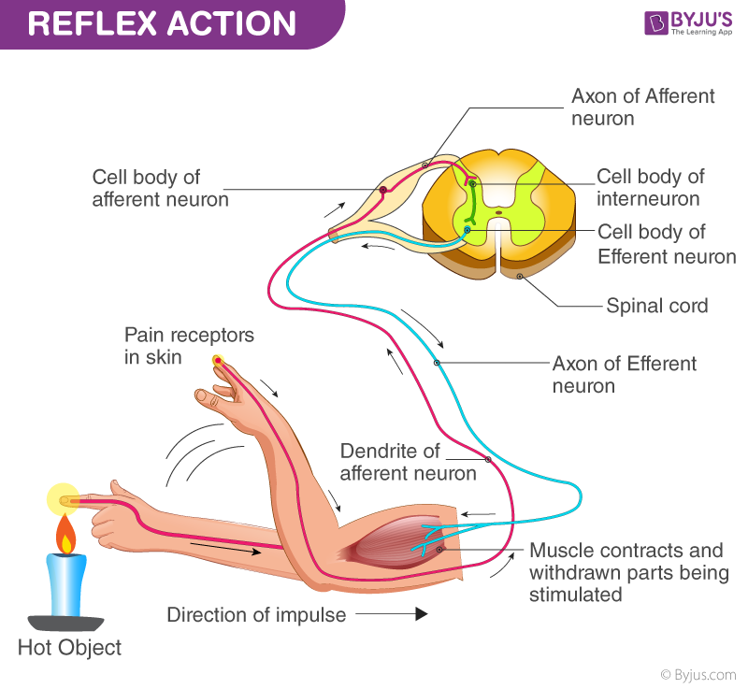
Reflex Action
What is Reflex Action?
Reflex is an involuntary and sudden response to stimuli. It happens to be an integral component of the famed survival instinct.
Most of the common reflexes are a response to all the well-trained, accumulated knowledge of caution that we have internalized. It could be anything and ranges from the reflex action of abruptly withdrawing the hand as it comes in contact with an extremely cold or hot object. This action is termed as the reflex action. It has a subtle relation to instinct.
A point to be thought upon is that we all have our instincts differently depending on our past experiences and understanding. A reflex is a reaction triggered by this instinct. At times, we have no prior knowledge if the pan is hot or not. In other words, instinct has little to do with reflex.

Slide 3
The Action of Neuron
Two neurons dominate the pathway, afferent nerves (receptor) and the efferent nerves (effector or excitor).
A brief description of the events that take place:
Firstly, it begins with receptor detecting the stimulus or a sudden change in the environment, where the instinct again has a role to play. The stimulus is received from a sensory organ.
Then, the sensory neuron sends a signal to the relay neuron.
This is followed with the relay neuron sending the signal to the motor neuron.
Further, the motor neuron sends a signal to the effector.
The effector produces an instantaneous response, for example, pulling away of the hand or a knee-jerk reaction.
From the above explanations, it can be clearly summarized that the moment the afferent neuron receives a signal from the sensory organ; it transmits the impulse via a dorsal nerve root into the Central Nervous System.
The efferent neuron then carries the signal from the CNS to the effector. The stimulus thus forms a reflex arc.
In a reflex action, the signals do not route to the brain – instead, it is directed into the synapse in the spinal cord, hence the reaction is almost instantaneous.

Slide 4
Sense organs
We sense the changes in our environment (both internal and external) with the help of special sensory receptors. These environmental changes, called stimuli, once detected by the special sensory cells, are conveyed to the brain in the form of nerve impulses.
The meaning of each stimulus is interpreted in the brain and appropriate order is sent to the body parts for its appropriate response to ensure well being.
Traditionally, there are five senses: touch, vision, hearing, smell and taste.
While touch is a complex general sense, the other four are special senses. The general sensory receptors are simple receptors that are mostly modified dendritic ends of sensory neurons.
Such receptors are present throughout the body __ in the skin, mucous membranes, connective tissues and muscles. These monitor most of the types of general sensory information such as tactile sensation (a mix of touch, pressure, stretch and vibration), heat, cold, pain and muscle sense (proception).
In contrast, special sensory receptors are distinct receptor cells that are actually confined to the head region and are highly localized within complex sensory organs like eyes and ears and tissues of the taste buds and olfactory epithelium .
These sensory organs and tissues are collection of cells of many different types (receptor and non receptor cells}, working together to accomplish a specific receptive process.

Slide 5
The chemical senses: the taste and smell
The receptors for taste and smell are classified as chemoreceptors as these respond to special chemicals in aqueous solution.
In each case, the chemicals must go into solution in the film of liquid coating the membranes of the receptor cells before these can be detected.
The taste receptors are specialized cells that detect chemicals present in quantity in the mouth itself, while smell receptors are modified sensory neurons in the nasal passage which detect the volatile chemicals that get wafted up the nostrils from distant sources.
These two types of receptors complement each other and often respond to the same stimulus. You can now guess why a very strong perfume leaves a peculiar taste in your mouth. The smell receptors can be as much as 3,400 times more sensitive than the taste receptors.
Sense of smell (olfaction): Nose contains the receptors of smell, in the mucous coated thin, yellowish patch (about 5 cm2 ) of modified pseudo stratified epithelium called olfactory epithelium. It is located way up at the roof of the nasal cavity on either sides of the nasal septum.

Slide 6
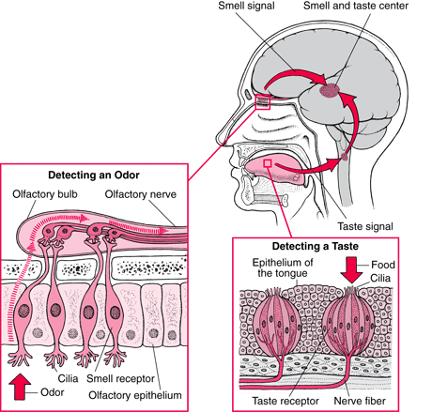
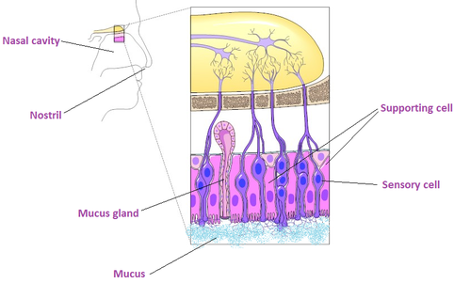
The chemical senses: the taste and smell
The nervous impulse from sense of taste and smell interprets at the same place of brain at the same time

Slide 7
Olfactory epithelium
The olfactory epithelium contains three types of cells:
(a) millions of olfactory receptor cells;
(b) columnar supportive cells;
(c) short basal cells.
Olfactory receptors are unusual bipolar sensory neurons.
The thin dendrites of each of these neurons run to the surface of the epithelium where these bear a cluster of about 20 modified cilia which function as receptor sites.
These cilia extend from the olfactory epithelium into the thin coat of nasal mucous secreted by the supportive cells and olfactory glands.
This mucous is a solvent that captures and dissolves the air borne odour molecules. Once dissolved, the chemicals bind to the specific receptors on the cilia stimulating the receptor cells. This causes depolarization and ultimately action potential in the receptor cell.
The axons of the olfactory receptors unite to form the olfactory nerve which transmits the information directly to the overlying olfactory bulb, a relay station in the brain.
Unlike receptor ends of other senses, the axons of the olfactory receptors directly extend from the outside environment (the nasal cavity) into the olfactory bulb, a part of the brain. The number of receptors stimulated indicates the strength of the stimulus.
Although humans do have a good sense of smell - we can detect about 10,000 different odours - our olfactory capability is not as good as those of many vertebrates, especially fish and mammals such as a dog

Slide 8
Sense of taste (gustation)
The sense of taste and smell work closely together. If we cannot smell some thing we cannot taste it either. When we speak of taste sensations we are often referring to the combined sensation produced by both taste and smell receptors. One reason why we cannot taste (or smell) food well with a common cold is that with the nasal passages inflamed and coated with thick mucus layer the smell receptors are practically non functional.
The receptor cells for taste are located in taste buds. Humans have about 10,000 taste buds.
The majority of taste buds are located in pockets around the papillae (peg-like projections of the mucous membrane) on the surface and sides of the tongue, but there are some on the surface of the pharynx and the larynx.
Each taste bud contains about 40 specialized receptor cells or gustatory cells, many more supporting cells and some basal cells that replace the worn out cells of the taste buds.
The receptor cells for taste are not neurons, but rather specialized cells with slender microvilli on their outer ends.

Slide 9
Sense of taste (gustation)
The microvilli protrude into the surrounding fluids through a narrow opening called the taste pore.
Dissolved chemicals contacting the microvilli bind to specific receptor proteins on the microvilli, thereby depolarizing the cell.
The dendrites of the associated sensory neurons coil intimately around the receptor cells and synapse with them so that, when a receptor cell is stimulated and depolarized, it releases neurotransmitter which leads to the generation of an action potential in the associated sensory neuron. Each dendrite receives signals from several receptor cells within the taste bud. Nerve fibers emerging from the taste buds pass to the brain stem. From here the nerve impulse is relayed to the taste centre in the cerebral cortex of the brain that perceives the taste sensation.
In humans there are four basic taste senses: sweet, sour, salt, and bitter. The receptors for these four basic tastes have their areas of greatest concentration on different parts of the tongue _ sweet and salty on the front, bitter on the back, and sour on the sides.

Slide 10
Sense of touch
Sense of touch Skin is the sensory organ for touch and is also the largest sense organ.
Our sense of touch allows us to feel light sensation like the touch of a feather as well as a heavy sensation like a stone falling on the toe. These sensations come from millions of microscopic simple sensory receptors located all over the skin and associated with the general sensations of contact or pressure, heat, cold, and pain. The receptors are located at different levels within the skin and distributed unevenly. Some parts of the body have a large number of these such as the finger tips, making them more sensitive

Slide 11
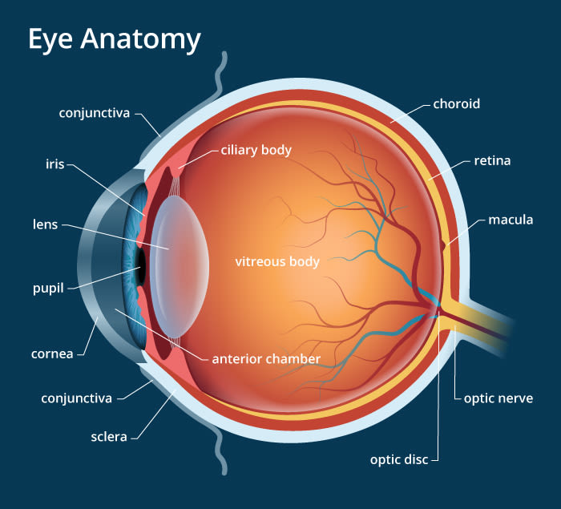
Human eye
Structure
The eyes are sensory organs of sight which are sensitive to light. The wall of eyeball is made up of three layers: sclera (outer layer), choroid (middle layer) and retina (innermost layer, it has many photoreceptors called cones and rods that are sensitive to light.
The External Structure of an Eye
The parts of the eye that are visible externally include the following:-
Sclera: It is a white visible portion. It is made up of dense connective tissue and protects the inner parts.
Conjunctiva: It lines the sclera and made up of stratified squamous epithelium. It keeps our eyes moist and clear and provides lubrication by secreting mucus and tears.
Cornea: It is the transparent, anterior or front part of our eye, which covers the pupil and the iris. The main function is to refract the light along with the lens.
Iris: It is the pigmented, coloured portion of the eye, visible externally. The main function of the iris is to control the diameter of the pupil according to the light source.
Pupil: It is the small aperture located in the centre of the Iris. It allows light to enter and focus on the retina.

Slide 12
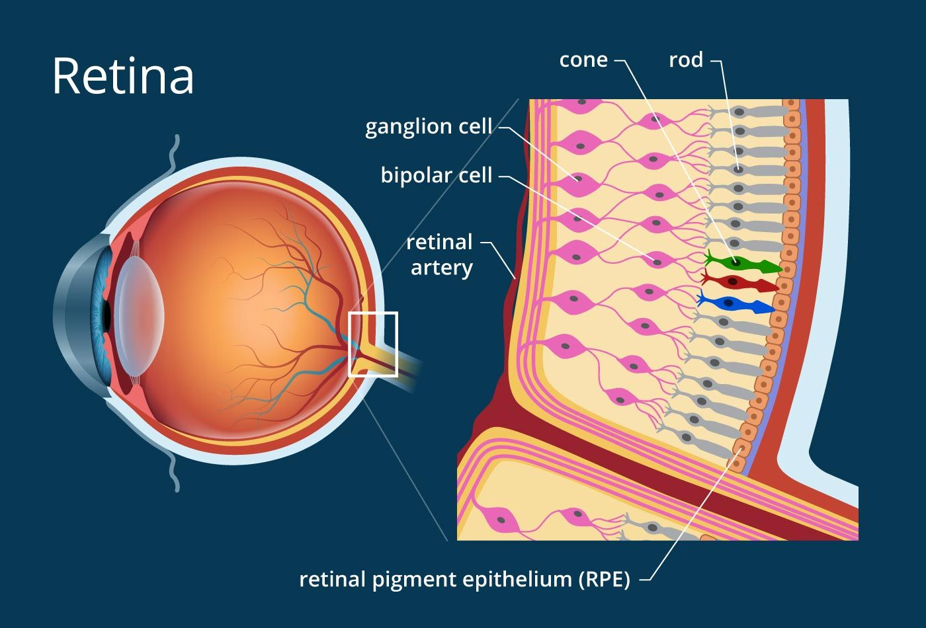
The Internal Structure of an Eye
The internal components of an eye are:
Lens: It is a transparent, biconvex, lens of an eye. The lens is attached to the ciliary body by ligaments. The lens along with cornea refracts light so that it focuses on the retina.
Retina:
It is the innermost layer of the eye. It is light sensitive and acts as a film of a camera. Three layers of neural cells are present in them, they are ganglion, bipolar and photoreceptor cells.
It converts the image into electrical nerve impulses for the visual perception by the brain.
The two types of photoreceptor cells, namely, rods and cones.
These cells contain the light-sensitive proteins called the photopigments.
The daylight (photopic) vision and colour vision are functions of cones and the twilight (scotopic) vision is the function of the rods. The rods contain a purplish-red protein called the rhodopsin or visual purple, which contains a derivative of Vitamin A.

Slide 13
The Internal Structure of an Eye
In the human eye, there are three types of cones which possess their own characteristic photopigments that respond to red, green and blue lights.
The sensations of different colours are produced by various combinations of these cones and their photopigments.
When these cones are stimulated equally, a sensation of white light is produced
Optic nerve:
It is located at the posterior portion of the eyes. The optic nerves carry all the nerve impulses from the retina to the human brain for perception.
At the posterior pole of the eye lateral to the blind spot, there is a yellowish pigmented spot called macula lutea with a central pit called the fovea. The fovea is a thinned-out portion of the retina where only the cones are densely packed. It is the point where the visual acuity (resolution) is the greatest.
Aqueous Humour: It is a watery fluid present between the cornea and the lens. It nourishes the eye and keeps it inflated.
Vitreous Humour: it is a transparent, jelly-like substance present between the lens and the retina. It contains water (99%), collage, proteins, etc. The main function of vitreous humour is to protect eyes and maintain its spherical shape.

Slide 14
The mechanism of vision in human eye.
The light rays emitted by various objects are captured by eyes and then send inwards.
The light rays entering the eyes are either parallel or diverging when they strike the eye.
In both the cases, the light rays need to be bend or refracted to focus on the retina. The work of refracting the light rays is done by curved corena.
The work of refracting the light rays is done by curved cornea, refracting eye lens and the humors present in the eye.
The light rays are visible wavelength are focussed on the retina through the cornea & the lens.
This generates the potentials (impulses) in the rods and the cones present in the retina.
The photosensitive compounds (photopigments) in rods in the human eyes are composed of opsin and retinal.
Similarly, the cone pigments in human eyes are composed of retinal and three different types of proteins (opsins) to which retinals are attached.
However, when light falls on rods and cones, it causes dissociation of retinal from opsin. This results in changes in the structure of the opsin.
This change in the structure of the opsin, causes membrane permeability changes.

Slide 15
The mechanism of vision in human eye
As a result, potential differences are generated in the photoreceptor cells, i.e., rods and cones.
As the photoreceptor cells synapse with the bipolar cells, a signal generates the action potential in bipolar cells also.
Now bipolar cells synapse with the ganglion cells, so action potentials are generated in the ganglion cells through the bipolar cells.
So finally the action potential (impulses) generated in the ganglion cells are transmitted through their axons, i.e., optic nerve to the visual contex area of the brain.
After reaching the visual cortex area, the neural impulses are analyzed the image formed on the retina is recognized. This recognition is based on earlier memory and the experience stored in the brain.

Slide 16
THANKING YOU
ODM EDUCATIONAL GROUP

