Slide 1


SKELETAL SYSTEM
SUBJECT : BIOLOGY
CHAPTER NUMBER: 20
CHAPTER NAME : LOCOMOTION AND MOVEMENT

Slide 2
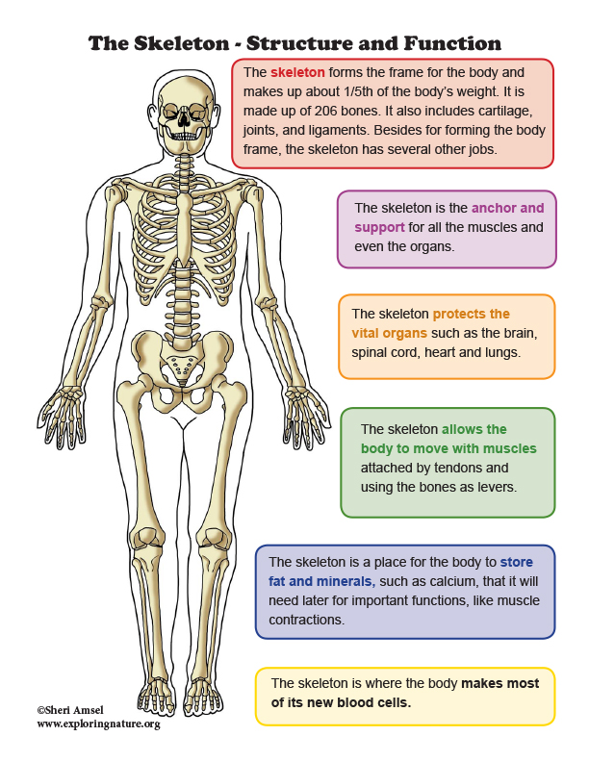
Skeletal system
Skeletal system consists of a framework of bone and a few cartilages.
Bone and cartilage are specialised connective tissues.
The former has a very hard matrix due the calcium salts in it and the latter has slightly pliable matrix due to chondroitin salts.
In human being: this system is made up of 206 bones and a few cartilages.
It is grouped into two principal division the axial and the appendicular skeleton.

Slide 3
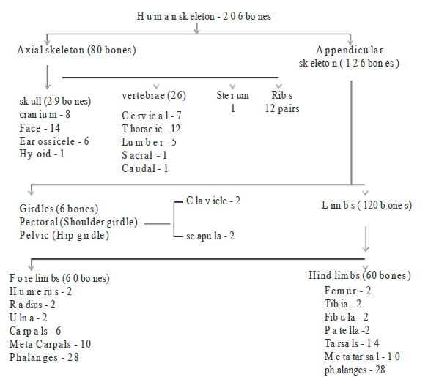

Slide 4
Axial skeletal system
In human being it is consisted of 80 bones distributed along the main axis of the body.
The skull, vertebral column, sternum and ribs constitute axial skeleton.
Skull Bone – It includes 8 cranial bones, 14 facial bones, 6 auditory ossicles, and the Hyoid Bone
The bone of the Thoracic Cage – It includes 25 bones of the thorax- a breastbone and 24 ribs.
The bone of the Vertebral column- It includes 24 vertebrae bones, the sacrum bone, and the coccyx bone.

Slide 5
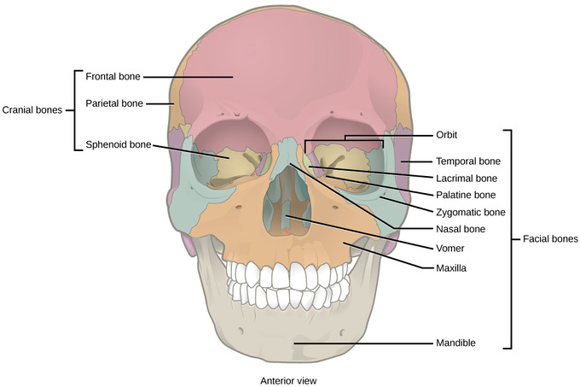
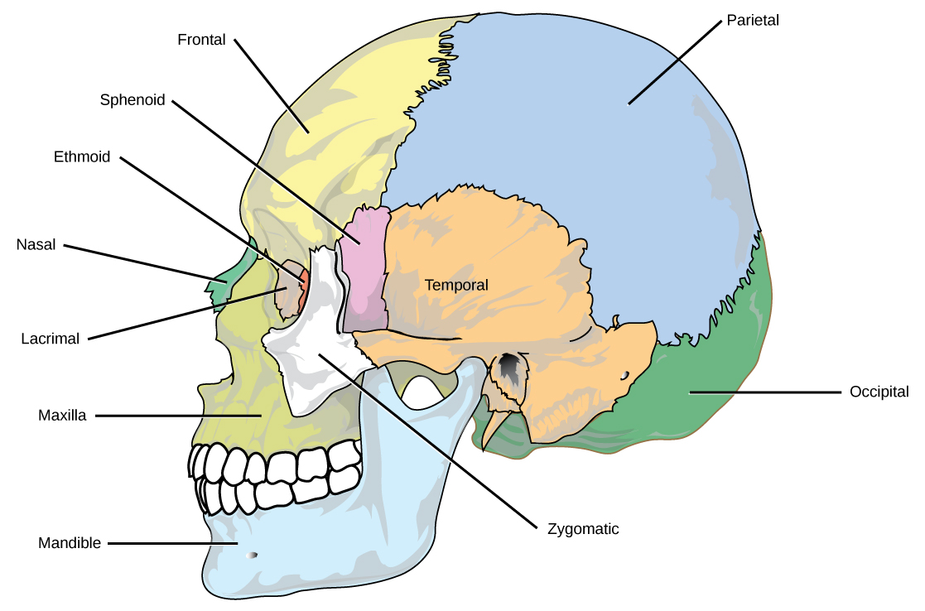
The Skull
The Skull
It is consisted of two sets of bones – cranial and facial bones.
Cranial bones are 8 in number. These bones are- Frontal bone (1), Parietal (2), Temporal (2), Occipital (1), Sphenoid (1), Ethmoid (1)
The facial bones :The facial region is made up of 14 skeletal elements which form the front part of the skull. These bones are- Interconchal (2), Lacrimal (2), Nasal (2), Vomer (1), Zygomatic (2), Palatine (2), Maxillary (2), Mandibular (1).
Despite of these bones there is a “U” shaped bone known as Hyoid bone. It supports the tongue
Each of middle ears also contains 3 bones the Malleus, Incus and Stapes. These bones are said as ear ossicles. Thus in two ears total 6 bones are found.

Slide 6
Vertebral Column
It is our backbone which extends in the mid axis of the back (posterior) part of our trunk from head to the lower (inferior) extremity of trunk.
Together with the sternum and rib, it forms the supporting frame work of our trunk.
It support and rotate the head, suspends the viscera, protect vital organs, provides attachment to limb girdles, facilitates some movement of the trunk and houses the spinal cord.
Vertebral column make two-fifth of total weight of body.
The length of human vertebral column is 71 cm. (28 Inc.) in adult male and about. 61 cm (24 m) in an average adult female.
Our vertebral column is formed by 26 'serially arranged units called vertebrae and is dorsally placed.
It extends from the base of the skull and constitutes the main framework of the trunk.
Each vertebra has a central hollow portion (neural canal) through which the spinal cord passes.
First vertebra is the atlas and it articulates with the occipital condyles.
The vertebral column is differentiated into cervical (7), thoracic (12), lumbar (5); sacral (1- fused) and coccygeal (1-fused) regions starting from the skull.
The number of cervical vertebrae are seven in almost all mammals including human beings.
The vertebral column protects the spinal cord, supports the head and serves as the point of attachment for the ribs and musculature of the back.

Slide 7
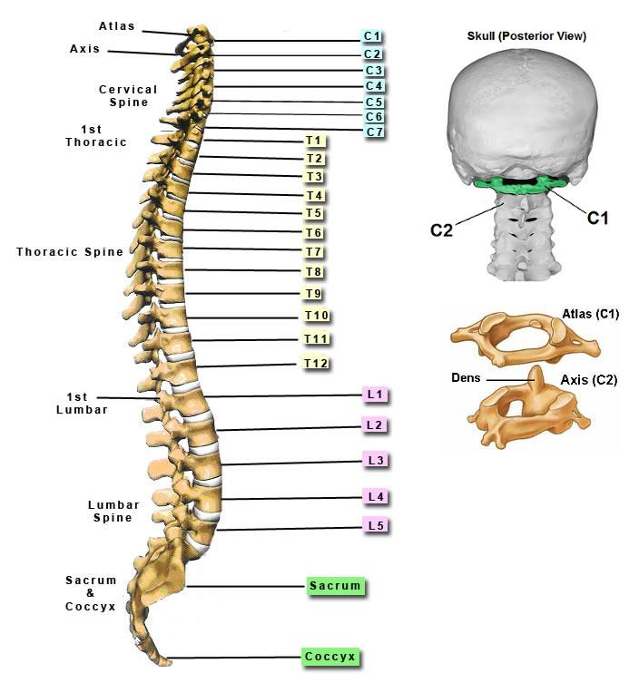
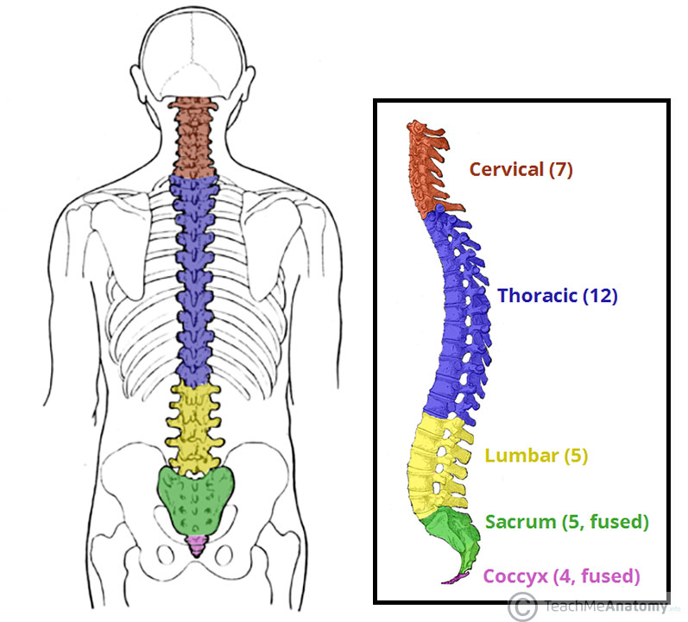

Slide 8
Ribs and Sternum
The ribs' are curved bars, which movably articulate with the thoracic vertebrae at the back and while with the sternum in front. All collectively forming a bony cage, the thoracic basket.
There are 12 pairs of ribs.
Each rib is a thin flat bone connected dorsally to the vertebral column and ventrally to the sternum.
Sternum (breast bone) is a long flat bone lying in the middle of the front part of the chest.
It has two articulation surfaces on its dorsal end and is hence called bicephalic.
First seven pairs of ribs are called true ribs.
Dorsally, they are attached to the thoracic vertebrae and ventrally connected to the sternum with the help of hyaline cartilage.
The 8th, 9th and 10th- pairs of ribs do not articulate directly with the sternum but join the seventh rib with the help of hyaline cartilage. These are called vertebrochondral (false) ribs.
Last 2 pairs (11th and 12th) of ribs are not connected ventrally and are therefore, called floating ribs. Thoracic vertebrae, ribs and sternum together form the rib cage.
The ribs serve three important functions
a) They protect the heart, large blood vessels and lungs.
b) They bear respiratory muscle (external and internal intercostal muscle).
c) Lower two pair of ribs protect the kidney. (11th and 12th)

Slide 9
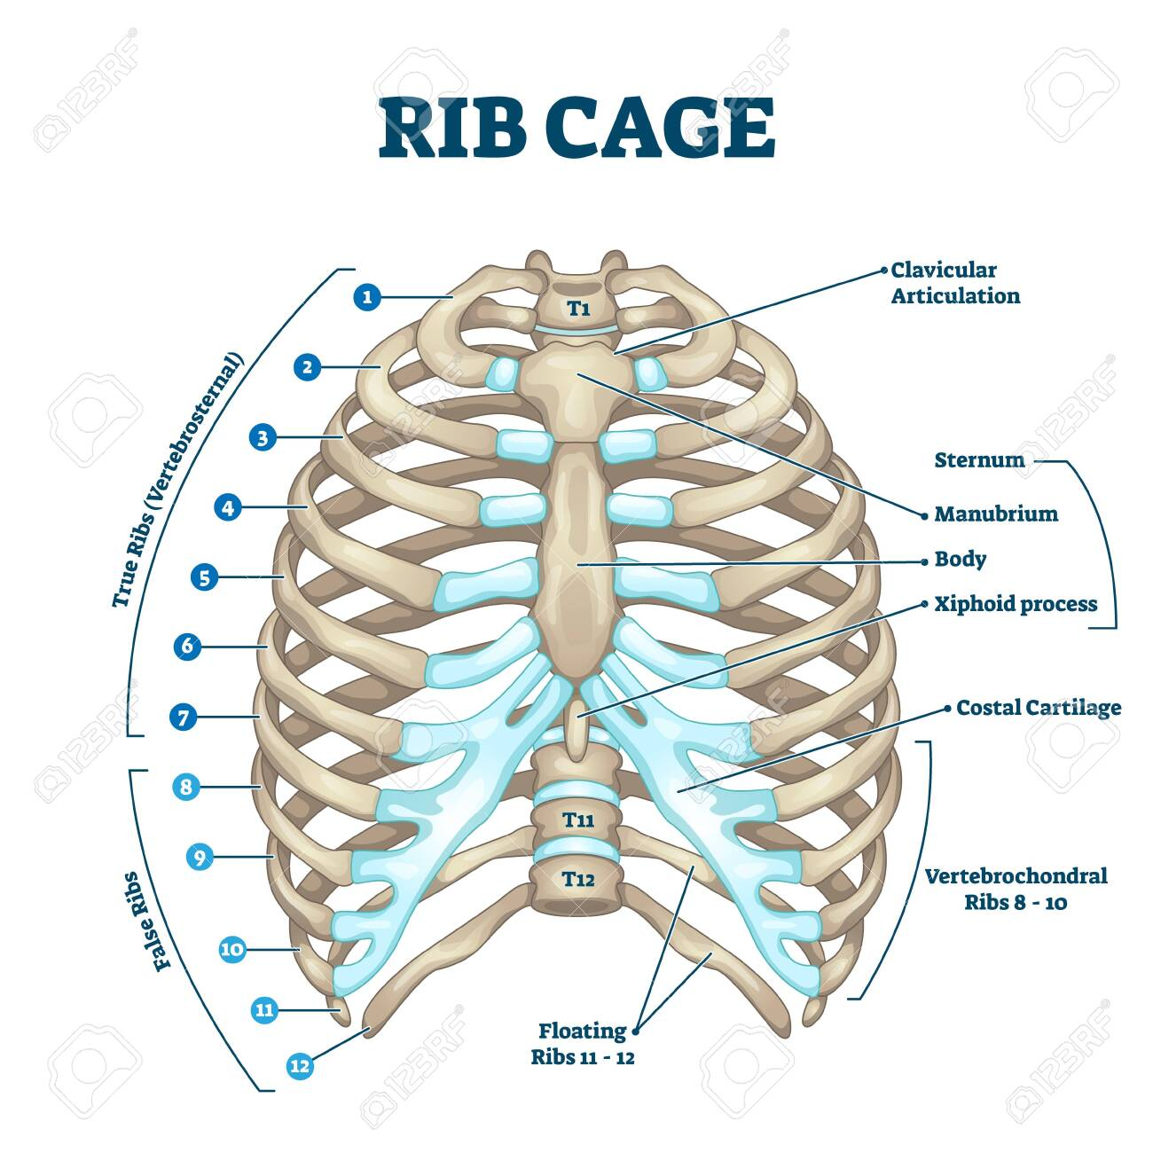

Slide 10
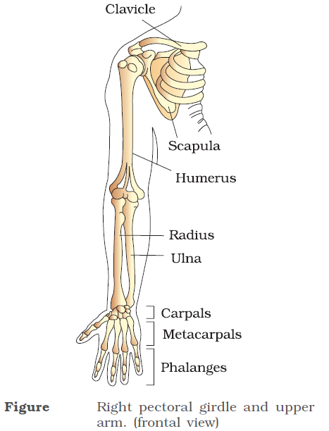
Appendicular skeleton
In human being the limbs and associated structures form appendicular structure.
There are total 126 bones in appendicular skeleton.
This skeletal system is consisted of Pectoral girdle, Pelvic girdle, Fore limb or arm and Hind limb or legs.
The pectoral girdle is consisted of 4 bones, pelvic girdle is consisted of 2 bones and each of limbs is consisted of 30 bones.
Forelimb-
The bones of hand or fore limb are humerus, radius and ulna, carpals or wrist bones (8 , metacarpals (5) and phalanges (14 in number) .
Humerus – Humerus runs from the shoulder socket and joins the radius and ulna at the elbow.
Radius – Radius is a forearm which runs from the elbow to the thumb side of the wrist.
Ulna – Ulna, a forearm which runs from the elbow to the ‘pinky’ side of the elbow.
Carpals – Carpals are a set of 8 irregularly shaped bones located in the wrist area.
Metacarpals – Metacarpals are bones which are related to each digit, there are 5 metacarpal bones.
Phalanges – Phalanges are the bones of the fingers. There are 3 phalanges in each finger, except, for the thumb which has two phalanges only.

Slide 11
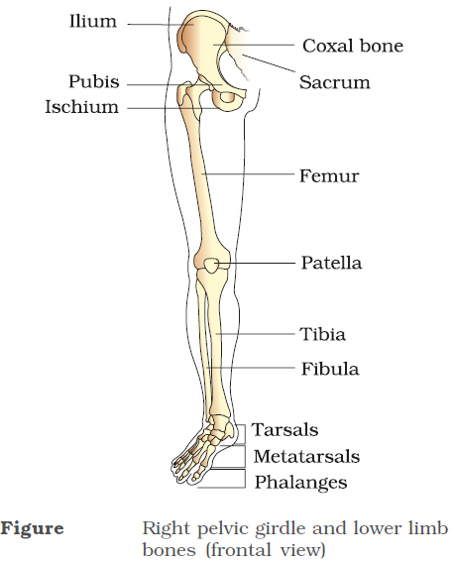
Hind limb
The bones of the legs and thighs are part of the appendicular skeletal system which supports the muscles of the lower limbs. These muscles help in walking, running, standing and jumping. These bones should be strong enough in order to support the body’s weight.
Hindlimb- The bones of leg are Femur , tibia and fibula, tarsals (7), metatarsals (5) and phalanges (14) A cup shaped bone called patella cover the knee ventrally.
The Femur or thigh bone is the largest and heaviest bone in the human body.
The Tibia and Fibula are the two long bones in the lower leg. They are two separate bones but are closely linked at the knee and the ankle.
The top of Tibia connects to the knee joint and bottom connects to the ankle joint. Although Tibia carries all the body weight, it needs the support of Fibula.
The foot is a firm platform which supports the weight of the body. It is formed of many bones such as the tarsals, metatarsals and phalanges.
Tarsals : A set of 8 irregular bones situated proximally in the foot in the ankle area.
Metatarsals: A set of 5 bones each one for a digit. These bones connect tarsals with the phalanges.
Phalanges: Each toe has 3 phalanges namely the proximal, intermediate and distal.

Slide 12
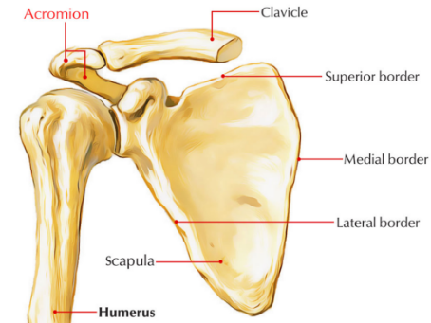
Pectoral girdle
Pectoral girdle-
It’s bones help in the articulation of the upper limbs with the axial skeleton.
Each of pectoral girdle is formed of two halves.
Each half of pectoral girdle consists of a clavicle and a scapula.
Pectoral girdle

Slide 13
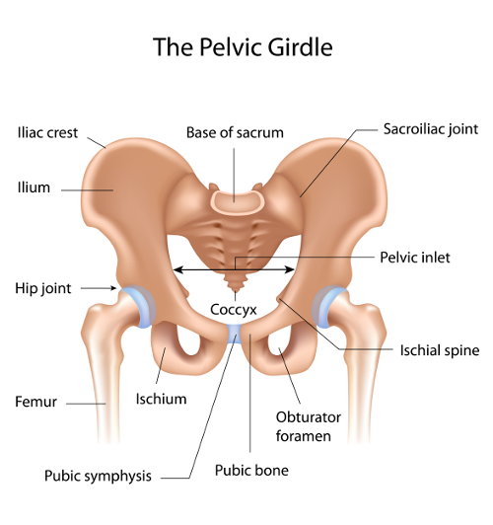
Pelvic girdle
Pelvic girdle- It consists of two coxal bones. Each coxal bone is formed by the fusion of three bones – ilium , ischium and pubis. At the point of fusion of the above bones is a cavity called acetabulum to which the thigh bone articulates. The two halves of the pelvic girdle meet ventrally to form the pubic symphysis containing fibrous cartilage.
Functions of Pelvic Girdle
It transfers the weight of the body from the axial skeleton to the appendicular components, especially during the movement.
Provides attachment from a number of muscles and ligaments enabling movement.

Slide 14
THANKING YOU
ODM EDUCATIONAL GROUP

