Slide 1


CNS,HUMAN BRAIN-FORE BRAIN, MID BRAIN, HIND BRAIN
SUBJECT : BIOLOGY
CHAPTER NUMBER: 21
CHAPTER NAME :NEURAL CONTROL AND COORDINATION

Slide 2
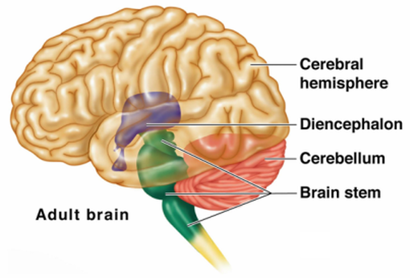
Introduction-The Human Brain
The brain is the central information processing organ of our body, and acts as the ‘command and control system’.
It controls the voluntary movements, balance of the body, functioning of vital involuntary organs (e.g., lungs, heart, kidneys, etc.), thermoregulation, hunger and thirst, circadian (24-hour) rhythms of our body, activities of several endocrine glands and human behaviour.
It is also the site for processing of vision, hearing, speech, memory, intelligence, emotions and thoughts.
On average, an adult brain weighs between 1.0 kg – 1.5 kg. It is mainly composed of neurons – the fundamental unit of the brain and nervous system.
Recent estimates have suggested that the brain contains anywhere between 86 billion to 100 billion neurons.
The brain, along with the spinal cord, constitutes the central nervous system. It is responsible for thoughts, interpretation and origin of control for body movements.

Slide 3
Where is the Brain located?
The brain is enclosed within the skull, which provides frontal, lateral and dorsal protection.
The skull consists of 22 bones, 14 of which form the facial bones and the remaining 8 forms the cranial bones. Anatomically, the brain is contained within the cranium and is surrounded by the cerebrospinal fluid.
The Cerebrospinal Fluid (CSF) is a fluid that circulates within the skull and spinal cord, filling up hollow spaces on the surface of the brain.
Every day, the specialised ependymal cells produce around 500mL of cerebrospinal fluid.
The primary function of the CSF is to act as a buffer for the brain, cushioning mechanical shocks and dampening minor jolts.
It also provides basic immunological protection to the brain.
Furthermore, CSF provides buoyancy for the brain. i.e., the brain is suspended in a layer of CSF, wherein, the weight of the brain is nearly negated.
If the brain is not suspended in CSF, it would be impeded by its weight, consequently cutting off the blood supply in the lower half of the brain. It would lead to the death of neurons in the affected area.

Slide 4
Parts of Human Brain
Following are the major parts of the human brain:
1.Forebrain – Largest part of the brain
It is the anterior part of the brain. The forebrain parts include:
Cerebrum
Hypothalamus
Thalamus
Forebrain Function: Controls the reproductive functions, body temperature, emotions, hunger and sleep.
Fact: The largest among the forebrain parts is the cerebrum. It is also the largest part of all vertebrate brains.
2.Midbrain: Smallest and central part of the brain.
3.Hindbrain: The lower part of the brain
The hindbrain is composed of:
Cerebellum
Medulla
Pons
Hindbrain functions: The three regions of the hindbrain coordinates all processes necessary for survival. These induce breathing, heartbeat, sleep, wakefulness and motor learning.

Slide 5
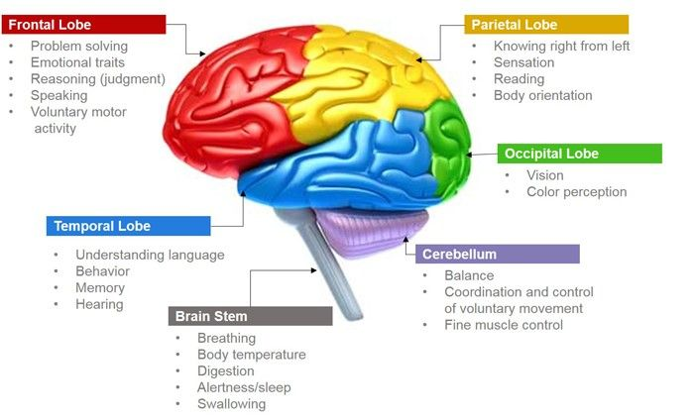
Parts of Human Brain

Slide 6
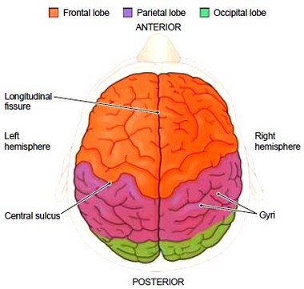
Cerebrum
The cerebrum is the largest part of the brain. It consists of the cerebral cortex and other subcortical structures. It is composed of two cerebral hemispheres that are joined together by heavy, dense bands of fibre called the corpus callosum. The cerebrum is further divided into four sections or lobes:
Frontal lobe: It is associated with parts of speech, planning, reasoning, problem-solving and movements.
Parietal lobe: Help in movements, the perception of stimuli and orientation.
Occipital lobe: It is related to visual processing.
Temporal lobe: This region is related to perception and recognition of memory, auditory stimuli, and speech.
The brain consists of two types of tissues: Grey matter and White matter.
Grey matter mainly consists of various types of cells, which make up the bulk of the brain.
White matter is primarily composed of axons, which connect various grey matter areas of the brain with each other.
The exterior portion of the cerebrum is called the cortex or the cerebral mantle. The cortex is extremely convoluted, due to which, it has a large surface area.

Slide 7
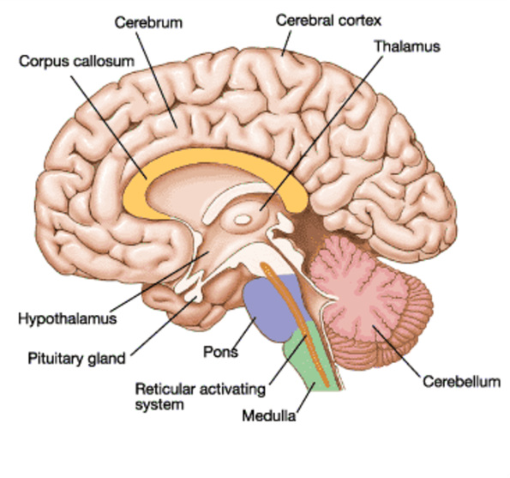
Contd ..
The cerebrum also includes:
Sensory areas: To receive the messages.
Association areas: These areas integrate the incoming sensory information. It also forms a connection between sensory and motor areas.
Motor areas: This area is responsible for the action of the voluntary muscles.
Cerebrum Function
The cerebrum is responsible for thinking, intelligence, consciousness and memory. It is also responsible for interpreting touch, hearing and vision.
Thalamus
The thalamus is a small structure, located right above the brain stem responsible for relaying sensory information from the sense organs. It is also responsible for transmitting motor information for movement and coordination. Thalamus is found in the limbic system within the cerebrum. This limbic system is mainly responsible for the formation of new memories and storing past experiences.

Slide 8
Hypothalamus
The hypothalamus is a small and essential part of the brain, located precisely below the thalamus. It is considered the primary region of the brain, as it is involved in the following functions:
Receives impulses
Regulates body temperature
Controls the mood and emotions
Controls the sense of taste and smell
Synthesises the body’s essential hormones
Coordinates the messages from the autonomous nervous system
Controls appetite, peristalsis, the rate of heartbeat, and blood pressure
Forms an axis with the pituitary gland which is the main link between the nervous and the endocrine systems

Slide 9
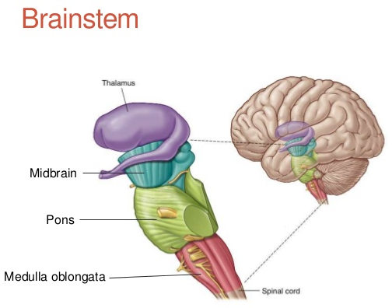
Midbrain
The midbrain is located between the thalamus/hypothalamus of the forebrain and pons of the hindbrain.
A canal called the cerebral aqueduct passess through the midbrain.
The dorsal portion of the midbrain consists mainly of four round swellings (lobes) called corpora quadrigemina.
Midbrain and hindbrain form the brain stem

Slide 10
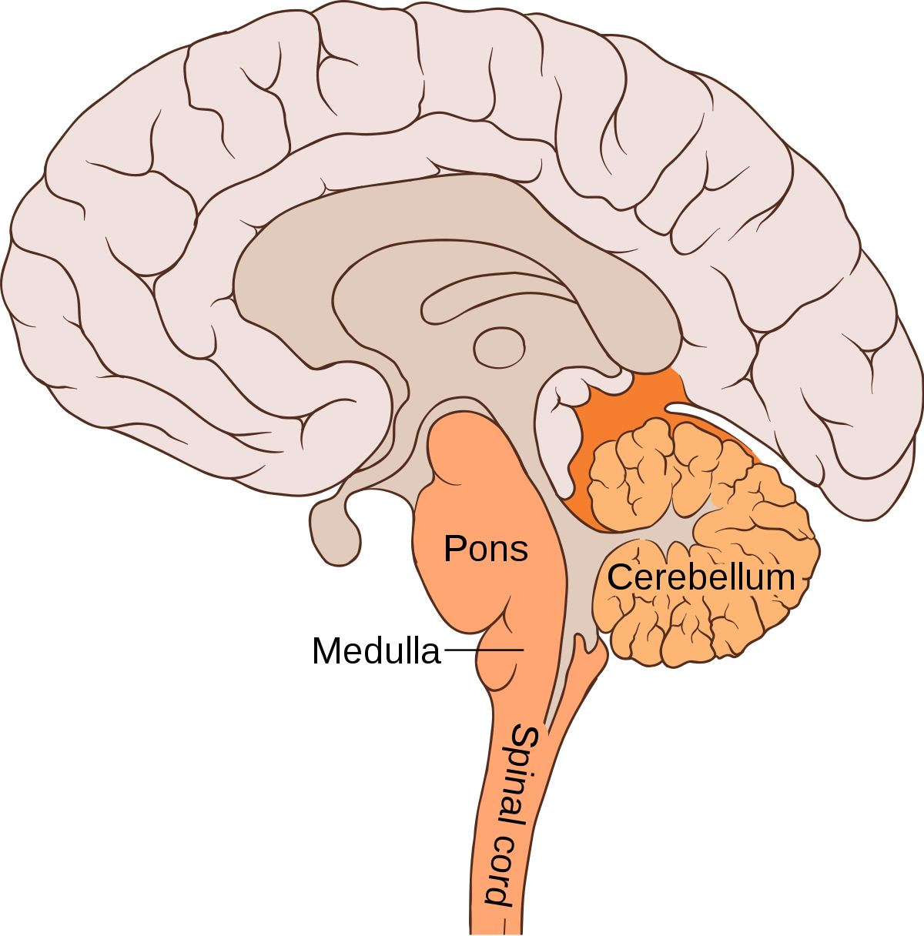
Hindbrain
Hindbrain, also called rhombencephalon, region of the developing vertebrate brain that is composed of the medulla oblongata, the pons, and the cerebellum.
The hindbrain coordinates functions that are fundamental to survival, including respiratory rhythm, motor activity, sleep, and wakefulness.
It is one of the three major developmental divisions of the brain

Slide 11
Cerebellum
The cerebellum is the second largest part of the brain, located in the posterior portion of the medulla and pons.
The cerebellum and cerebrum are separated by cerebellar tentorium and transverse fissure.
Cortex is the outer surface of the cerebellum, and its parallel ridges are called the folia.
Apart from this, the cerebellum has the cerebellar peduncles, cerebellar nuclei, anterior and posterior lobes.
The cerebellum consists of two hemispheres, the outer grey cortex and the inner white medulla.
It is mainly responsible for coordinating and maintaining the body balance during walking, running, riding, swimming, and precision control of the voluntary movements.
The main functions of the cerebellum include:
It senses equilibrium.
Transfers information.
Coordinates eye movement.
It enables precision control of the voluntary body movements.
Predicts the future position of the body during a particular movement.
Both anterior and posterior lobes are concerned with the skeletal movements.
The cerebellum is also essential for making fine adjustments to motor actions.
Coordinates and maintains body balance and posture during walking, running, riding, swimming.

Slide 12
The medulla oblongata and the pons
Medulla Oblongata
The medulla oblongata is a small structure present in the lowest region of the brain.
It mainly controls the body’s autonomic functions such as heartbeat, breathing, and digestion.
It plays a primary role in connecting the spinal cord, pons and the cerebral cortex.
Also, it helps us in maintaining our posture and controlling our reflexes.
Pons
The pons is the primary structure of the brain stem present between the midbrain and medulla oblongata.
It serves as a relay signals between the lower cerebellum, spinal cord, the midbrain, cerebrum and other higher parts of the brain.
The main functions of the pons include:
Controlling sleep cycles.
Regulating the magnitude and frequency of the respiration.
Transfers information between the cerebellum and motor cortex.
Pons is also involved in sensations, such as the sense of taste, hearing, and balance.

Slide 13
THANKING YOU
ODM EDUCATIONAL GROUP

